Slide 1
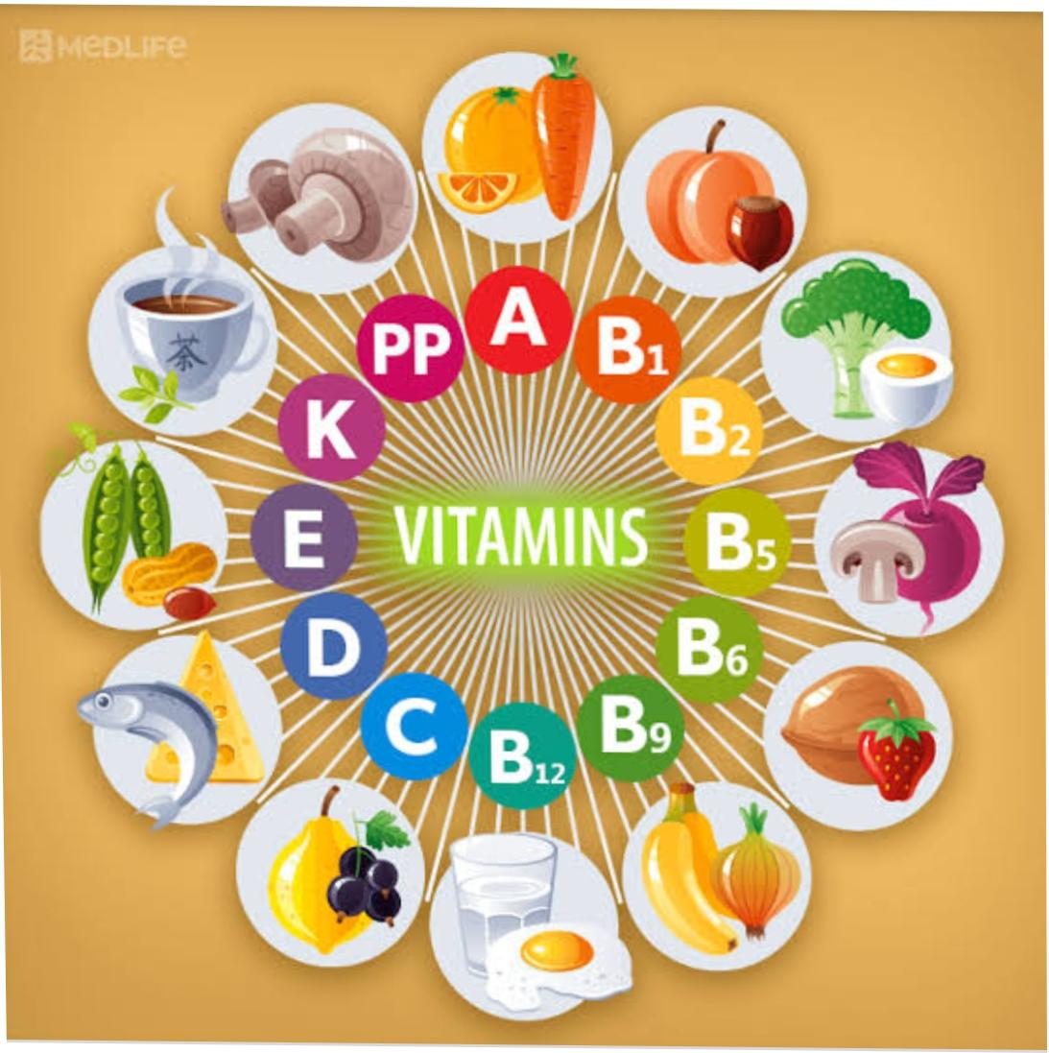
VITAMINS

Slide 2
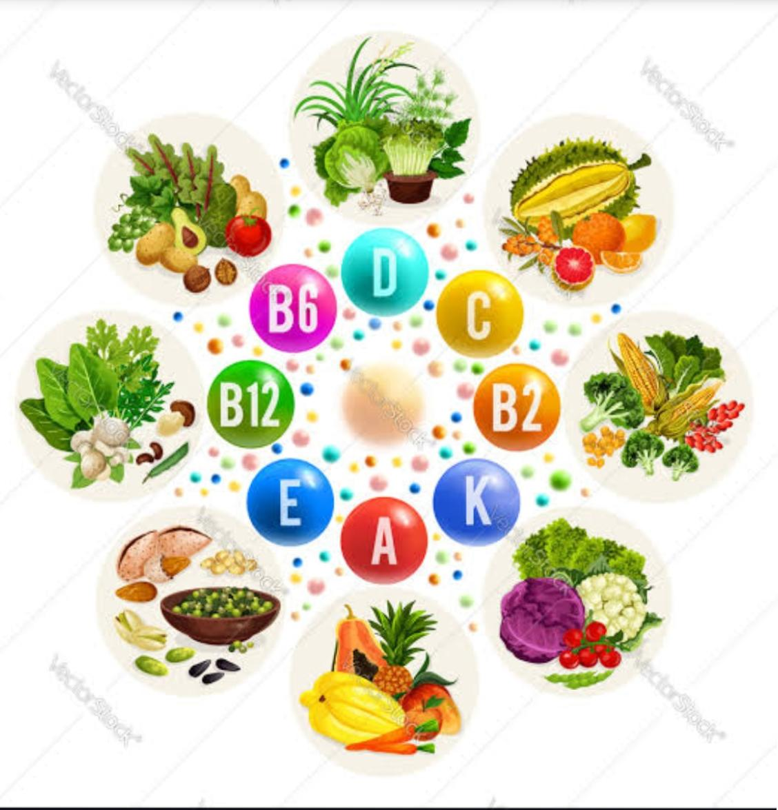
◆ Vitamins :
- A vitamin is an organic molecule that is an essential micronutrient which an organism needs in small quantities for the proper functioning of its metabolism.
- Essential nutrients cannot be synthesized in the organism, either at all or not in sufficient quantities, and therefore must be obtained through the diet.
● Types :
1. Fat soluble vitamins - Vitamin A ,
Vitamin D ,
Vitamin E ,
Vitamin K
2. Water soluble vitamin - Vitamin B ,
Vitamin C

Slide 3
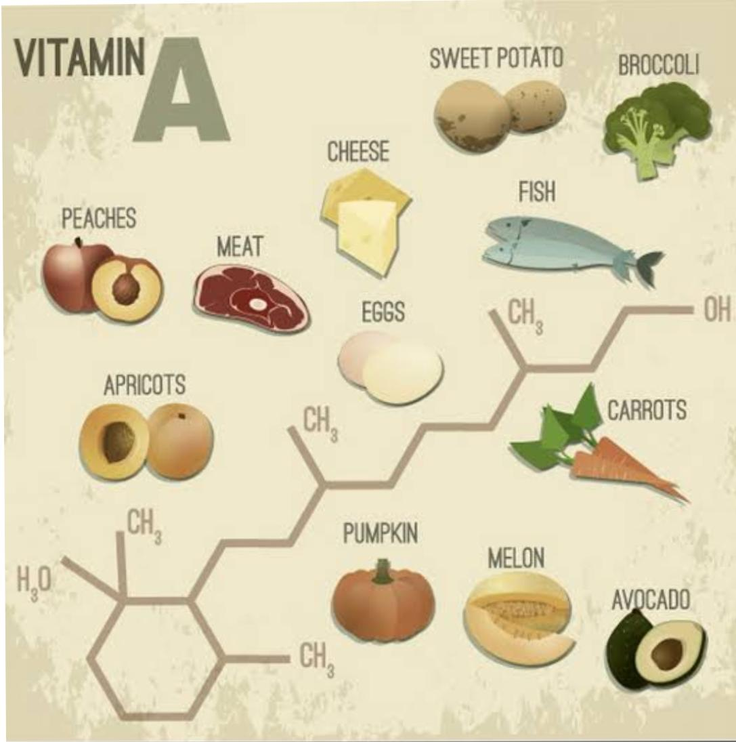
Vitamin A
◆ Responsible For :
- Young looking skin
- Beautiful hair
- Healthy nail
- Sharp vision
- Strong bone
◆ Deficiency :
- Night blindness
- Xeropthalmia
◆ Sources :
- Carrots , Citrus Fruits , Hard cheese , Spinach , Milkcottage Cheese ,eggs , Fish
Milk and fever.
◆ Recommended Daily amount :
- 0.4 to 1 mg

Slide 4
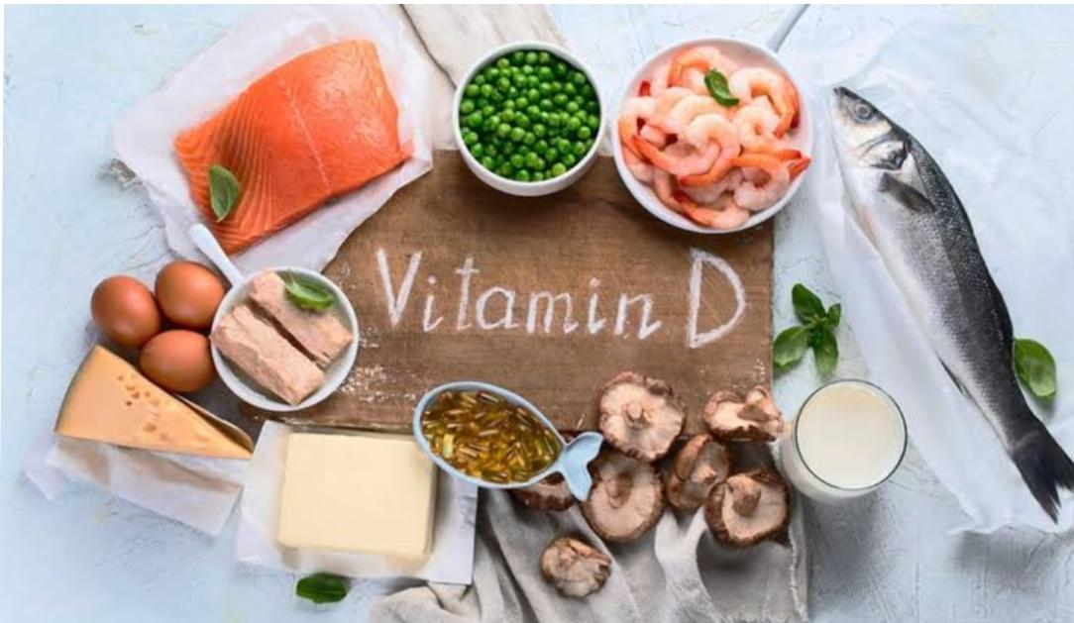
Vitamin D
◆ Responsible for :
- Healthy bone
- Good blood Circulation
- Immunity to clod
- Elimination of toxins
◆ Deficiency :
- Rickets
- Osteomalacia
◆ Sources :
- Cheese , Butter , Egg yolk , Fish , Seafood , Potatoes , Vegetables.
◆ Recommended amount per day :
- 2 to 5 mg

Slide 5
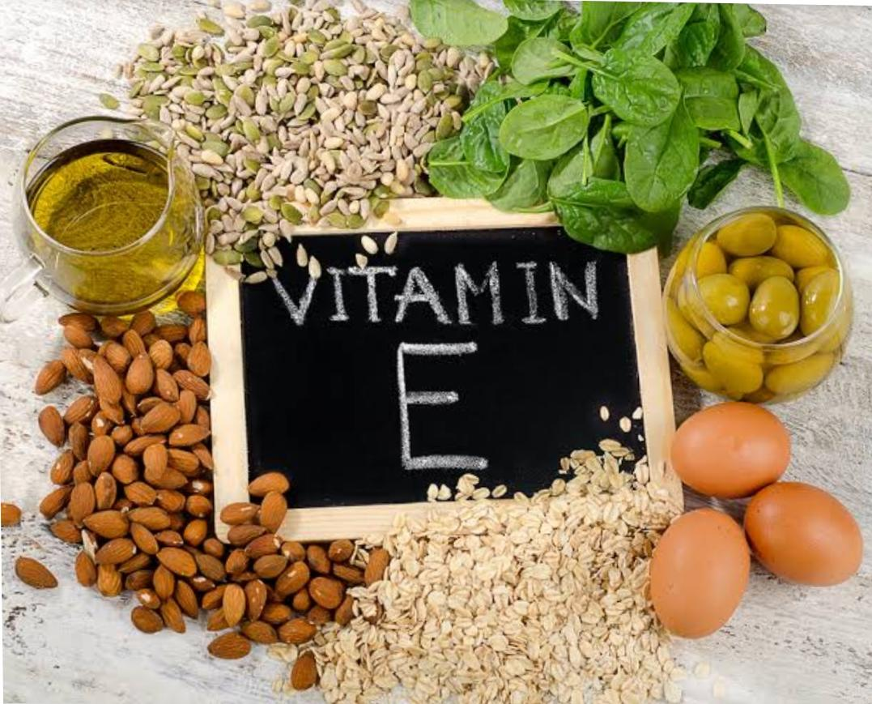
Vitamin E
◆ Responsible for :
- A rejuvented body
- Normal operation of reproductive system
- Protection against environment
◆ Sources :
- Corn , Meat , Pumpkin seed nuts , Dairy products .
◆ Recommended amount per day :
- 30 to 50 mg

Slide 6
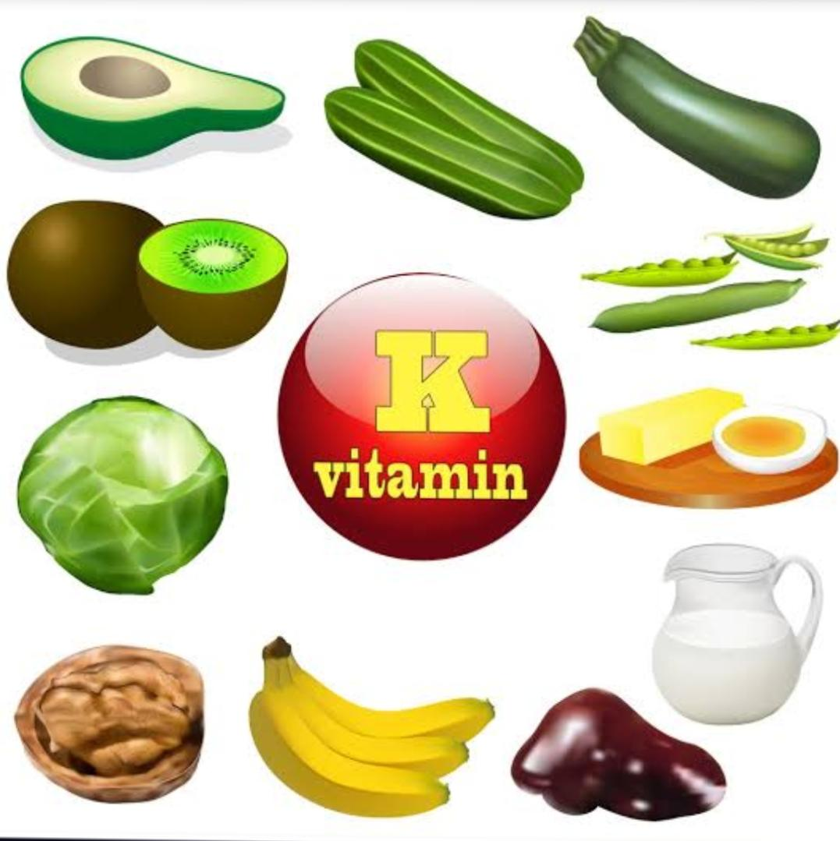
Vitamin K
◆ Responsible for :
- Fast healing
- Normal blood coagulation
◆ Sources :
- Spinaches , nettles , Cauliflower , Carrots , Tomatoes , Green tea.
◆ Recommended amount per day :
- 1 to 2 mg

Slide 7
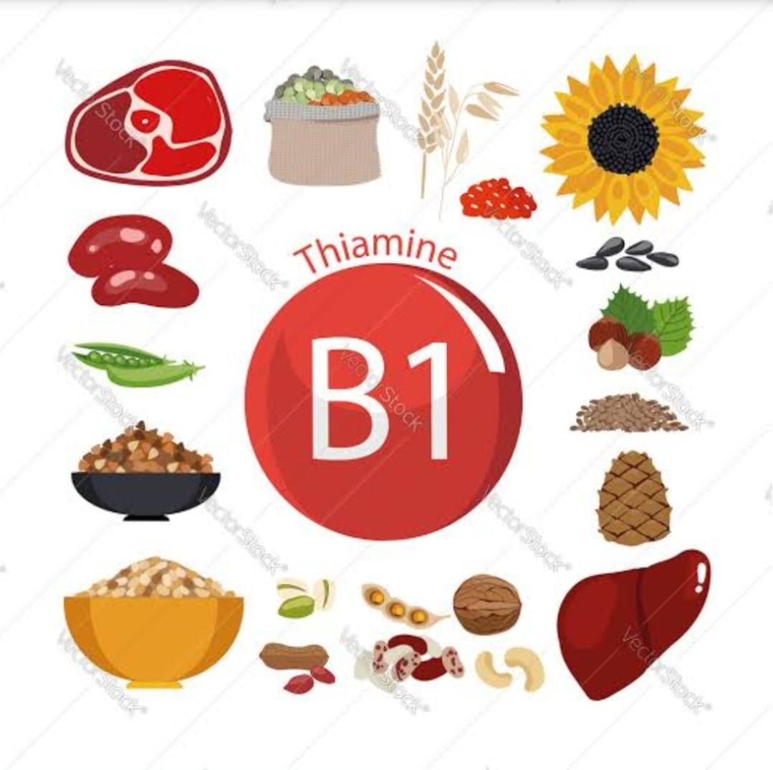
Vitamin B
( 1 ) Vitamin B₁ [ Thiamine ]
◆ Responsible for :
- An effective brain
- Good digestion
- Healthy muscle
- Healthy heart
- Quality sleep
◆ Deficiency :
- Beriberi
- Wernicke’s encephalopathy
◆ sources :
- Brewing Yeast , Porks , Oats , Nuts , Wheat grass , Legumes.
◆ Recommended amount per day :
- 1.3 to 2 mg

Slide 8
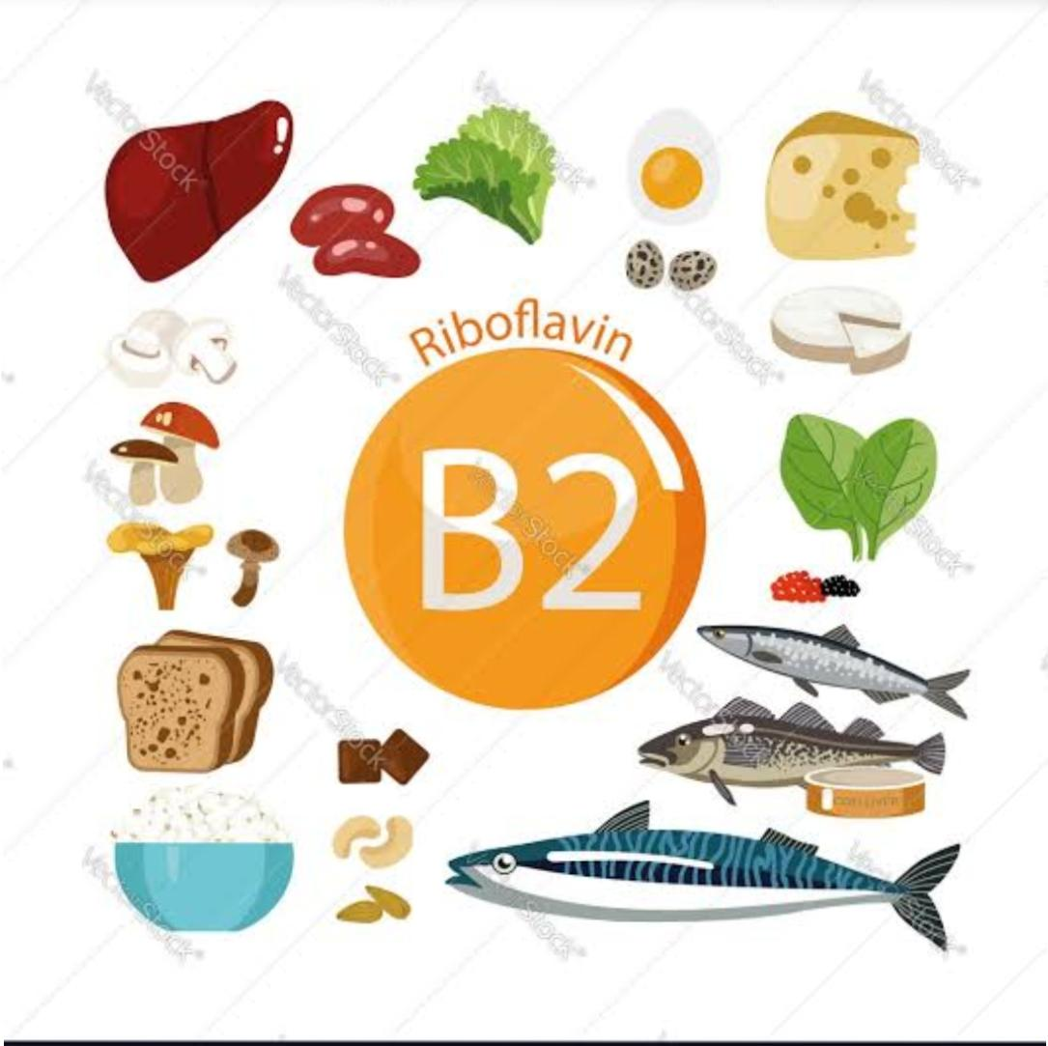
( 2 ) Vitamin B₂ [ Riboflavin ]
◆ Responsible for :
- Regenerated cell
- Sharp vision
- Healthy muscle
◆ Deficiency :
- Angular stomatitis
◆ Sources :
- Milk , Almond , Eggs , Mushroom , cheese , Yeast , Milk.
◆ Recommended amount per day :
- 1.3 to 3 mg

Slide 9
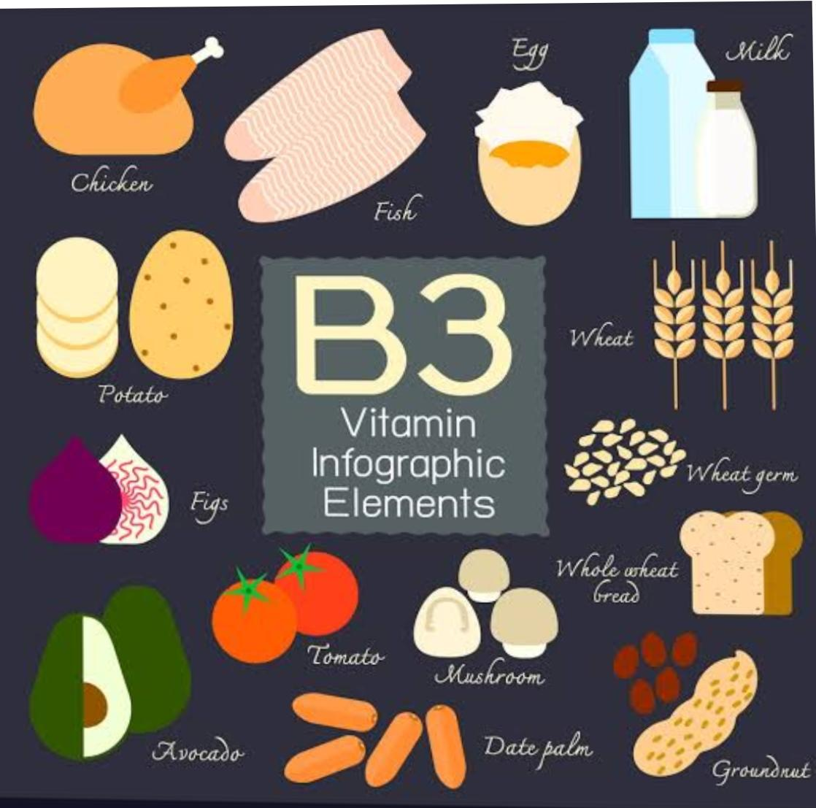
( 3 ) Vitamin B₃ [ Niacin ]
◆ Responsible for :
- Reduces the cholesterol level
- Treats the cardiovascular disease
- Improve digestion
- Supports the brain functioning
- Ensure healthy skin.
◆ Deficiency :
- Pellagra
◆ Sources :
- Meat , poultry , fish , Legumes , groundnut , Maize
◆ Recommended amount per day :
- 14 to 16 mg

Slide 10
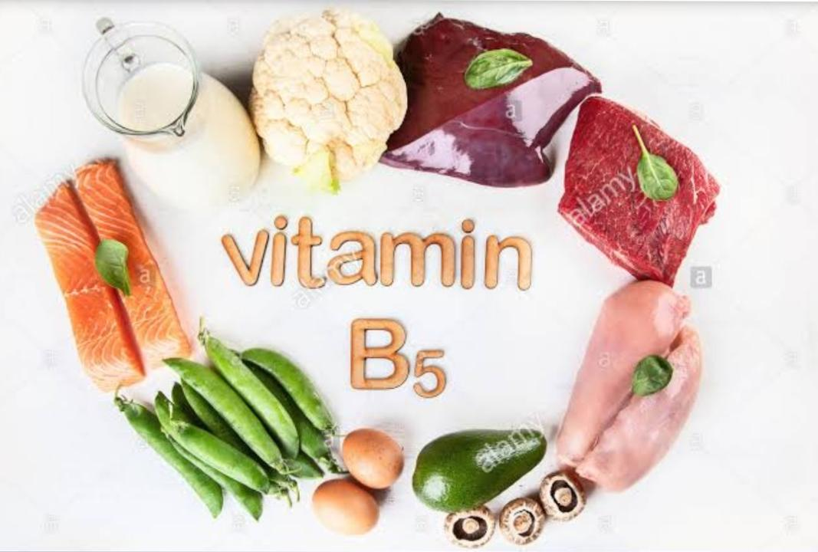
( 4 ) Vitamin B₅ [ Pantothenic acid ]
◆ Responsible for :
- Good memory
- Cheerful mood
- Healthy Blood vessels
- Healthy heart
◆ Sources :
- Chicken , Egg Yolk , Dairy products , Legumes , Nuts , Oatmeals , Rice , Broccoli.
◆ Recommended amount per day :
- 10 mg

Slide 11
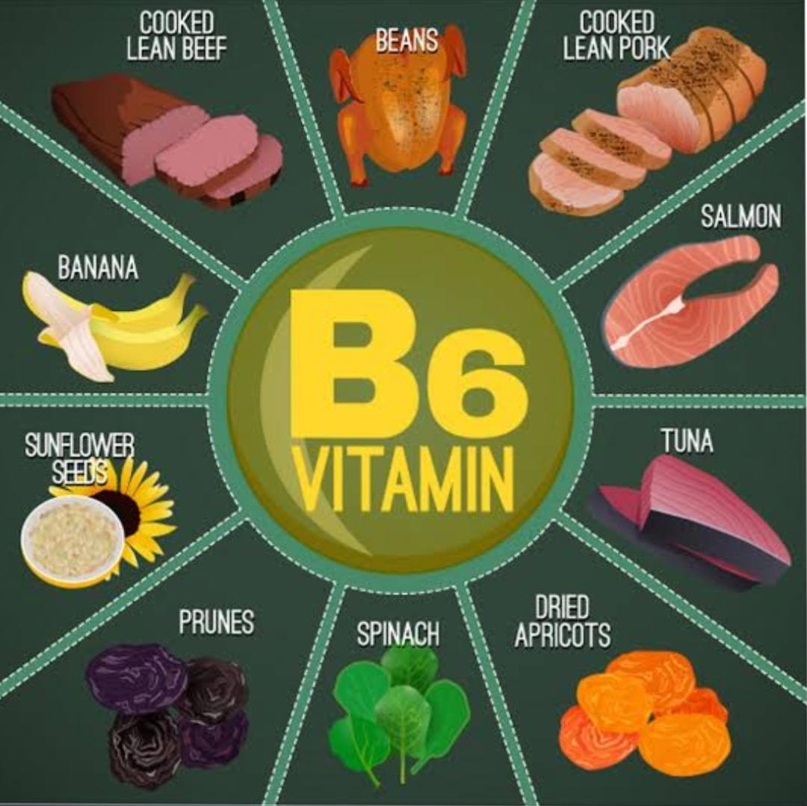
( 5 ) Vitamin B₆ [ Pyridoxine ]
◆ Responsible for :
- Rejuvenated Body
- Strong nervous system
- Healthy Blood vessels
◆ sources :
- Cereals , Green salad , cabbage , Walnuts , Bananas , Wheat bran , Salmon , Meat.
◆ Recommended amount per day :
- 2 mg

Slide 12
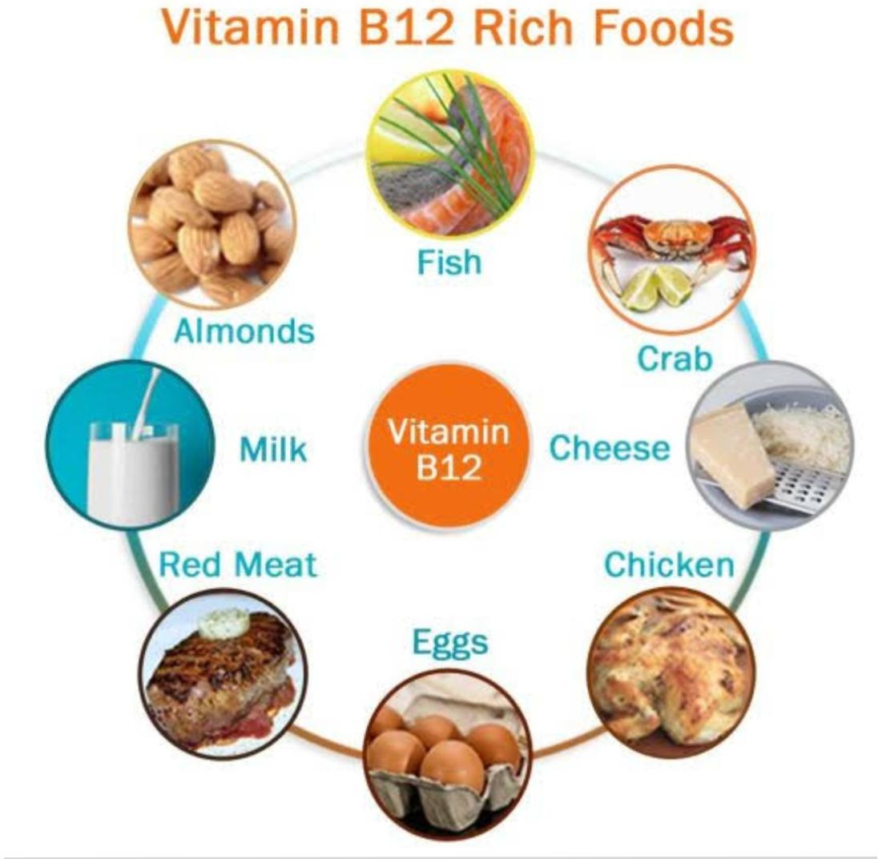
( 6 ) Vitamin B₁₂
◆ Responsible for :
- Noraml weight
- Good immunity
- Sound memory
- Healthy gastrointestinal tract.
◆ Deficiency :
- Megaloblastic anaemia
◆ Sources :
- Soyabeens , Spinach , Oysters , Fish , Cheese , Milk , Egg yolk.
◆ Recommended amount per day :
- 2 to 5 mg

Slide 13
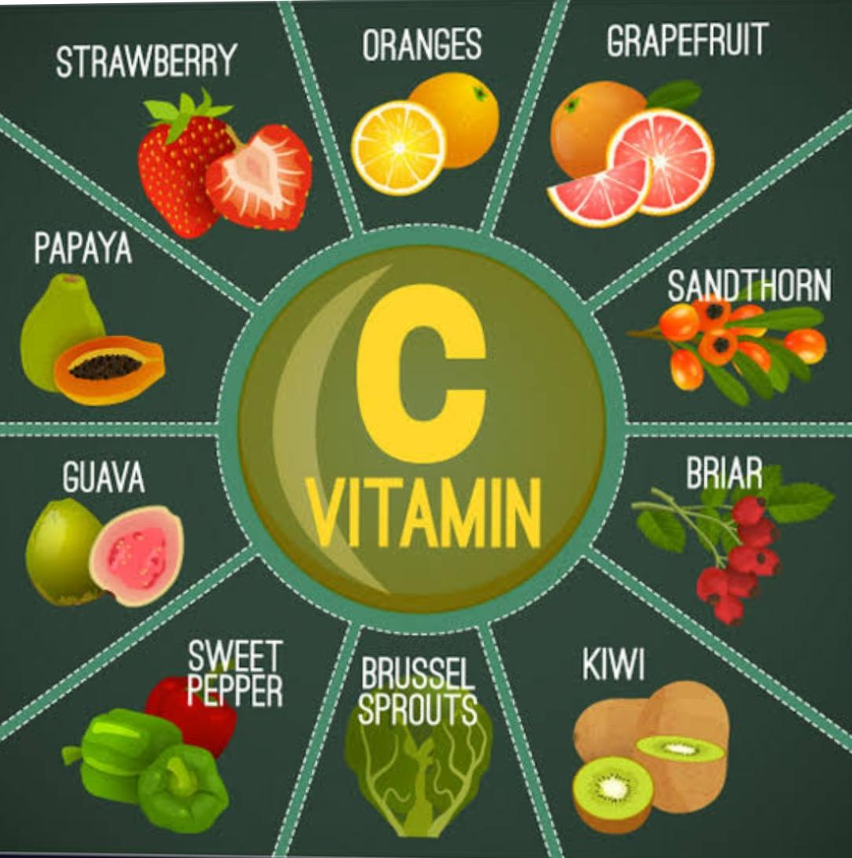
Vitamin C
◆ Responsible for :
- Smooth skin
- Immunity
- Cheerful mood
- Healthy hair and nail
◆ Deficiency :
- Scurvy
◆ Sources :
- Citrus food , Cauliflower , Beans , Peas , Kisi fruits , Radish.
◆ Recommended amount per day :
- 40 mg

Slide 14
Thank you
◆ PRESENTED BY : PATEL PAYAL DHARMENDRA KUMAR
( Student of Final year at Ahmeadabad Homoeopathic
Medical college )
◆ UNDER GUIDANCE OF : DR. TEJAL SHAH
( H.O.D & PROFESSOR )
( Community medicine department )

