Slide 1
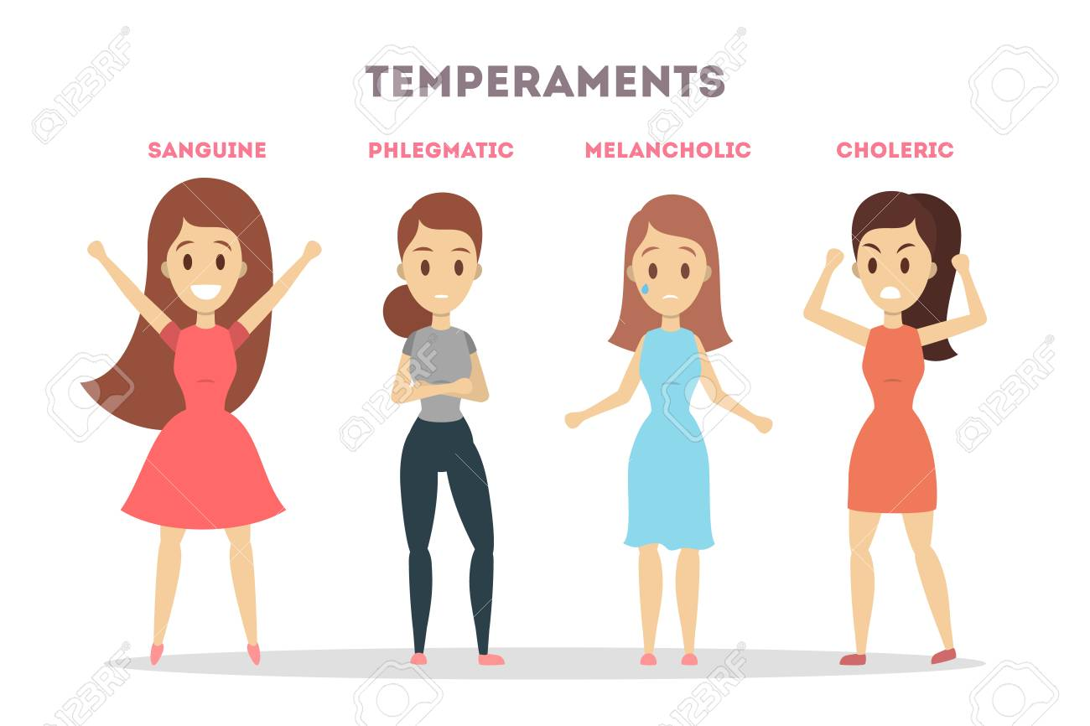
TEMPERAMENTS
PRESENTED BY : DR DEEPTI DEWAN
DEPARTMENT OF CASE TAKING & REPERTORISATION
UNDER THE GUIDANCE OF : DR. ANUSUYA

Slide 2
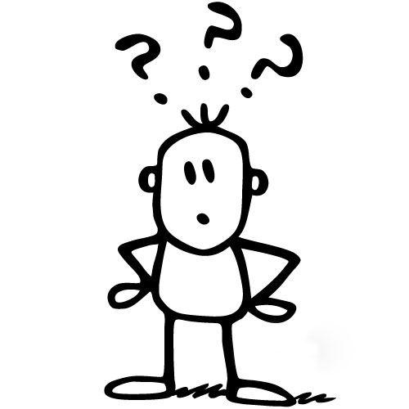
What is
Temperament ??

Slide 3
A person’s nature ,especially as it permanently affects their behaviour.
The word temperament originated from Latin word ‘temperare’ which means to temper, restrain, a mixture or balance of contrary qualities; an innate or acquired disposition.
Characteristic combination of bodily, mental, and moral qualities, which together constitute the character and disposition of an individual and predispose him to act and behave in a particular manner- Webster Universal Dictionary

Slide 4
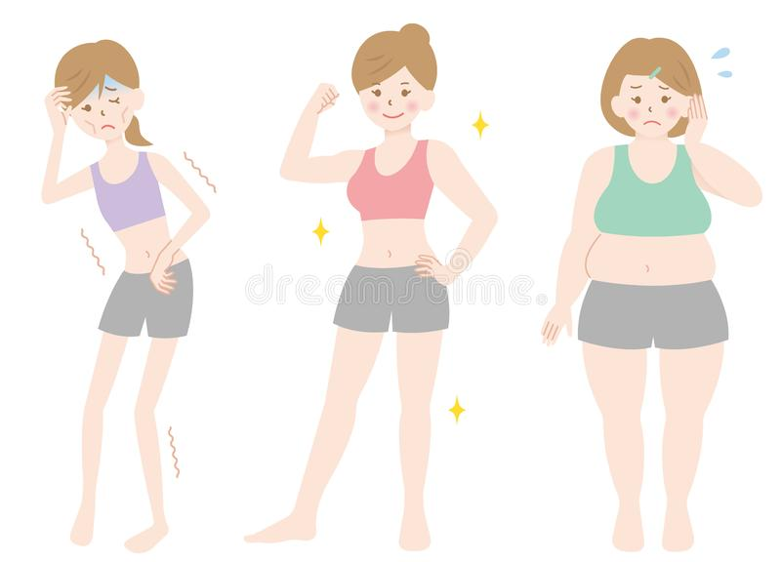
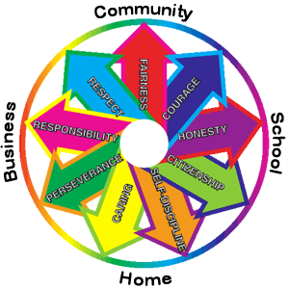
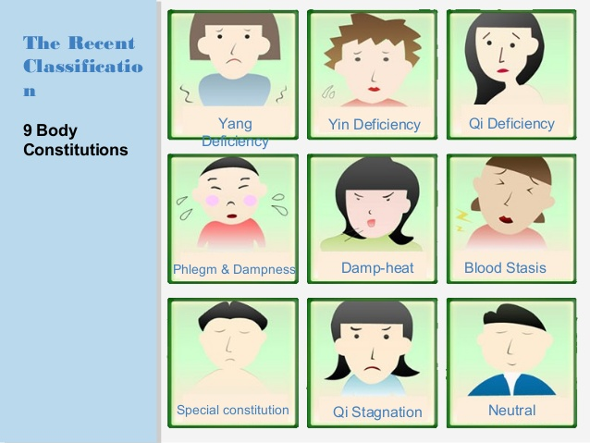
Temperament is the characteristic combination of bodily, mental and moral qualities which together constitute the character and disposition of an individual and predispose him to act and behave in a particular manner.

Slide 5
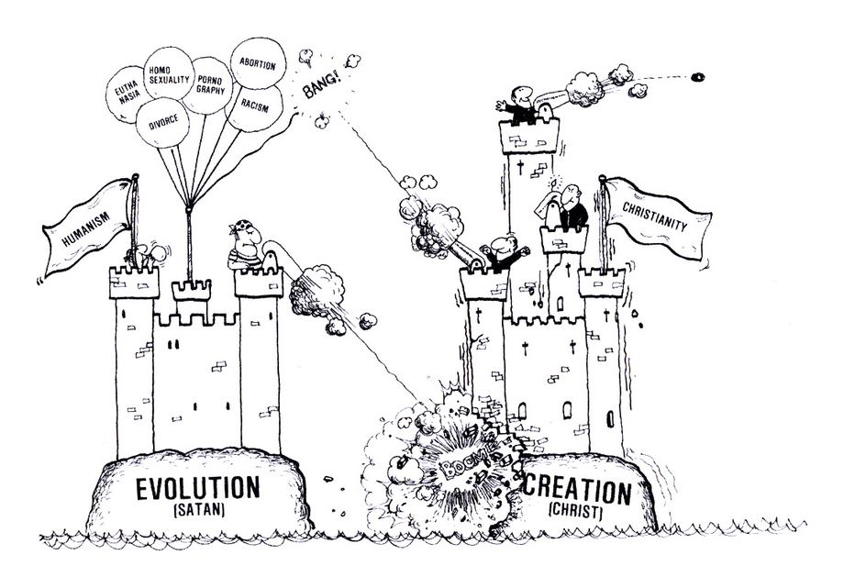
EVOLUTION
OF
TEMPERAMENTS

Slide 6
HIPPOCRATES’ HUMORISM
Hippocrates (400 B.C.) believed that body is composed of Four Humors viz Blood, Phlegm, Yellow bile and Black bile.
The Imbalance of Humors, or Dyscrasia was thought to be the Cause of all Diseases.

Slide 7
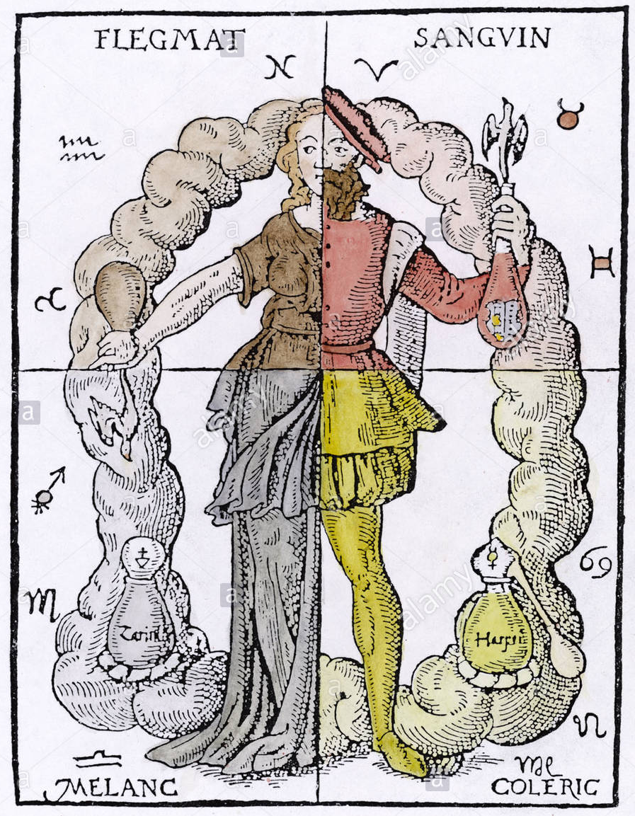
GALEN’S TEMPERAMENT
Galen (130-200 AD) used the term to refer to Bodily dispositions, which determined a person’s susceptibility to particular diseases as well as
behavioral and emotional inclinations.

Slide 8
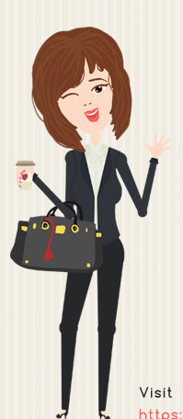
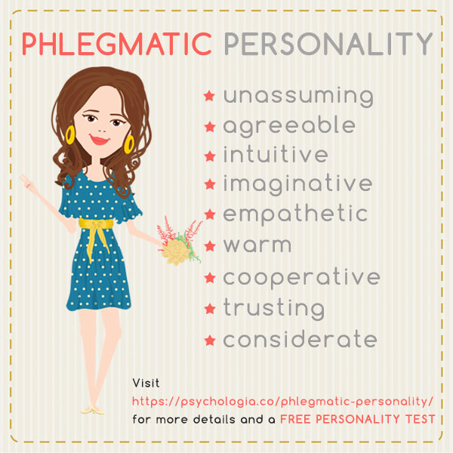
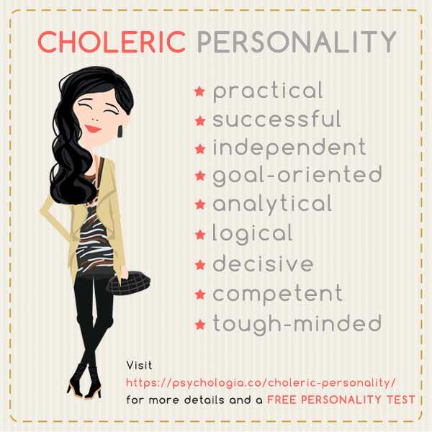
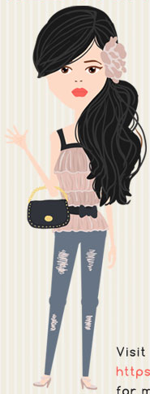
While the Humors literally represented fluids thought to circulate in the body, metaphorically each became associated with a prevailing emotion:
Blood with joy, called the Sanguine temperament
Phlegm with worry and contemplative calm, the Phlegmatic temperament.
Yellow bile with anger, called the Choleric temperament.
Black bile with sadness, called the Melancholic temperament

Slide 9
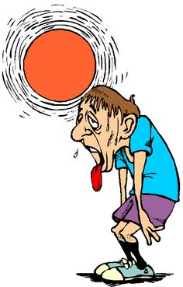
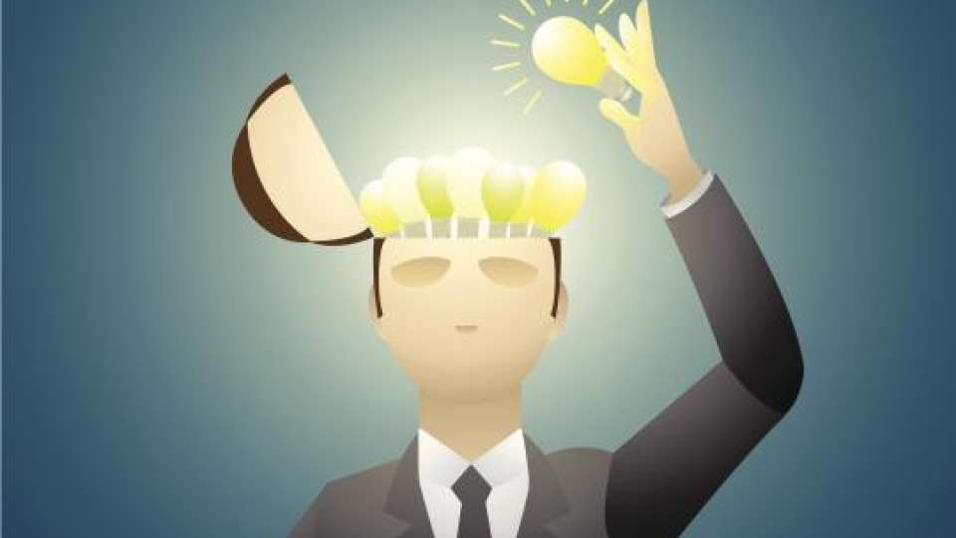
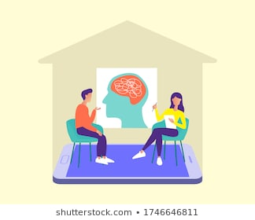
They are our patterns of behaviour ……the way we usually respond to situations.
It is also defined as a persons nature ,ones usual way of thinking or acting.
The physical data can be easily elicited , but problem arises in understanding the mental makeup of the patient.
Knowledge of temperaments can be used as a tool to understand the mentals better.

Slide 10
According to psychologists ,the innate aspects of an individuals personality such as introversion or extroversion is termed as temperament.
They are instinctive natural behaviours ,rather than learned behaviours.

Slide 11
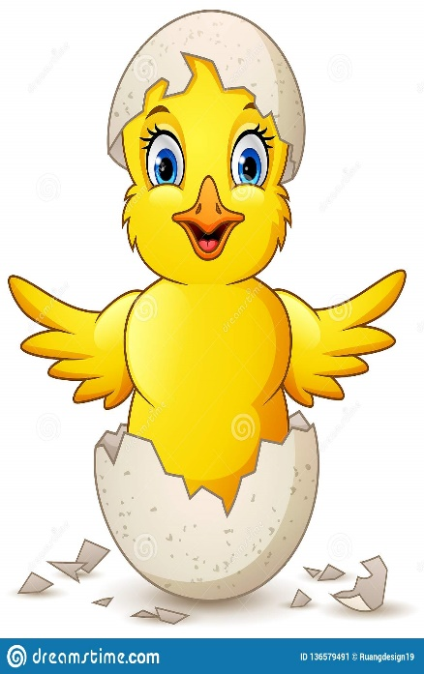
Temperament is our inborn, God given nature.
Temperament remains constant throughout our life.
Temperament is different from personality
Personality is something which can be changed, developed or enhanced.
It is this aspect of Personality concerned with emotional dispositions and Reactions.
No temperament type is good or bad. Each temperament has its own set of strength and weakness. With the similimum the weakness can be diminished.

Slide 12
CONSTITUTIONAL
Mentals
Physical
Temperament
Personality
Generals
(cravings, aversion, thermals etc.)
Diathesis
(Rheumatic, Haemorrhagic,
Tubercular, Lymphatic, Gouty, etc)

Slide 13

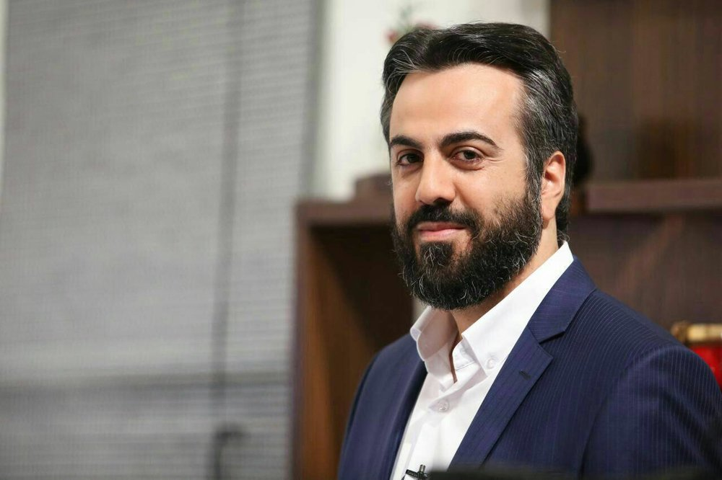
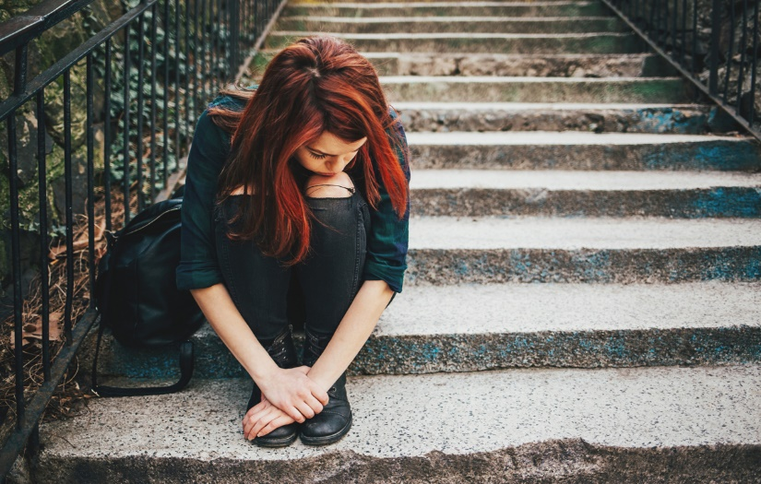

types OF Temperament
Sanguine Choleric
Melancholic Phlegmatic

Slide 14
SANGUINE
TEMPERAMENT
The sanguine temperament, the one with the kind word and easy smile. He is rightly called as people’s person. Of the four personalities, the sanguine is the most positive.

Slide 15
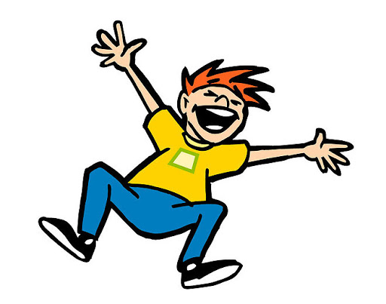
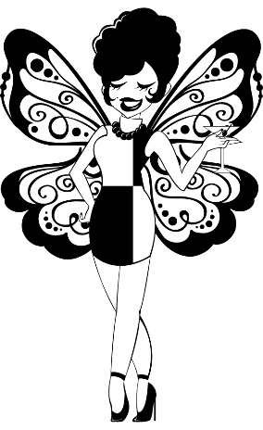
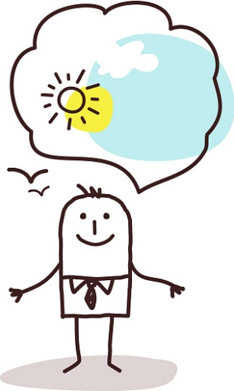
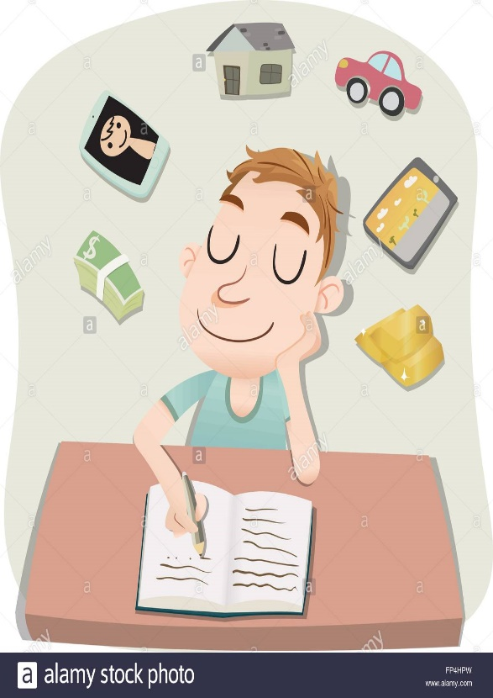
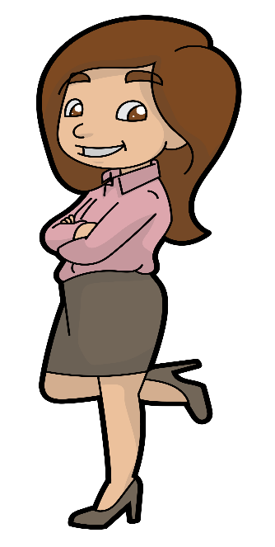
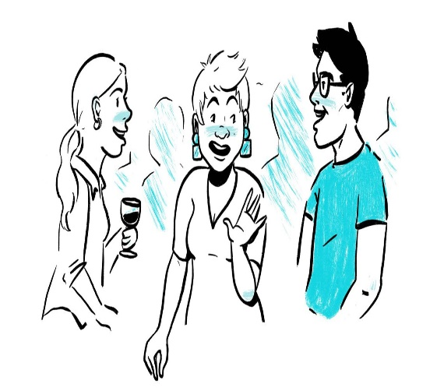
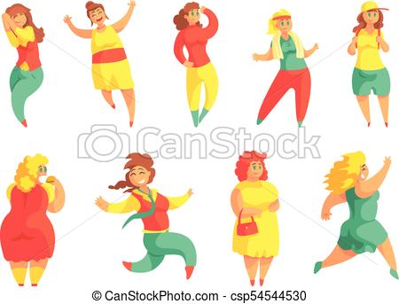
Happy-go-lucky types
Social Butterflies
Optimistic,Confident,
Day-dreaming
Extrovert
Enjoying life

Slide 16
Makes adjustments easily ,welcomes changes.
Impetuous and impulsive ;his decisions are often wrong

Slide 17
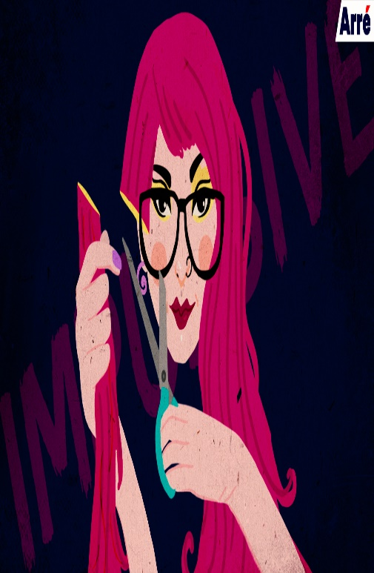
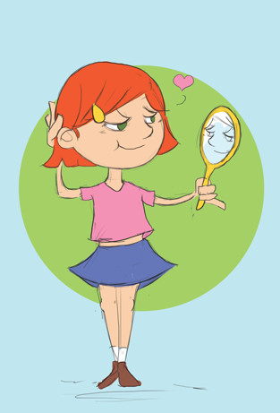
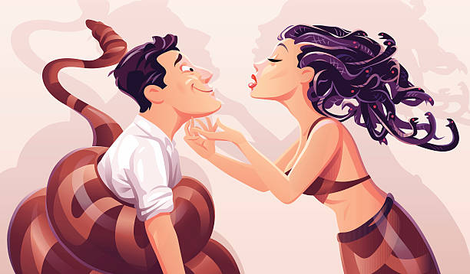
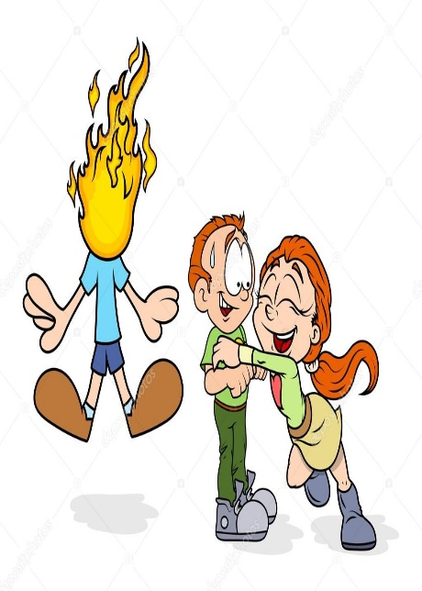
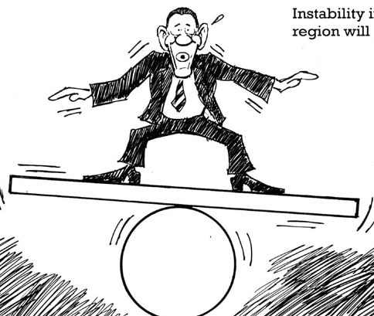
WEAKNESSES
Vanity and self-complacency
Impulsive
Superficiality
Instability
Inclination to flirtation,
Envy and jealousy

Slide 18
Sanguine - Rubrics
A/F : excitement,
Emotional
Exhilaration
Impetuous
Loquacity
Impulsive
Vivacious
Vanity
High spirited
Mirth
Playful
Cheerful
Jealousy
Company, desire for
Envy
Forgetful
Optimism
Careless
Extroverted
Theorizing
Charming
Exuberance
Amusement desire
Jesting

Slide 19
Full of unrestrained enthusiasm or joy
Amusement desire for mirth
Buoyancy merry
Cheerful , gay ,mirthful optimistic
Contented play desire to, playfull
Exultant pleasure
Good humour witty
High spirited smiling

Slide 20
Marked by sudden action ,energy or emotion
Abrupt Impulsive
Answers abruptly Quick to act
Answers hastily Rashness
Excitement ,excitable speech ,abrupt
Hastiness speech, hasty
Hurry ,haste
Impatience

Slide 21
Delirium loquacity
Talk ,talking ,talk incessantly Talkitive
Talk ,talking , talks ,prattling Talk desire to ,to someone
Speech babbling
Speech hasty loquacity
Speech prattling
Talk ,listens ,does not care whether anyone
Reveals secret

Slide 22
Filled with animation and spirit, lively
Excitement
Exhilaration
High spirited
Quick to act
Thoughts rapid quick
Disease condition MANIA
heedless
Impulsive
Inattentive
Indiscretion
Inquisitive
Rashness
Unobserving
Sanguine – Remedies
Ferrum
phos
Lachesis
coffee

Slide 23

CHOLERIC TEMPERAMENT
Has a lot of drive
Struggles with his surroundings because of the constant drive within him to change existing conditions out of boredom.
Will power and decision making ability are better developed in this type of person than in others
Thinking is clear but can be influenced by the urge to do something or get something done THERE IS NO REVERSE GEAR IN HIS CAR

Slide 24

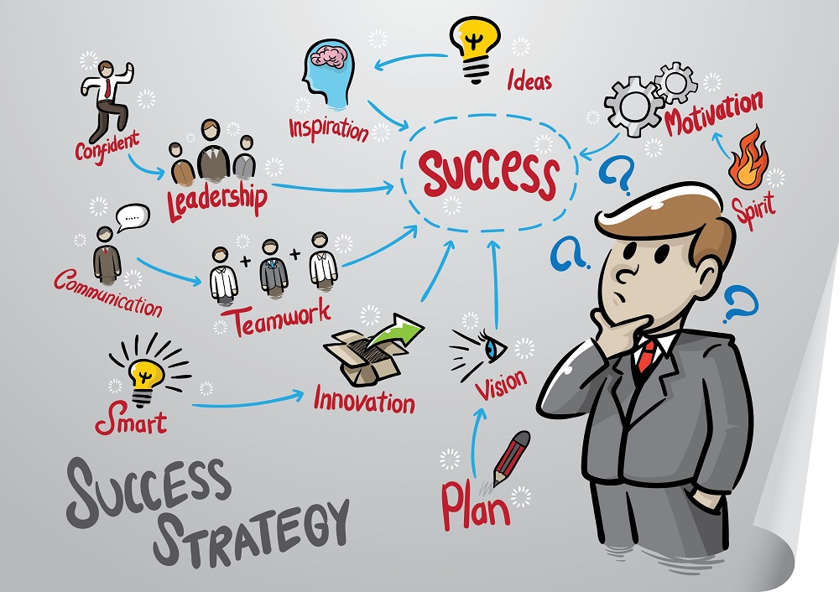
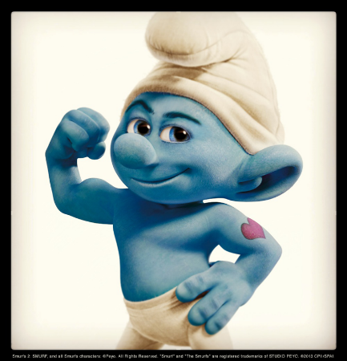
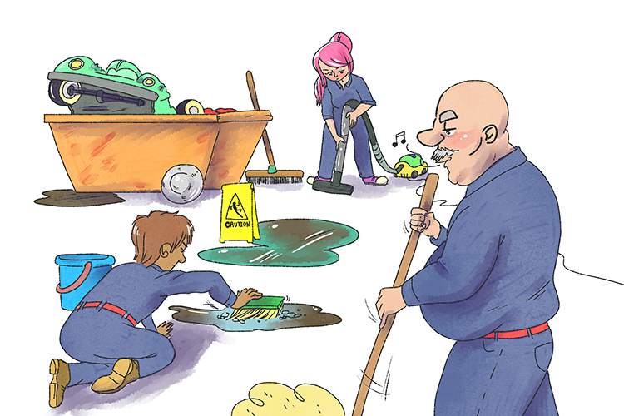
World “My Way”
To be or not To Be
Born Leaders
Decisive
Strong Willed
Confident
Fastidious

Slide 25
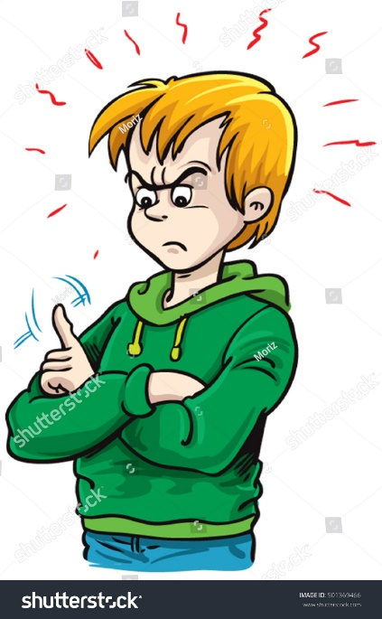

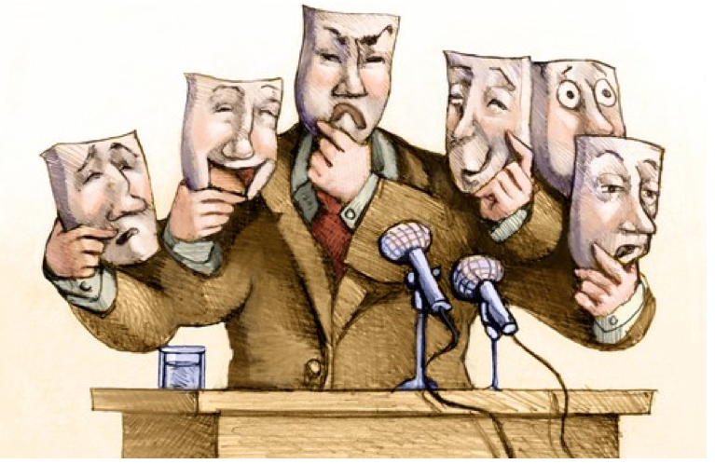
WEAKNESSES
Anger prone
Superiority complex
Cannot bear Contradiction
Deceit, Disguise and
Hypocrisy
Lacks Sympathy
Unemotional

Slide 26
The following Rubrics describe Choleric temperament:
Haughty
Censorious
Malicious
Industrious
Destructive
Impatient
Capricious
Dictatorial
Contradiction, intolerant of, disposition
Ailments from: Anger, vexation
Quarrelsome

Slide 27
Contemptuous
Dogmatic
Manipulative
Obstinate
Reproaching others
Selfishness
Rudeness
Egotism
Presumptuous

Slide 28

A/F : Anger, Vexation
Hatred
Irritability
Peevishness
Quarrelsome
Rage
Vexation
Wildness

Slide 29
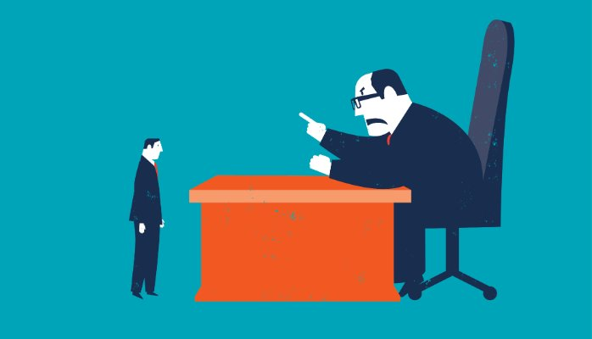
Dictatorial
C/R
Domineering
Power , love of
Reproaches others
Suggestions ,will not receive

Slide 30
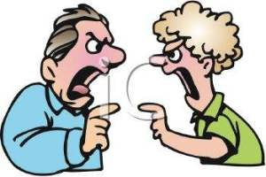
Quarrelsome
Censorious ,critical
Contrary
Contradict ,disposition to
Cursing, swearing
Defiant
Fight ,wants to
Insolence

Slide 31
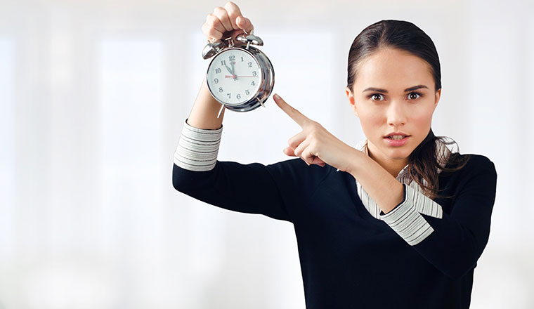

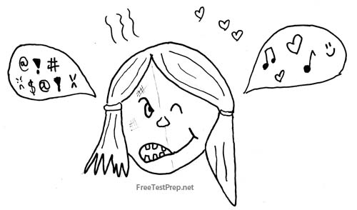
Impatient
Malicious
Destructive
Capriciousness
Lycopodium
Verat –album
Nux-vomica
Bryonia

Slide 32
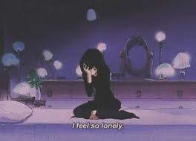
MELANCHOLIC TEMPERAMENT
Melancholic is often referred to as the black or dark temperament. The most gifted, emotional and sensitive person with the deepest depression all wrapped into one package is the melancholic

Slide 33
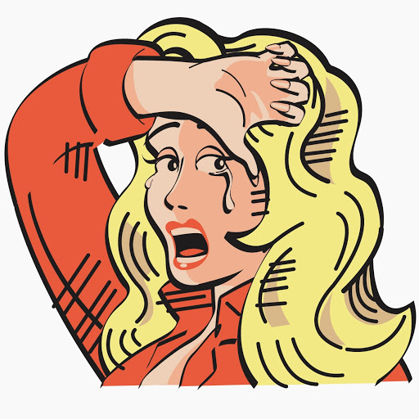
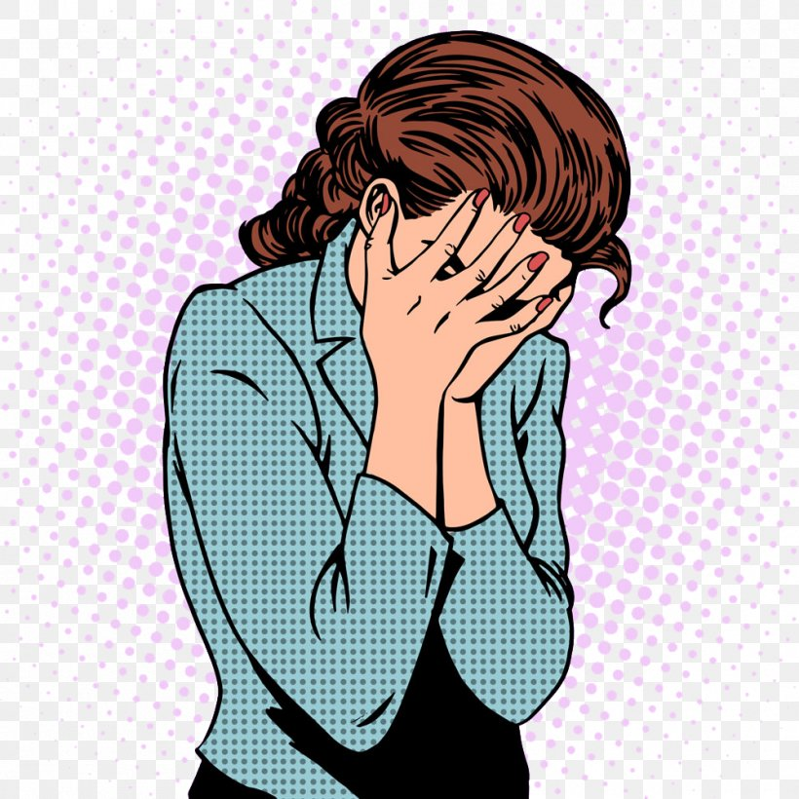
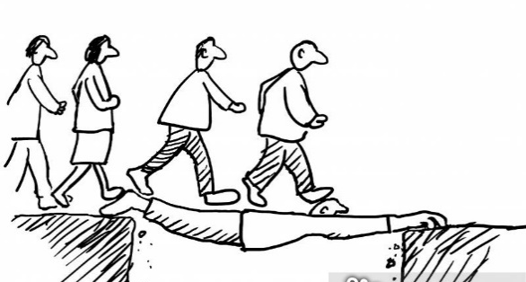
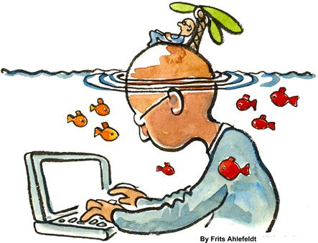
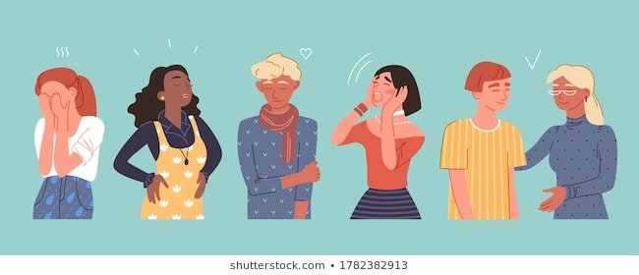
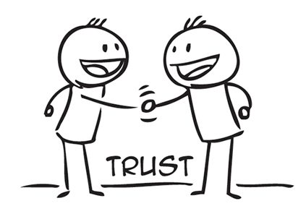
WEEPING OF THE HEART
TALENTED, HIGHLY CREATIVE
SENSITIVE, DREAMERS
RESERVED, THOUGHTFUL
SELF SACRIFICING
RESPONSIBLE, TRUSTWORTHY

Slide 34

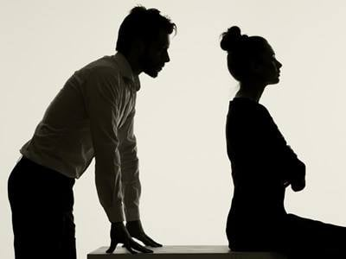
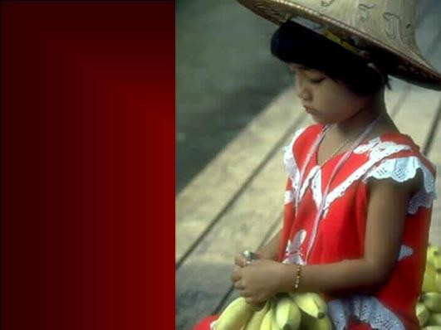
WEAKNESSES
Brooders, Depressive
Unforgiving
Oversensitive
Pessimistic
Remembers the negatives
Moody and depressed
Has false humility
Off in another world
Low self-image
Has selective hearing
Self-centered
Too introspective
Guilt feelings
Tends to hypochondria

Slide 35
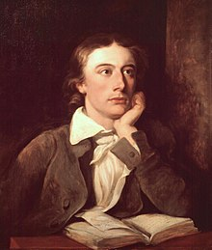
They will not forget anything bad that has happened to them and just cannot get over it.
Very sensitive to others and very considerate
Work : well planned , dedication and passion
Romanticism lies more in thoughts

Slide 36
The following Rubrics describe melancholic temperament:
Ailments from: Grief
Brooding
Conscientious-trifles at
Fastidious
Hypochondriasis
Sentimental
Sympathetic
Suicidal tendencies
Unfortunate feels

Slide 37
Industrious
Benevolence
Weeping-sympathy
Generous
Affectionate
Compassion
Kindness
goodwill

Slide 38
Company aversion to
Embarrassment
Secretive
Industrious
Grief
Brooding
Sympathetic
Hypochondriasis

Slide 39
Remedies :
Nat mur
Ignatia
Aur met

Slide 40
PHLEGMATIC TEMPERAMENT
This temperament goes through life doing as little as possible, quietly and expending little energy. They are friendly, patient, contented and peaceful people rightly known as “couch potatoes”.

Slide 41
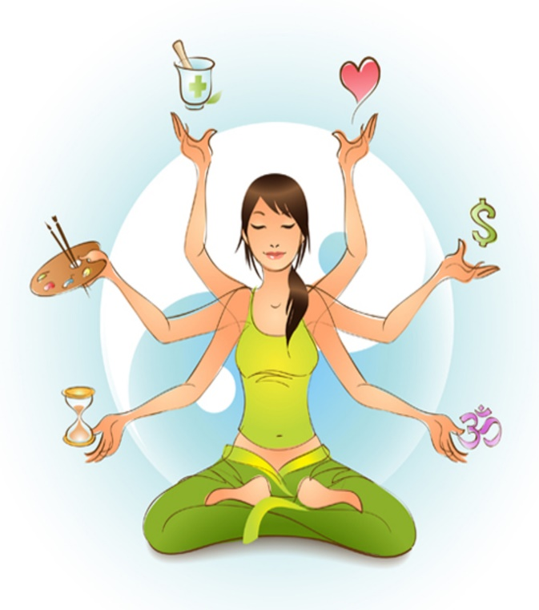
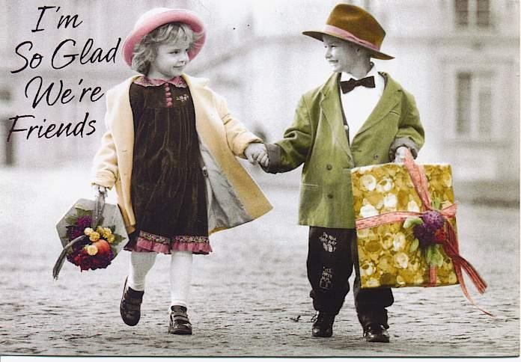
NOTHING RUFFLES THEIR FEATHERS
WELL BALANCED
CONSISTENT WITH LIFE
DEPENDABLE, EASY GOING
COMPOSED AND THOUGHTFUL
CONTENT, PATIENT

Slide 42


WEAKNESSES
Couch Potatoes
Lazy, Indolent
Neglect their Duties
Indecisive, Procrastinator
No Ambition: Does not Aspire
TEND to be Observer

Slide 43
The following Rubrics describe Phlegmatic temperament:
Mildness
Timidity
Bashful
Irresolute
Indolent, averse to work
Dull, sluggish
Confidence-want of
Ailments from: Mental work

Slide 44
Inhibition
Quiet disposition
Undertaking nothing
Postponing
Insecurity
Confidence- want
……etc

Slide 45
Remedies like
Calc carb,
Baryta carb
Puls

Slide 46
RECOGNITION TRIO
■ SANGUINE: Extrovert, Optimistic, Talker
■ CHOLERIC: Extrovert, Optimistic, Doer
■ MELANCHOLIC: Introvert, Pessimist, Thinker
■ PHLEGMATIC: Introvert, Pessimist, Watcher

Slide 47
ADDITIONAL
TYPES OF
TEMPERAMENTS
(Specific to Homeopathic Literatures)

Slide 48
NERVOUS TEMPERAMENT
The nervous temperament is generally worried about day to day issues and treats every problem like a matter of life and death.

Slide 49


NERVOUS TEMPERAMENT
■ Excitable, Apprehensive
■ Studious, Inventive, Subtle
■ Great Susceptibility of Mental Impressions
■ Bipolar Moods
■ Starts easily

Slide 50
The following Rubrics describe nervous
temperament:
A/F anticipation
Confidence want of
Confusion of mind
Hurry
Impatience
Hypochondriasis
Fears
Pessimistic
Anxiety about family, health…etc

Slide 51
Remedies like
Arg nit,
Gels,
Ars alb

Slide 52
The Knowledge of Temperaments is vital for:
Understanding the Patient and the portrait of Medicine
Constructing the Totality
Selecting a Similimum
Deciding the Course of Action
Establishing a Complete Cure

Slide 53
Thank you

