Slide 1
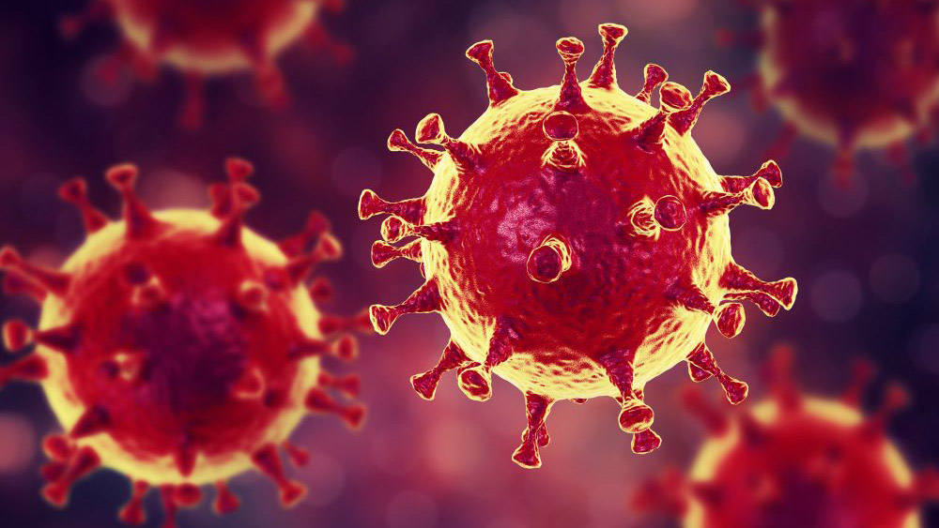
Severe Acute Respiratory syndrome
(SARS)

Slide 2
SARS is communicable viral disease caused by new strain of corona virus which differs considerably in genetic structure from previously recognised coronavirus.
Problem statement :
Earliest case was traced to the health care worker to China ,in late 2002.
Then it was noticed in Hong - Kong, singapor,Vietnam,Taiwan,toranto.
In early August 2003, 8422 cases were reported to WHO from 30 countries with 916 fatalities.

Slide 3
Incubation period :
2 to 7 days ,commonly 3 to 5 days.
Mode of transmission :
The primary mode of transmission can occur through the mucous membranes of eyes, nose or mouth with respiratory droplets or fomites.
The virus is shed in stool but the role of faeco - oral transmission is unknown.
The natural reservoir appears to be the horseshoe bat.

Slide 4
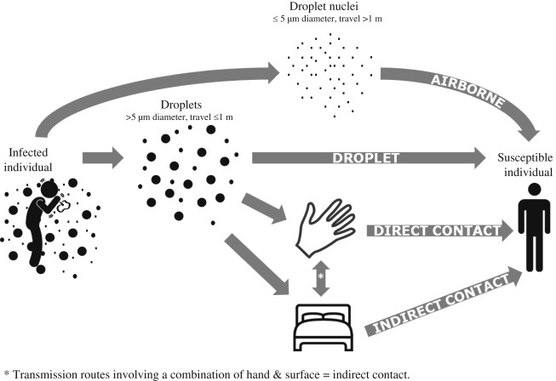

Slide 5
SARS virus can survive for hours on surfaces out side of human body. & Up to 4 days in human waste.
The virus can survive for at least 24 hrs on plastic surface at room temperature. & Can live for extended period in cold.

Slide 6
Clinical case definition of SARS :
A history of fever or documented fever
One or more symptoms of lower respiratory tract illness
Radiographic evidence of lung infilterates consistent with pneumonia or ARDS or autopys finding consistent with pathology of pneumonia or ARDS without an identifiable cause
No alternative diagnosis full expalining the illness.

Slide 7
Diagnostic tests :
Conventional reverse transcripted PCR or real time reverse transcripted PCR assay detecting viral RNA present in :
At least 2 different specimens(nasopharyngeal & stool specimen).
Same clinical specimens collected 2 or more occasions during the course of illness.
New extract from original clinical specimen tested positive by 2 different assays or repeat RT-PCR or real time RT-PCR on each occasion of testing.
Virus culture from any clinical specimen.

Slide 8
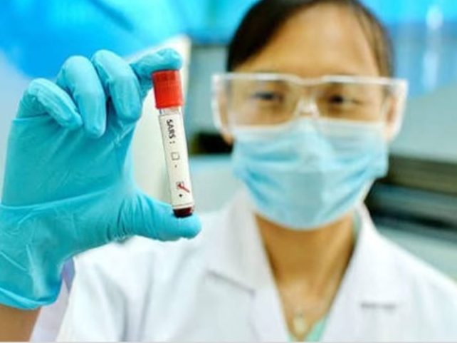
Enzyme linked immunosorbent assay(ELISA) and immunofluorescent assay (IFA):
Negative antibody test on serum collected during the acute phase of illness,followed by positive antibody test on convalescent- phase serum, tested simultaneously OR
A 4- fold or greater rise in antibody titre against SARS - CoV between an acute - phase serum specimen & a convalescent - phase serum specimen (paired sera) ,tested simultaneously.

Slide 9
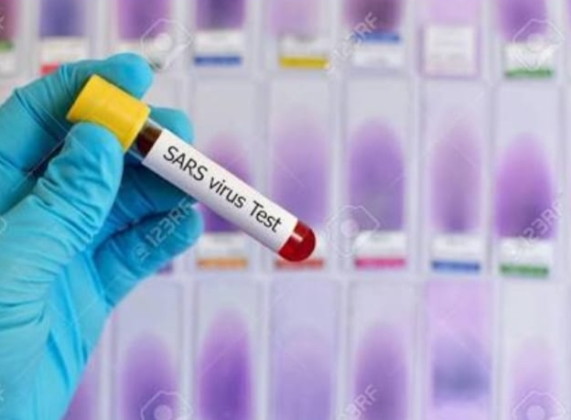
A 4- fold or greater rise in antibody titre against SARS - CoV between an acute - phase serum specimen & a convalescent - phase serum specimen (paired sera) ,tested simultaneously.

Slide 10
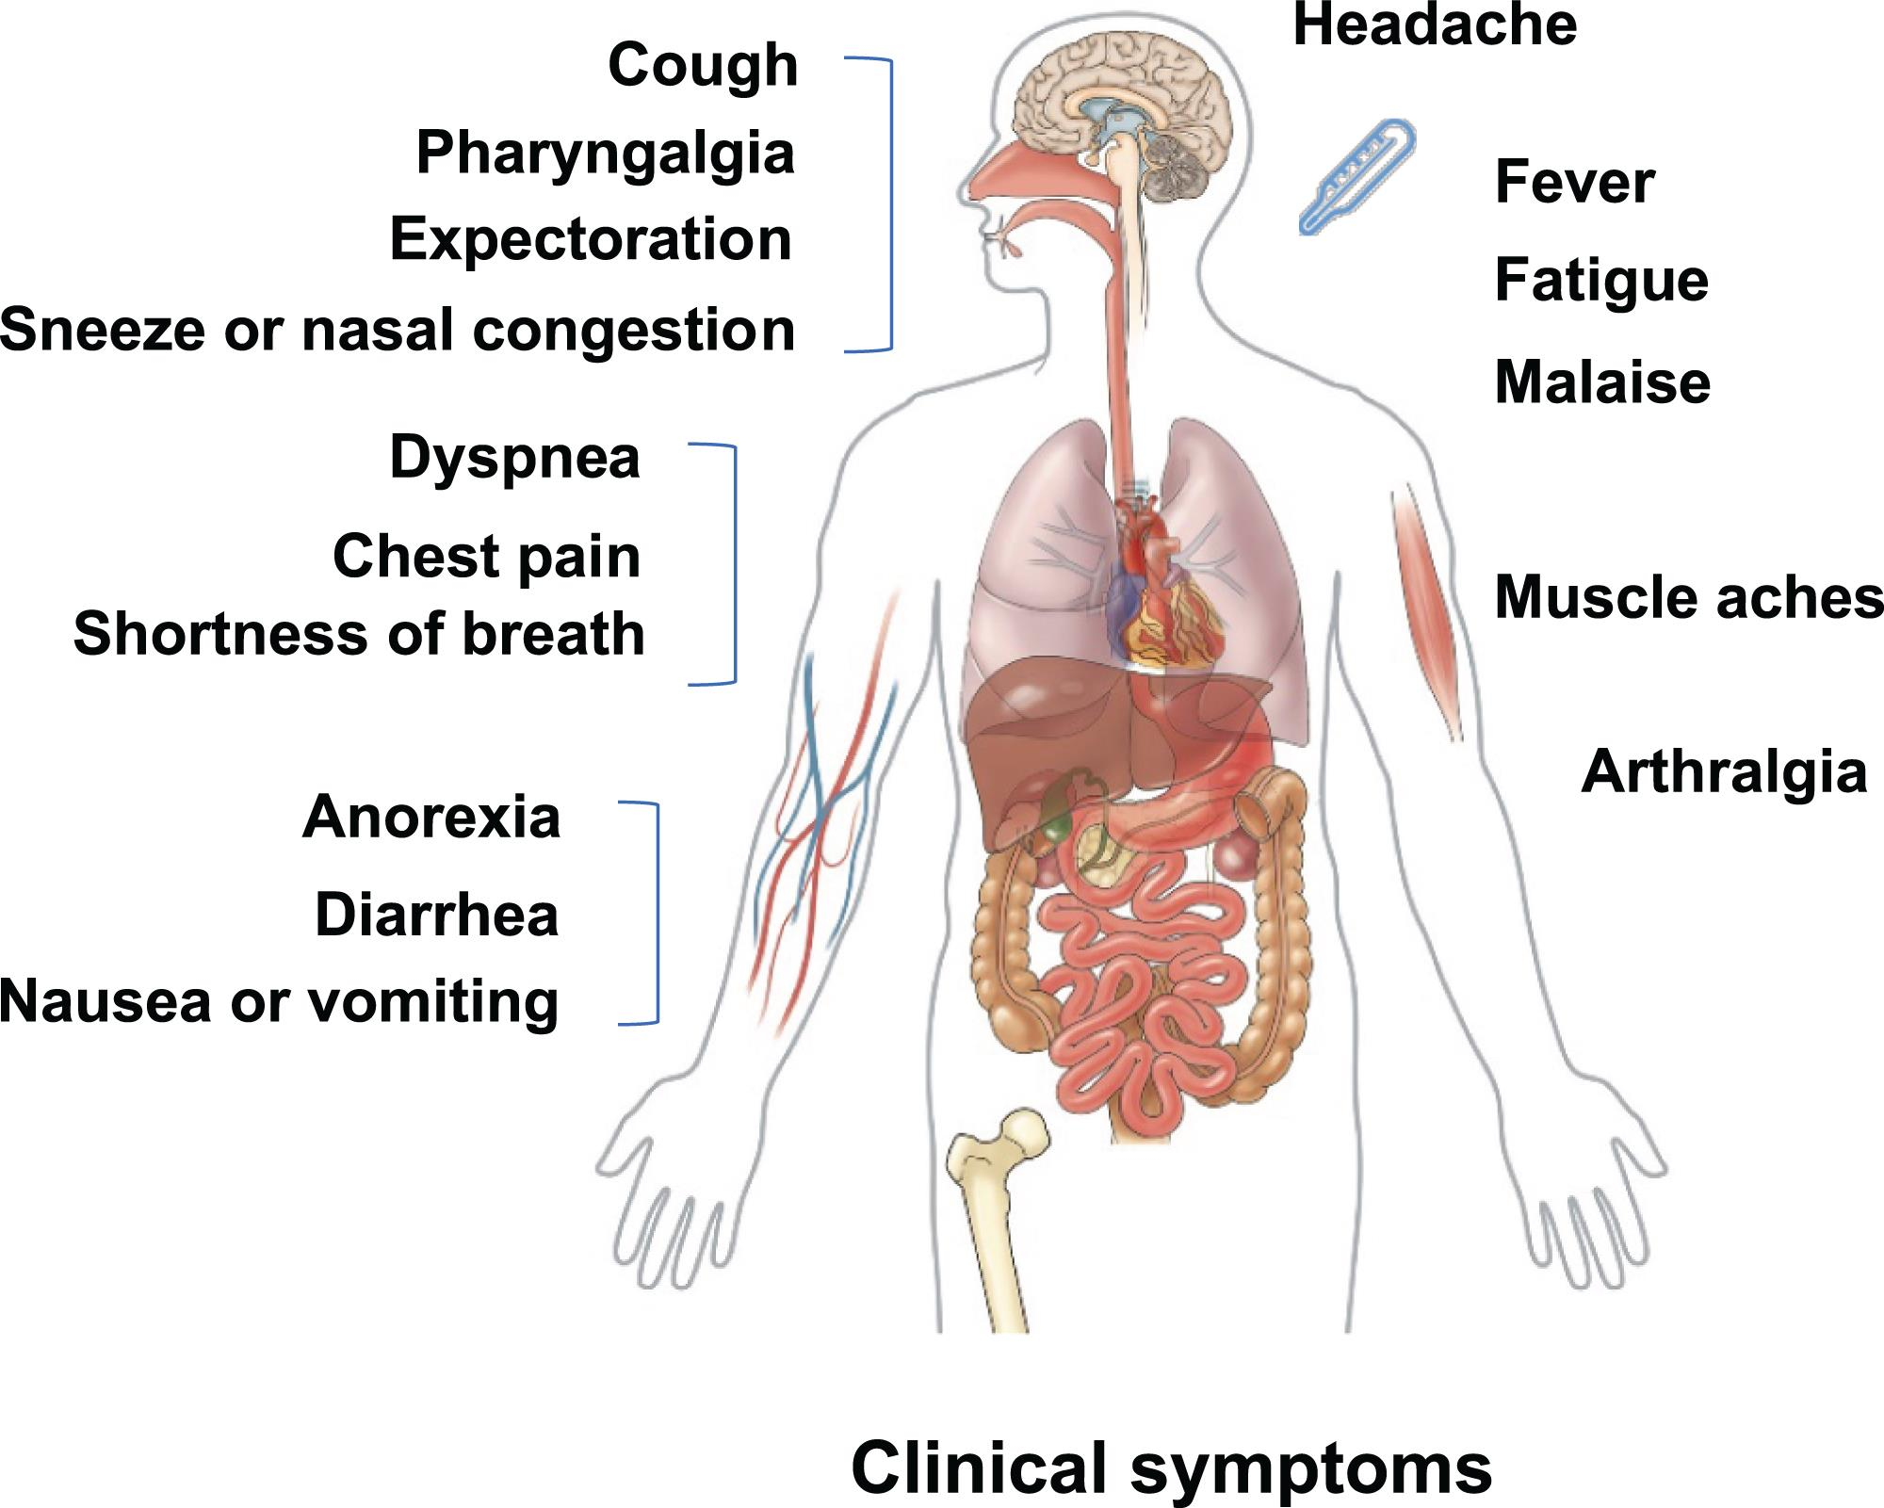

Slide 11
Epidemiological aspect :
Health care workers, especially those involved in procedures generating aerosols,accounted for 21% of all cases.
When symptomatic cases were isolated within 5 days of the onset of illnessw cases of secondary transmission occured.
There was no evidence that patient transmits infection 10 days after fever has removed .
Children are rarely affected by SARS.
International flights have been associated with the transmission of SARS from symptomatic

Slide 12
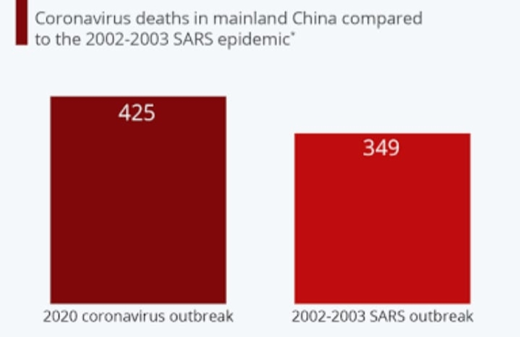
probable cases to passangers or crew.
WHO recommends exit screening & other measures to reduce opportunities for further international spread associated with air travel during epidemic period.

Slide 13
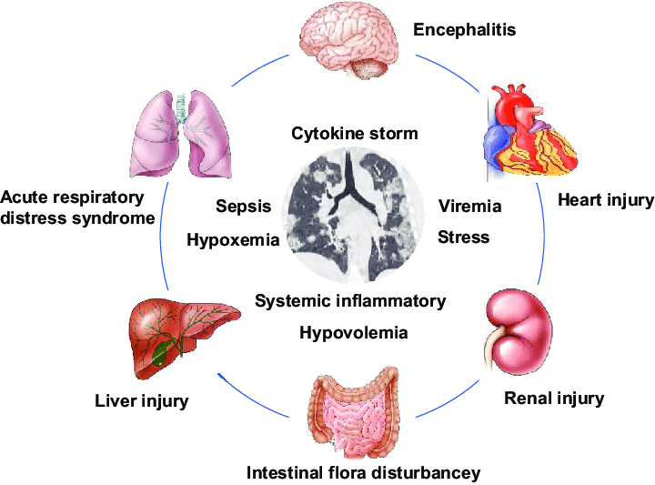
Complications :

Slide 14
ARDS occures in about 16% patients. About 20 to 30% requires intubation & mechanical ventilation.
Sequels of intensive care include infection with nosocomical pathogens,tension pneumothoraxfrom ventilation at high pick pressures & non cardiogenic pulmonary oedema.

Slide 15
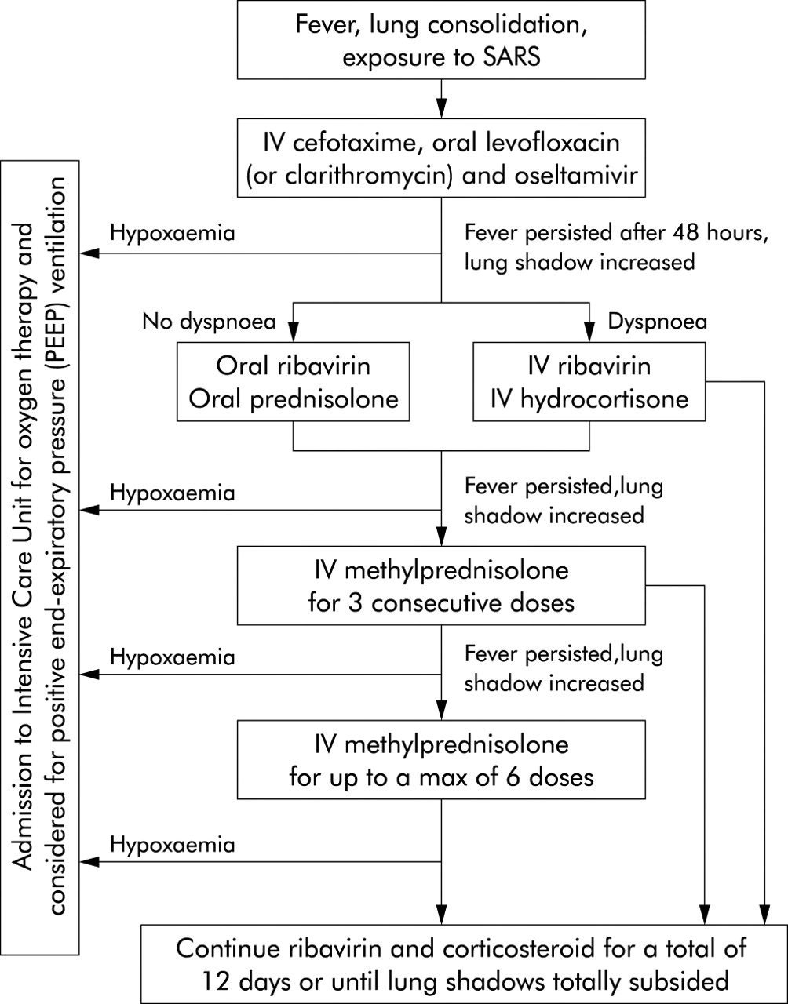
Treatment

Slide 16
Prognosis :

Slide 17
Prevention :

Slide 18
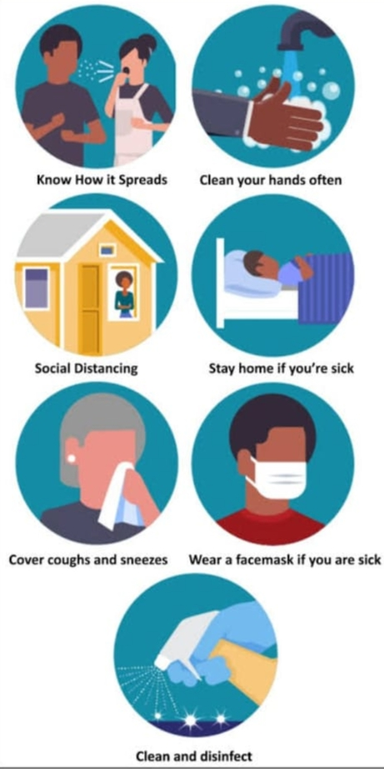
Prevention :

Slide 19
Thank you
Presented by : FAIZAH R. KHANWALA
(Student of final year at Ahmedabad homeopathic medical College)
Under guidance of : DR. TEJAL SHAH
(H.O.D & PROFESSOR)
(Community medicine department)

