Slide 1
Pregnancy and delivery

Slide 2
Pregnancy occurs in a woman due to embeding of a fertilised ovum or zygot deep in the endometrium of the uterus. The ovum is fertilised in the isthmus of the fallopian tube within about 12 to 24 hrs of ovulation and the fertilised ovum comes down in the uterine cavity by about the fourth day and its impregnation in the uterine wall occurs , after about 7 days of fertilisation. The fertilised ovum is known embryo up to 8 week after these period these is known as foetus.

Slide 3
Pregnancy continues normally for 9 month and 7 days from the date of lmp (last menstural period)

Slide 4
Medicolegal aspect of the pregnancy
A criminal cases
execution of death sentece == when a pregnant woman is awarded capital punishment after being convicted in a criminal case, the execution of the punishment may be deferred until 6 month pass after the birth of the child of the pregnant convicted and condemned woman, so that, she can rear the child till that period.

Slide 5
2 when a woman due to advance stage of pregnancy expresses her inability to stand the strain of trial in a criminal court, the trial of the case may be deferred to any future date.
3 when pregnancy is claimed to be the result of rape, kidnapping and seduction.
4 pregnancy in an unmarried girl of 16 yrs or less and in a married girl of 15 yrs or less point towards commision of the offence or rape

Slide 6
5 a pregnant woman (unmarried0 may bring charge of criminal breach of trust against a man, who alleegedly had intimate relationship with her with promise to marry her.
6 when a woman claiming to be pregnant by a man, tries to blackmail him on social grounds.
7 pregnancy of a woman, who had no access to her husband, within the reasonable period matching with the pregnancy, may be linked with charge of adultery against the man, who is responsible for the woman’s pregnacy.

Slide 7
8 prgnancy may be the cause of killing of unmarried woman or widow (homicide)
9 pregnant unmarried woman or widow may also commit suicide.
10 question of pregnancy is intimately related with abortion or concealment of birth cases.

Slide 8
B relating civil case
1 nullity of marriage== if at the time of marriage a woman is pregnant, then the marriage may be declared null and void.
2 if a woman had no access to her husband within the reasonable period matching with the duration of pregnancy then a decree of divorce may be allowed to the husband

Slide 9
3 inheritance of property when pregnancy is followed by the death of the husband, the widow may claim a greater share of the ancestral property of the husband.
4 in divorce cases pregnant women are allowed higher maintenance allowance.
5 compensation cases == death of the husband of a pregnant woman may allow her a higher compensation.

Slide 10
6 illegal pregnancy may causes baby illegitimate.
7 working pregnant women are allowed additional leave facility.

Slide 11
Diagnosis of pregnancy
after 1 months and 4 days the upt (urine pregnancy test) becomes positive the signs and symptoms of the pregnancy are as bellow
sign of pregnancy
1 amenorrhoea
After ovulation, there is formation of corpus luteum at the site of the ruptured graffian follicle of the ovary concerned. The function of the corpus luteum is to liberate certain hormons which prepares the endometrium for impregation due to hormons librates from it menstruation are prevented.

Slide 12
But amenorrhoea is not the result of pregnancy alone. In circumstances of hormonal imbalance some pathology in the ovary and the uterus, chronic debilitated condition like tuberculosis, carcinoma and psychological imbalance. Menstruation may cases temporarily and with menopause permanently.

Slide 13
2 changes in breasts
in pregnancy breasts enlarge. In the earlly period there are tingling and tense feeling on palpation, hypertrophied alveolar ducts give a nodular feeling. The shape is pendulous. Surface veins are prominent. Silvery striae may appear later. Areaola is enlarged darkly pigmented with montgomery’s tubercles (enlarged sebaceous glands). after 3 months of pregnancy colostrum is secreted from nipple when squeezing the brest.

Slide 14
Colostrum is a pale yellow secretion which contains free fat globules and large phagocytes containing fat globules. Some of the changes in breasts may occur in condition other than pregnancy, like ovarian tumour.
3 morning sickness.
A general feeling of indisposition, during the early hours of the morning is a common occurrence after pregnancy. This consist of lethargy, weakness sometime with feeling of heaviness in hands and legs.

Slide 15
4 vomiting
Mild degree vomiting and nausea is a common phenomenon in all cases of pregnancy partly during the early morning hours in some pregnant women however, there may be excessive vomiting , a condition known as hyperemesis gravidanum

Slide 16
5 pigmentation of selective parts of the skin
The eyelids the axilla and the areola of the breast darken during pregnancy
6 appearance of linea nigra
A vertical pigmented line appears over the midline of the abdomen, from umblicus to symphysis pubis.

Slide 17
7 striae gravidanum
Multiple transverse of oblique stipes appear over abdomen
8 increase in the frequency of micturition
Because of uterus is enlarge and give pressure on the urinary bladder so the frequency of the micturition is increase.

Slide 18
9 easy fatigue and irritable temprament are some of the addition non specific symptoms of pregnancy.
10 quickening === foetal movement inside the uterus starts and is appreciated between 16 to 18 week
11 desire for spicy food may be noticed from very early period

Slide 19
Jackquemier’s sign
This is the change in the vagina, mucus membrane is change from pinkish to bluish which occurs due to venous obstruction there is also simultaneous softening of the vaginal wall with increased secretion. These changes seen after 4 weeks of pregnancy.

Slide 20
B probable sign of pregnancy
1 enlargement of abdomen
with increase in the size of the foetus and the uterus, the abdomen enlarges. But this does not occur intill the duration of pregnancy is 12 week because, till this period, uterus remains in the pelvis below the level of the symphysis pubis. Then gradually the abdomen enlarges as the height of the uterus increases.

Slide 21
The enlargement of the uterus occurs for the rest of the period of pregnancy. Though during the last month the uterus drops to some extent with lowering of the height. Enlargement of abdomen,, is an important and essential change due to pregnancy but it is not specific of pregnancy. It may occurs due to ascitis. Due to any tumour in any organ inside the abdomen or may be even due to rapid obesity.

Slide 22
2 height of uterus
The increase in the size of the uterus follolws more or less a define rule during the period of pregnancy. Up to the 12 week of pregnancy it is not palpable per abdomen after 12 week it is just palpable just above the symphysis pubis. After 16 week it is just above the 2” above the symphysis pubis at the end of 20 week 2”inch below the umbilicus. At the end of 24 week, it is the level of umbilicus.

Slide 23
At the end of 28 week its just 2” below the xiphisternum. At the end of 36 week it is at the level of xiphisternum. At full term, it is again 2” below the xiphyisternum.
3 heigher’s sign == during the 2 month of pregnancy the body of uterus becomes soft . The cervix remains comparatively firm. Heigher’s sign is elicited by bimanual examination 2 finger of the one hand is placed at the posterior fornix and fingers of the other hand is placed over the midline just above the symphysis pubis. Fingers of both the hands are brought closer, when the isthumus the part of uterus is appreciated as soft compressible zone in between the very soft uterine body and firm and tough cervix below. Hegar’s sign becomes positive b y the end of 6 week of pregnancy.

Slide 24
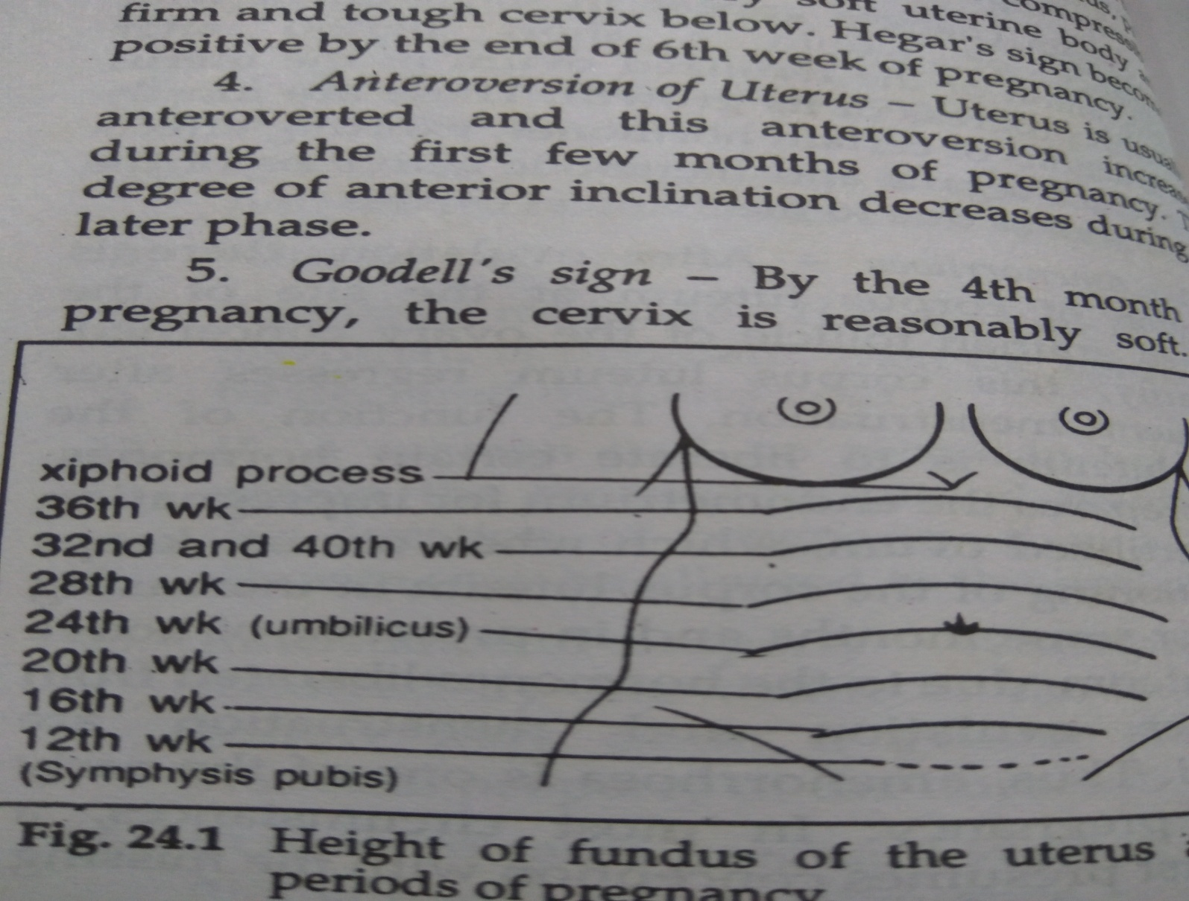

Slide 25
4 anteroversion of uterus
Uterus is usually anteroverted and this anteroversion increase during the first few months of pregnancy. The degree of anterior inclination decreases during the later phase. \
5 godell’s sign == by the 4 month after pregnancy, the cervix is reasonably soft. These changes starts occuring from the later part of the 2 month and reach its optimum by the 4 month by this time the external os is slightly enlarged in diameter. The change may occur in inflammatory condition of uterus and in case of new growth in the uterus.

Slide 26
6 uterine souffle == with increase in the size of uterus and the foetus inside, the circulation of blood in uterus is also increased. This increase in circulation causes flow of more amount of blood inside the uterus through the uterine vessels and thus, when the lateral aspects of fundus is ausculatated, murmur is heard, which synchronises with the mother’spulse beat.

Slide 27
7 ballotment == internal and external ballotment are objective signs of pregnancy, which can be elicited during the 4 or 5 months of pregnancy. Ballotment thests may be performed by external means as well as internal means accordingly, the tests are termed as internal ballotment test and external balllotment test. Inn ballotment test, actually the foetus is tossed in the amniotic fluid.

Slide 28
In the external ballotment test grip of 2 fingers is appllied over the lower part of uterus, the women beings in semi inclined position . As the foetus takes lowest position inside the uterus, in this posture of women, it is closer to the fingers by exerting trust with the help of the finger, the foetus can be made to move up in the amniotic fluide

Slide 29
Internal ballotment, the test is performed by pressing 2 fingers on 2 sides of the fornix and imparting a force for the upward movement of the foetus, which also resettles at the lower part of the uterus after a while. This test is give satisfactory results after 4 and 5 months of pregnancy.

Slide 30
8 braxton hick’s sign == after 15 to 16 week of pregnancy there is intermittent contraction and relaxation of uterine muscles. The duration of each contraction is for about a minute and the duration of relaxation is for about 5 minutes. The contraction is not a forceful one and is painless. Intermittent contraction may also occur due to other reasons of enlargemnt of uterus, including soft new grlowth.

Slide 31
9 test for human chorionic gonadotropin in the urine. == hcg can detected in the pregnant woman’s serum and urine. It becomes detectable by the 2 nd week of pregnancy and its concentration increases gradually with progress of gestation. The test for chorionic gonadotropin may be positive even up to 1 week after termination of pregnancy.

Slide 32
Biological test for the hcg
1 aschheim zondek test
in these test 4 ml morning urine of the pregnant women is injected subcutaneously, in the mouse, twice daily for the 3 days after lapse of another day,the mouse is sacrificed and the ovaries are searched for a haemorrhagic graffian follicle or corpus luteum, the presence of which is strongly indicative of pregnancy in the woman.

Slide 33
Disadvantage of the test is 5 days for complited these and each case, one animal has to be sacrificed.
B rapid rat test
In these test 2 ml of morning urine of pregnant women is injected intra peritoneally in rats. the rat is killed sometime after 4 to 5 hrs extreme congestion of the ovaries indicates presence of hcg in the urine.

Slide 34
Disadvantage is sacrifice of the animal
C friedman test or female rabbit test
An immature female rabbit of about 3 month old is selected and 5 ml of morning urine of the women is injected in the vein of its ear for 2 consecutive days and on the 3 day the rabbit is killed and the ovaries are searched for presence of hemorrhage or ruptured graffian follicle, which indicates pregnancy in women

Slide 35
Hogben test or female tod test
matured female xenopas toad lay eggs anytime when stimulated for the same and if it gets a moist place for laying eggs, hcg acts as the alternative of mating as a stimulus. About 5 ml of the morning urine of the woman is injected in the dorsal lymp sac of the toad and it is kept confined with a bell zar or some such thing,, on a moist place. If the urine of the woman contains hcg then the toad ovulates within 8 to 10 hrs.

Slide 36
Advantage == this test has an advantage over the 3 tests described above. Here the animal is not to be sacrificed on completion of the test. The toad can be used for several test, each time after effect of hcg is over. 2 it take moderate time for completion of test of pregnancy.

Slide 37
Gallimainini test or male toad test
It is the most popular one of the biological tests for pregnancy. Rana tigrina and rana hexadactyli are the two varieties of male toads, which are most suitable for the test.
preparatory testing of the toads
Urine of toad, free from spermetozoa is there then 5 ml of filtrated morning urine of the women in its dorsal sacs. After an hour or two , another sample of urine is taken and is subjects to microscpical examination if the urine which was free from spermetozoa before injection, shows presence of spermatozoa after 1 to 2 hrs of injection, the presencce of hcg in the urine of the woman is indicated and pregnancy is strongly suspected. To infer a result, another sample of urine after another 2 hrs should be examined.

Slide 38
Advantage ==1 time necessary for completion of the test is reasonably short 2 the same animal is ready for the next test again just after about 24 hrs.
Disadvantage === this test is also positive in case of hydatidiform mole and chorion epithelioma. To exclude these two possibilities, instead of concentrated urine, dilute urine in different gradations of titration may be used, when we get positive result with high dilution of urine then, that is suggestive of hydatidiform mole or chorionepithelioma.

Slide 39
Serology test for pregnancy
a haemagglutination inhibition test\
Material required
1 rbc, sensitized to antibody of hcg hormone, 2 anti hcg factor (antibody)
3 morning urine sample of the supposedly pregnant woman.

Slide 40
The test is performed in a tube 1 and 2 are mixed in a test tube of 5 mm diameter. If the woman is pregnant and her urine contains hcg then, on addition of urine in the tube the antibody i.e. anti hcg factor will be neutralised and the cells will then, gradually settle at the bottom around the ridge making a reddish circle. If there is no hcg in then urine then the anti hcg factor will not be neutralised and it will cause clumping or agglutination of the rbc and there is no red ring formation at the bottom.

Slide 41
B direct agglutination test for presence of hcg in urine with latex particles – latex particles are coated with anti hcg antibody. This is taken on a glass slide. Then 1 drops of morning urine of the woman is added to kit in case of pregnancy, the urine containing hcg hormone will react with the anti hcg antibody on the surface of the latex particles and there will be clumping of the particles.

Slide 42
C indirect agglutination inhibition test
In this test, the latex particles are coated with hcg. The morning urine is first treated with anti hcg antibody. To this mixture above mentioned latex particles coated with hcg hormone is added. If the urine of the woman contains hcg due to pregnancy then that will neutralise the anti hcg antibody after initial mixing of the two. If the urine does not contain hcg, ,then anti hcg antibody remains active and when the latex particles coated with hcg hormone are added at the 2 nd stage of the test, then due to the active antibody present, there will be agglutination of the latex particles.

Slide 43
Radio immunoassay and ELISA test can also detect pregnancy with high degree accurancy but chance of error cannot be eadicated completely.

Slide 44
C positive sign of pregnancy
1 auscultation of foetal heart sound
Heart sound aare detectable after 18 to 20 week of pregnancy. The rate of foetal heart beat is about 160/min at the early phase and about 120/min near the terminal phase of pregnancy.
foetal heart sound is absent in
1 before 18 week of pregnancy
2 when foetus dies inside the uterus
3 very obese women
4 hydramnios cases where there is excess of liquor amnii.

Slide 45
2 palapation of foetal part per abdomen is a positive sign of pregnancy from 4 month onward
3 perception of foetal movement is possible from 5 th month of pregnancy.
4 shadows of foetal bones by xx ray examination are available after 3 month
5 ultra sonography this can diagnose pregnancy of 6 week duration and above.

Slide 46
Sign of pregnancy in dead subject
in dead subjects, in addition to external physical changes, internal examination showws
1 enlarged uterus
2 a corpus luteum in an ovary in its progressive or regressive phase
3 product of conception,, either in the form of an embryo with decidual changes in the endometrium or, in the form of a foetus, plcenta, etc.

Slide 47
Superfoetation
This is a type of twin pregnancy where, during the continuation of pregnancy an ovum is liberated in a subsequent cycle which gets fertilised followed by progressive development of both the fertilised ova. In such a condition one foetus always remains more matured and developed than the other. Delivery of both foetues may occur in a single labour when one baby is perceivably larger and more developed than the other.

Slide 48
Superfecundation
In cases, where tow ova are discharged at a time in one ovulation period, the two ova may be fertilised by sperms of two different acts of coitus, occurring within a short period. The two fertilised ova grow simultaneously, though one may grow larger at the cost of other . There being two placentas, circulation through one placenta may be better than the other.

Slide 49
Medico legal aspect of superfoetation and superfecundation
These conditions are essentially twin pregnancies and being essentially the twin pregnancies and being essentially the product of two separate sexual contacts, gross variation between the complexion and other features in the appearance of the two babies after birth gives rise to the doubt of adultery and paternity of either or both the babies may be disputed.

Slide 50
Psudocyesis
This means false pregnancy, when the woman believes that she is pregnant. She presents many sign of pregnancy like enlarged abdomen due to disposition of fat or some pathological condition like ovarian tumour. Women may having imaginary or false feeling of movement or the foetus inside. This condition is seen in women who strongly desire for a child

Slide 51
Pregnancy without knowledge of the pregnant women
just in contrast with the condition of pseudocyesis, a pregnant woman may be ignorant of her pregnancy and may even go to labour without clear of knowledge of the same beforehand.

Slide 52
Maximum and minimum period of pregnancy
Though normal period of gastation is about 280 days a woman may over carry the foetus to postmaturity up to the extent of a total period of gestation of more than 320 days, and even up to about 350 days, with the foetus being alive birth being possible up to that extent.

Slide 53
Expulsion of prematured foetus may occur at any period before full term. But to have a live birth of a viable foetus, delivery should occur after 210 days of pregnancy. Foetuses born alive, after 180 days of pregnancy may surivifve if proper care can be taken.

Slide 54
Viability
Of a child means, capability of a foetus to lead a separate life after birth, ordinarily, a foetus becomes viable after 210 days of pregnancy but foetus born alive earlier can also be made to survive with proper care.

