Slide 1
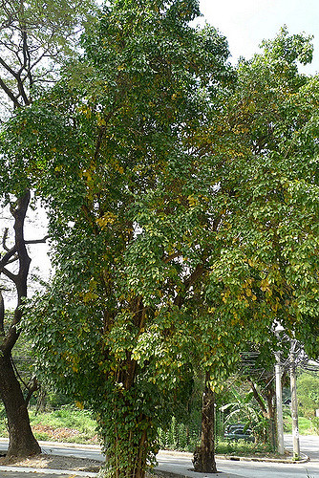
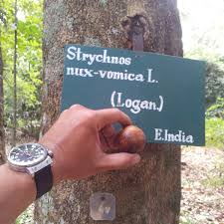
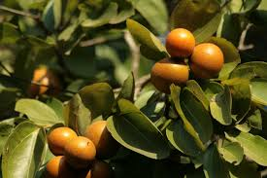
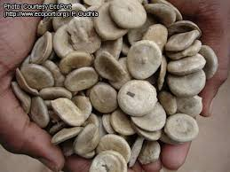
Learning NUX VOMICA through some interesting proverbs Loganeaceae
sriharithareddy.ambala@gmail.com

Slide 2
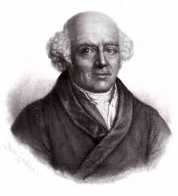
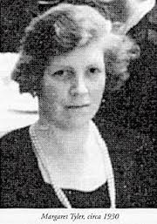
Nux.v- A great Polychrest
Dr. Hahnemann, writing about Nux vomica, tells us that there are just a few medicines whose symptoms are so similar to those of the common ailments, that they are very frequently found useful. These he terms the Polychrests – drug of many uses.
Dr. M. L. Tyler says ‘No household should be without its little homoeopathic medicine chest for common ailments, and no homoeopathic medicine chest should be without Nux’.
The nursery medicine chest when we were children contained Nux vomica, and the nurses were not far wrong when they dubbed it “temper medicine”.

Slide 3
Name POISON NUT it self telling that it is a strong poison and C. Coulter says ‘STRONGEST POISONS MAKE THE BEST MEDICINES’
Meaning- Nux vomica- stops vomiting so called as Vomiting nut.

Slide 4
Alkaloids – strychnine, brucine – gives bitter taste, bark is also bitter – pt has bitter taste in mouth.
Seeds contain copper ->> which is known for cramps- It produces irritability and spasms / muscle contractions – constriction sensation found all through the remedy- spasm of colon, limbs and spine, spasmodic labour pains, spasms of coughing, sneezing, hic coughs, sleeps by fits and starts, hysterical out- bursts- spasmodic immoderate laughter.
Becomes important remedy in convulsions which are re- excited by impressions made on senses – touch, light, sounds, odors.

Slide 5
The cleanser
Nux vomica is the opening remedy- for those cases where patient must be cleaned of the ill effects of previously used medicinal drugs- ‘drugged by mixtures, herbs, pills, and all kinds of quack medicines’ (H.C.Allen), hallucinogenic drugs
and also for homoeopathic over medication- sensitive to medicines – (Kent)
Sulphur is - for steroids, repeated course of antibiotics prescribed for relapsing conditions

Slide 6
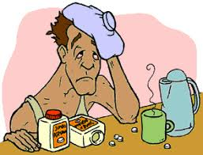
Nux v is ultimate hangover remedy
Mania in potu – acute exacerbation of alcoholism (euphoria)
Dipsomania (morbid addiction/craving for alcohol)
Delirium tremens (withdrawal effect of alcoholism)

Slide 7
Quick and efficient, the shortest distance between two points is a straight line
Nux vomicas are
Challenging
Their goals are well organised- perfectly planned and scheduled – to reach their destination
Accurate
Most disciplined way. Punctual.
Honest
Hard working. No softies. “Better be realistic” –is their MOTTO
Equally sympathetic – but don’t show it out

Slide 8
Action speaks louder than words
What you do carries more weight than what you say.
Nux vomica people set high demands for themselves and their employees..
More impressed with sincerity, than merely sitting and talking about.
He is a Good leader, doesn’t tell his team how things should be done, he shows them.
Enormous desire to work, and their assertiveness – driving forces within an organisation or family

Slide 9
AN OBSESSION WITH EXCESS – passion
THEY LIVE FOR WORK.
They say – ‘The devil finds work for idle hands’ (If some one doesn’t have enough work to occupy them, they are liable to cause or get into trouble)
They don’t like to waste their time. They always have better things to do.
They feel that they are valued only when they are achieving

Slide 10
If a job is worth doing, its worth doing well-
It is his Professed creed (fact of belief) – serious determination towards task
Fastidious
Too much of a good thing - an obsession instead of a virtue.
In this imperfect world, the individual is never at peace with himself and becomes nuisance to others, who heartily wish for some liberating dirt and disorder.
“A penny saved, is a penny earned or gained”

Slide 11
Longest memory but shortest temper….
Irritability- aversion to company. Desires solitude. Fault finders (ego), but repugnance of conversation. Aggravation from consolation.
Impulse – from consciousness of committing crime: and which urges even to commit to Suicide but fear of death - (but cannot commit to suicide because of super ego)

Slide 12
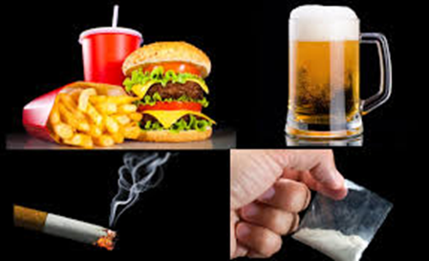
Mr. perfect with all bad habits..
Intelligent, capable, hyperactive, impulsive, competitive overly confident -> ego ->> hates loosing/ fear of failure/hurried ->> thwarted ambition ->> stress ->> insomnia -> touchiness- explosive temper ->> break things out of frustration.
Need for a constant recharging of energy >> attracted to the use of all forms of stimulants (high living) >> tobacco, alcohol, coffee , spicy food (making him dyspeptic), tea, sex(makes him impotent) >> hypersensitivity of special senses (primary action) >> system get disturbed easily by external influences

Slide 13
Allen says - oversensitive to external impresions; to noise, odors, light or music. Touchiness- Trifling ailments are unbearable, every harmless word offends.
Tendency to faint (Nux m., Sulph.); from odors; in morning; after eating; after every labor pain.

Slide 14
Body suffers..
Stimulants and Medications ->> system gets injured / breakdown ->> cannot perform eliminative functions properly->> inability to vomit, inability to void urine or stool completely – IRREGULAR / ANTI PERISTALISIS
Alcohol- stomach absorbed- liver cells deranged- hepatic portal system effected- stasis- haemorrhoids- deranged digestion- heaviness – no stool still urging

Slide 15
Absent minded-
Incapacity for meditation
Tendency to misapply words when speaking
Difficult in finding suitable expression
Mistaking weights and measures
Frequent confusion when writing with omission of syllable's or entire words

Slide 16
This can happen to anybody !!!
This is Vicious cycle – Person burn out with out a dose of Nux Vomica.
This is the reason why nux vomica is currently such an important and frequently prescribed remedy not just for nux vomica people but also who finds themselves in a (acute) nux vomica state after too much stress, with little relaxation.

