Slide 2
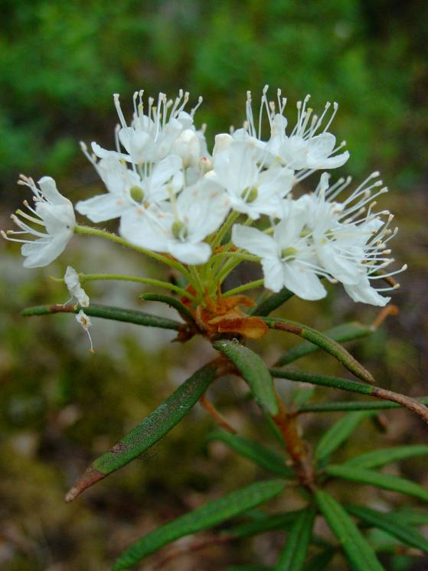
LEDUM PALUSTRE
Common name:- Wild Rosemary, Marsh tea & Labrador tea.
Proved by:- Dr. Hahnemann
Family:- Ericacea

Slide 3
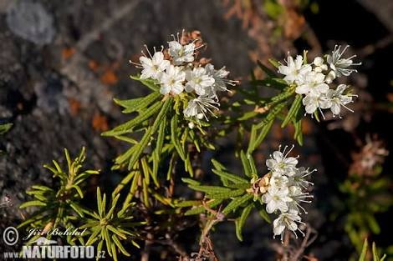
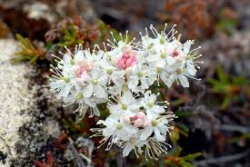

Slide 4
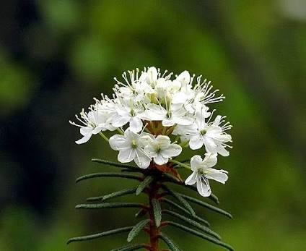
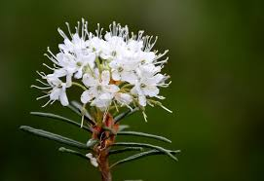

Slide 5
Introduction
It is a remedy gifted by the vegetable kingdom; particularly so from a wild plant which normally has no utility. But hahnemann found its usefulness in injury, skin affections, rheumatic & gouty complaints.
In rheumatic diathesis this remedy going through all the changes, from functional pain to altered secretions and deposits of solid, earthy matter in tissue.
It is antidotal to Lachesis, to the poison of insects to the poison of Apis& to animal poison. Dr. Kent described Ledum pal in his lectures as “ REMEDY FOR SURGEON.”
Hahnemann says, “It is suitable for the part, only for the chronic maladies in which there is a predominance of coldness & deficiency of animal heat.”

Slide 6
Key- notes
Extremely cold feeling of the body surface due to lack of vital heat; warmth aggravates, relieved by application of cold.
Adapted to people of rheumatic diathesis and to constitutions abused by alcohol.
Acute& Chronic rhematism, gradually ascending, affinity for smaller joints.
Gouty nodosities & ‘Gout-stones’
Arthritic fever, on exposure to cold, chills are very violent.
For punctured wounds or bites of animals& insects, for injuries leaving long lasting discolouration.

Slide 7
Constitution
Consideration of constitution is not important, as it is an acute drug.
Ledum patient is very chilly, with psoric & syphillitic background.

Slide 8
Sphere of action
Its seat of action in mainly on skin, serous and mucous membrane, fibrous tissues, circulatory system and joints.

Slide 9
Pathogenesis
The action of Ledum on skin retards capillary circulation, especially on the external surface of the body and the extremities, resulting in coldness of the surface & due to its affections on the fibrous tissues & joints, joints are enlarged and become the seats of nodosities and “Gout-Stones”.

Slide 10
Guiding Symptoms
General lack of animal heat, yet heat of bed is intolerable. The patient is unnaturally cold.
Cold to touch, but not cold subjectively to patient.
The very striking feature is INSPITE OF COLDNESS OF THE BODY, THE SYMPTOMS ARE RELEIVED BY COLD APPLICATION.
Relief from cold is so prominent that sometimes the only amelioration is obtained by putting the feet in ice-cold water.
Swelling & shooting pain in knees when walking.
Stiffness of all joints, can only move them after applying cold.
Rheumatism or gout in lower limbs which ascends.

Slide 11
Punctured wound:- From sharp pointed instruments, as awls, rat bites, nails, particularly if the wounded parts are cold.
A/F :→ Abuse of alcohol, injuries from sharp, pointed instruments.

Slide 12
PARTICULARS:- “EYES”
Haemorrhage into interior chamber of eyes after iridectomy.
Cataracts with gout.
Aching in eyes.
Extravasation of blood in lids, conjuctiva.

Slide 13
“FACE”
Red pimples on forehead & cheeks, stinging when touched.
Crusty eruptions around nose & mouth.
Puffed & bloated appearance of face as like Lachesis patient.

Slide 14
“FEVER”
It is an excellent remedy in arthritic fevers brought on by exposure to cold.
The chills are very violent. He shivers with chilliness.
HE FEELS AS IF COLD WATER WERE POURED OVER THE WHOLE BODY.
Heat of the body becomes excessive but it is characterized by an intolerance of warmth of bed & a distended condition of the veins of the hands.

Slide 15
“INJURY”
Punctured wounds: by sharp pointed instruments, as awls, rat bites, mosquito bites.
Punctured wounds anywhere on the body.
Pain as if the whole body is bruised & beaten. (Arn.)
Pain in ankles as if sprained or from false step.
Pains are sticking, tearing & throbbing type.
< - by motion& at night, by warmth of bed & covering.
Long remaining discolouration after injury.
Black & blue places become green.

Slide 16
>- by applying ice-cold water.
Emaciation of affected part.
Parts are very cold to touch but not cold subjectively to the patient.

Slide 17
“SKIN”
A/F due to injury, loss of vital heat.
Acne on forehead
Facial eczema
Itching on feet & ankle.
Red pimples or tubercles on forehead & cheeks as in brandy drinkers, stinging when touched.
Pain as if whole body is bruised & beaten.
Swelling of feet upto knees with unbearable pain, when walking, as from sprains or false step.
Ball of great toe is swollen.
Painful heels as if bruised

Slide 18
< - at night, from heat of bed, by scratching
> - by cold water.

Slide 19
“RESPIRATORY”
Burning in nose
Dyspnoea
Cough with bloody expectoration
Chest feels constricted
Suffocative arrest of breathing
Pain along trachea
Bronchitis with emphysema of aged
Oppressive constriction of chest
Tickling in larynx
Spasmodic cough

Slide 20
Haemoptysis alternating with rheumatism.
Whooping cough
DOUBLE INSPIRATION WITH SOBBING.

Slide 21
“RHEUMATISM & GOUT”
Applicable in both acute & chronic rheumatism.
A/F due to alltered secretion & deposit of solid substances, like uric acid, sodium biurate & other crystals in tissue.
Rheumatic diathesis, have “Gout-stones” i.e. stones in joints like wrist, fingers, toes.
Throbbing pain especially in left shoulder.
Tearing pain & sticking pain in left shoulder & right hip joint.
IN ACUTE TYPE:-
Joints are swollen & hot.

Slide 22
Inflammed part are red or pale.
< - at night
Patient can’t tolerate heat of bed & wants to uncover.
IN CHRONIC TYPE:-
Joints are swollen & very painful.
Painful hard nodules, first in joints of feet and then in hands.
Periosteum of phalanges is very painful on pressure.
Usually it affects the left shoulder & right hip.
The ankles & soles are very painful & sensitive; can hardly step on them.
There is swelling with shooting pain in knees when walking.

Slide 23
Stiffness of all joints ; can only move them after applying cold water.
Rheumatism & gout begin in lower limb and ascend.
Swelling of feet upto knees with unbearable pain when walking as from sprain or false step.
Ball of great toe swollen & painful.
Pain in heels as if bruised.
<- At night, from heat of bed & on walking
> - From cold, holding feet in ice-cold water.
The only peculiarity is that in spite of extreme cold sensation, he is relieved by application of cold.

Slide 24
Dr. Clarke has a patient with rheumatism in the left arm.
This patient used to take cold baths at night to be rid of the pain and this alone enabled him to sleep.
So, according to this PQRS symptom Ledum was given and that cured the whole case.

Slide 25
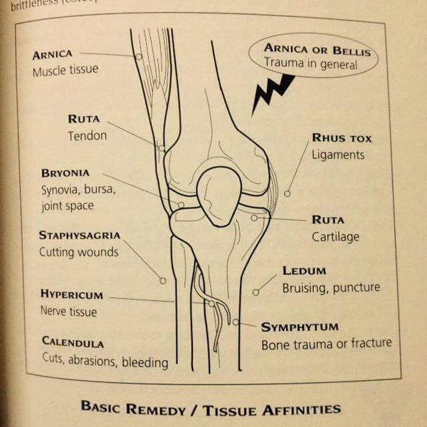
Differentiation of joint affinity of different drugs

Slide 26
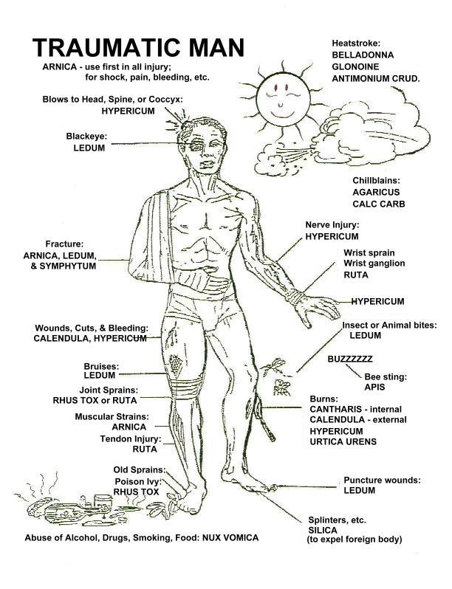
Differentiation of injury drugs

Slide 27
Remedy relationship
ANTIDOTE:- Camphor
LEDUM IS ANTIDOTE OF:- Apis, China

Slide 28
Difference of Ledum & Arnica injury
Ledum palustre
Arnica Montana
A/F:- Punctured wound by sharp pointed instruments, as nails, rat& mosquito bites.
Pain as if the whole body is bruised & beaten.
Haemorrhage in interior chamber of eyes after iridectomy. Contusion of lids.
Black & blue parts become green with long standing discolouration.
< - by motion, at night, by warmth of bed& covering.
>- by applying ice-cold water.
A/F:- Results from blow, fall, contusion, traumatic& mechanical injury, injury from blunt objects.
SORE, LAME, BRUISED FEELING ALL OVER THE BODY AS IF BEATEN.
Injury to conjuctiva & retina due to coughing with extravasation of blood.
Affected part becomes blue & black.
<- From least touch, motion, rest, in damp cold weather.
>- from lying down.

Slide 29
Difference of Ledum & Calendula injury
Ledum Palustre
Calendula Officinalis
A/F:- Punctured wounds, by any sharp instruments, as nails, rat bites or mosquito bites.
Punctured wounds anywhere on the body.
No need of plaster but the pain is like as if whole body is bruised &beaten.
Part becomes emaciated.
<- by motion, by warmth of bed.
A/F:- Clean cut injury, amputation, surgical operation, lacerated wound etc.
Rupture of the muscles & tendons, laceration, perineal tear during labour.
Calendula is effected in cases when union is not effected by adhesive plaster.
For old, neglected injuries where part threatening to gangrenous condition.
<- in damp cloudy weather.

Slide 30
Difference of Ledum & Hypericum injury
Ledum Palustre
Hypericum
A/F:- Punctured wound, by any sharp instruments as nails, rat bites, mosquito bites etc.
Punctured wounds anywhere on the body.
Pain as if whole body is bruised and beaten.
Emaciation of the affected part.
<- by motion, at night, by warmth of bed and covering.
>- by applying ice-cold water.
A/F:- Mechanical affection of spinal cord, bad effects of spinal concussion, fall on coccyx.
Injuries of parts which are rich in SENTIENT NERVES such as fingers, toes.
Intolerable pain that patient screams and cries with pain.
Soreness of the affected part.
<- in cold dampness, in fog, in a closed room, least exposure, touch.
>- bending head backwards.

Slide 31
Sources :-
Pocket manual of Homoeopathic materia medica → By William Boericke
Text book of Materia medica → By S. K. Dubey
Study on materia medica → By N.M. Chaudhary

Slide 32
THANK YOU

