Slide 1
PRESENTATION
On PULMONARY TUBERCULOSIS
By dr. Anjali sharma

Slide 2
PULMONARY TUBERCULOSIS (PHTHISIS)
An infectious disease that may affect almost all tissue of the body.
This is the disease of lungs, pleura and mediastinal lymph nodes caused by Mycobacterium tuberculosis.
It is a classical example of Chronic Granulomatous Inflammation.
Disease usually affects the lungs but in one – third of cases other organs are involved.
If untreated , disease may be fatal within 5 years.

Slide 3
CAUSATIVE ORGANISMS
Mainly caused by :-
Mycobacterium tuberculosis
Mycobacterium bovis
Mycobacterium africanum
Mycobacterium microti

Slide 4
PREDISPOSING FACTORS
AGE - Age is an important determinant of risk all ages but highly susceptible below 3 years.
DEVITALIZED CONDITION – Chronic malnutrition , Diabetes , HIV infection.
ECONOMIC STATUS – Common in poor countries immigration from higher prevalence areas ,poor sanitation, overcrowding.
GENETIC FACTOR .
ADDICTION TO TOBACCO AND ALCOHOL.
DRUG RESISTANCE .
HIV INFECTED PATIENTS .
CLOSE CONTACTS OF PATIENTS WITH SMEAR POSITIVE PULMONARY TB.

Slide 5
MODES OF TRANSMISSION
Inhalation of organism(common)
Ingestion
Inoculation into skin(rare)
Transplacental route-congenital TB in foetus from infected mother.

Slide 6
SPREAD OF TUBERCULOSIS
Local spread :- Takes place by macrophages carrying the bacilli into surrounding tissue.
Lymphatic spread :- Primarily an infection of lymphoid tissue . Bacilli may pass into lymphoid follicles of pharynx , bronchi , intestinal and regional lymph node resulting in regional TB.
Haematogenous spread:- Drainage of lymphatics into venous system due to caseous material escaping through ulcerated wall of veins.
By Natural Passage :- It can spread into pleura, adjacent lung segments, peritoneal cavity and other body party to primary site.

Slide 7
PATHOLOGY AND PATHOGENESIS
M.tuberculosis spread by inhalation of droplet
Smallest particles (1-5µm) entered the periphery of lung
Engulfed by macrophages
CD4+ T lymphocytes produce cytokine in response to antigen presentation
Recruitment of monocytes and formation granuloma
Limiting the replication and spread of organisms

Slide 10
TYPES OF TUBERCULOSIS
There are 2 types of TB:-
PRIMARY TUBERCULOSIS
SECONDARY TUBERCULOSIS

Slide 12
PRIMARY TUBERCULOSIS (Ghon’s complex/Childhood TB)
The infection of an individual who has not been previously infected.
An initial infection with tubercle bacilli.
most commonly involved tissue for primary infection are peripheral lungs and hilar lymph nodes. Infection localized to the middle and lower lung zone.
Lesion produced in the tissue of portal entry with foci in the draining lymphatic vessels and lymph nodes.
When healing takes place by calcification , pulmonary component can be seen as opaque spot on X- Ray it is known as Ghon Focus.
Incubation Period :- 4-8 weeks.

Slide 13
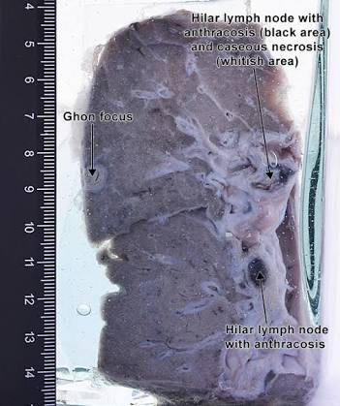
GHON’S COMPLEX

Slide 14
COMPONENTS OF PRIMARY COMPLEX
PULMONARY | LYMPHATIC VESSEL | LYMPH NODE
1-2 cm lesion in the peripheral part of lung mostly located in the upper part of lower lobe . | The lymphatic draining the lung lesion developed beaded, miliary tubercles along the path of hilar lymph node. | Consist of hilar and tracheo-bronchial lymph nodes in the area drained. Affected lymph nodes are matted and show caseation necrosis.

Slide 16
CLINICAL TYPES WITH
FEATURES
ASYMPTOMATIC | FEBRILE | ALLERGIC | PROGRESSIVE
Commonest type. 75-80% off all cases. Mantoux test positive.( evidence of past infection) X-Ray – Ghon’s Focus. | Fever ranging from 100-103.F lasting for 1-2 weeks. WBC count -Normal , ESR- high. | Patient may show erythema nodosum or phyctenular keratitis, conjunctivitis or both . Sometimes allergic bronchospasm. | Patient may develop tuberculous pneumonia, broncho -pneumonia , pleurisy, pleural effusion, miliary TB, tuberculous meningitis, lobar or segmental collapse or post-primary TB.

Slide 17
FATE OF PRIMARY TUBERCULOSIS
The lesion do not progress but instead heal by fibrosis than calcification and even ossification.
Sometimes it changes into progressive primary TB in which primary focus continue to grow.
At times it spread by haematogenous route to other tissues and organs like liver, spleen, kidney, brain and bone marrow called primary miliary TB.
In increased hypersensitivity of the host, healed lesions are activated and cause progressive secondary TB and affect children more commonly.

Slide 18
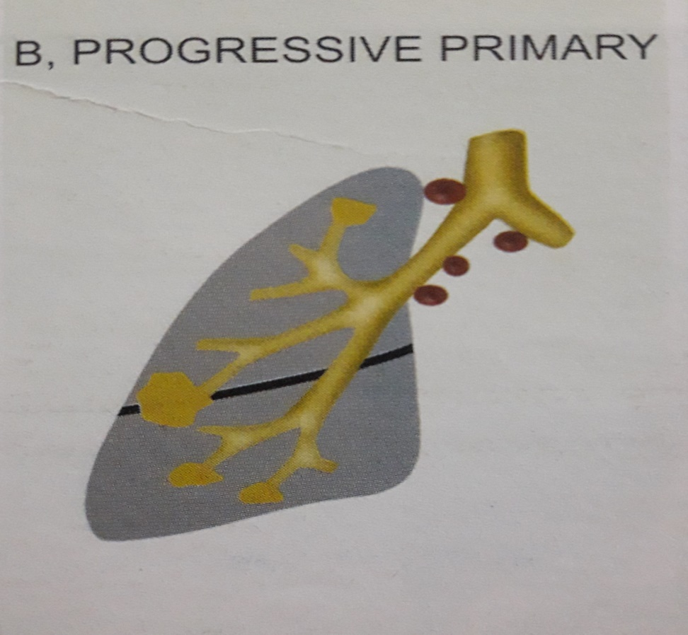
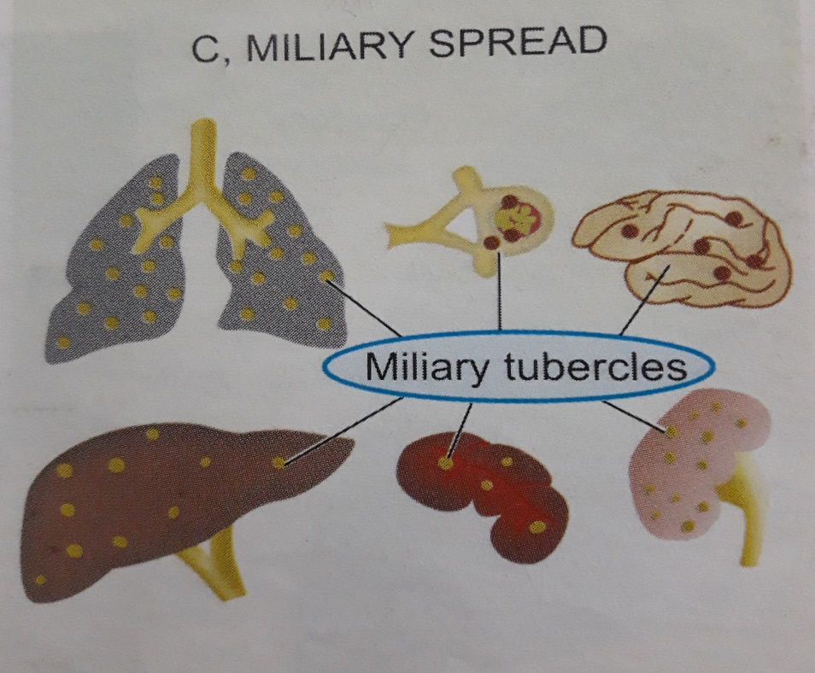
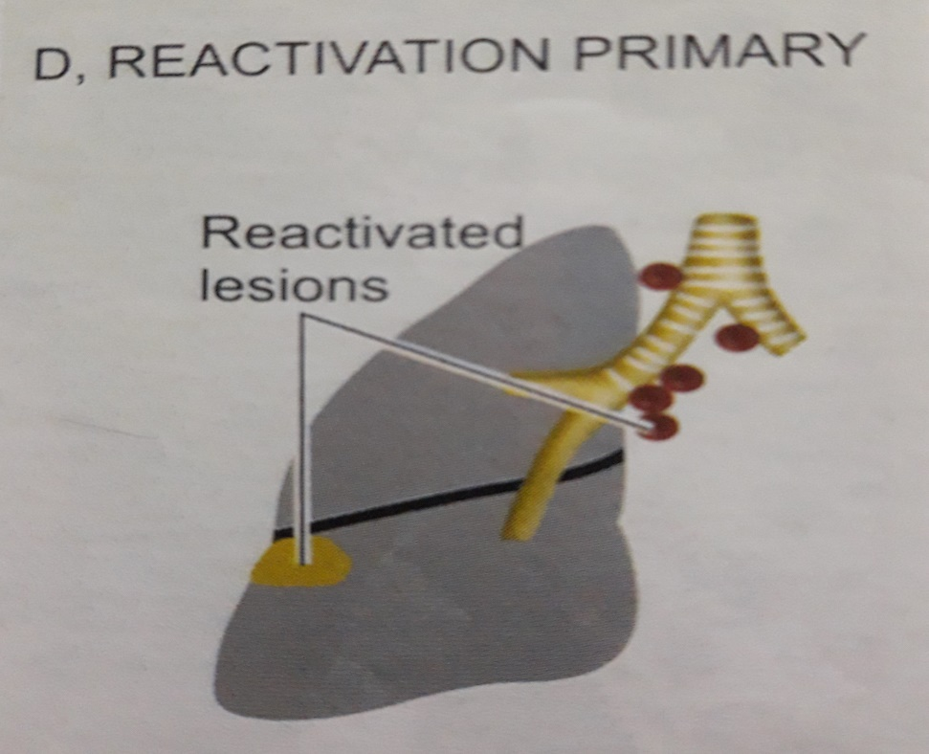

Slide 19
SECONDARY TUBERCULOSIS (Post Primary TB/Adult type)
It occurs:-
A) Directly from a primary lesion.
B) From endogenous reactivation of primary lesion.
C) Reinfection after primary lesion has been completely healed up.
Characteristic lesion of secondary TB is a cavity in lungs.
It begins as a small caseo-pneumonic focus in apical and posterior segment of the upper lobe and superior segment of lower lobe.
The lesion usually begin as 1-2 cm apical area of consolidation of the lung.

Slide 21
It spreads by lympho-hematogenous mode of primary complex to the apex of affected lung where oxygen tension is high and favorable for growth of aerobic tubercle bacilli.
The extent of lung parenchymal involvement varies greatly , from small infiltrates to extensive cavitary disease resulting in satellite lesions within lungs.
Massive involvement of pulmonary segments or lobes, with coalescence of lesion, produces TUBERCULOUS PNEUMONIA.

Slide 22
CLINICAL FEATURES
Constitutional symptoms
- Weakness
-Lassitude
-Malaise
-Night sweating
-Weight loss
-Loss of appetite
-Evening raise of temperature
-Palpitation
-Menstrual disturbance
-Rapid emaciation
Local Affections
-Cough
-Chest pain
-Sputum
-Hemoptysis :-
Ulceration of bronchial mucosa
Rupture of congested vessel
Cavitary lesion

Slide 24
FATE OF SECONDARY TUBERCULOSIS
The lesion may heal with fibrous scarring and calcification.
The lesion may coalesce together to form larger area and produce progressive secondary pulmonary Tb with following pulmonary and extra pulmonary involvement:
Fibro-caseous tuberculosis.
Tuberculous caseous pneumonia.
Miliary tuberculosis.
Tuberculous empyema.

Slide 26
NATURAL HISTORY OF UNTREATED PRIMARY TUBERCULOSIS
TIME FROM INFECTION | MANIFESTATION
3-8 WEEKS | Primary Complex, Positive Tuberculin Test
3-6 MONTHS | Meningeal, Miliary and pleural disease
UPTO 3 YEARS | Gastro- intestinal ,Bone and Joint and Lymph Node Disease
AROUND 8 YEARS | Renal Tract Disease
FROM 3 YEARS ONWARDS | Post primary disease due to reaction and reinfection.

Slide 27
CHRONIC COMPLICATION OF PULMONARY TB
PULMONARY :
Massive haemoptysis Cor pulmonale Emphysema Pleural calcification Obstructive airway disease Bronchiectasis
NON PULMONARY :
Laryngitis Amyloidosis Poncet’s polyarthritis

Slide 28
EXTRAPULMONARY SITES

Slide 29
DIAGNOSIS OF TUBERCULOSIS
1.RESPIRATORY
Sputum
Gastric washing(children)
Broncho-alveolar lavage
Trans-bronchial biopsy
2.NON RESPIRATORY
Fluid examination (cerebrospinal , ascitic , pleural , pericardial and joint).
Tissue biopsy (from affected site).

Slide 30
INVESTIGATIONS
AFB microscopy of diagnostic specimen.
Mycobacterial culture- definitive diagnosis depends on the isolation and identification of M.tuberculosis from diagnostic specimen(sputum).
Molecular method such as PCR.
Complete haemogram (lymphocytosis & raised ESR)
Radiographic procedures e.g. Chest x-ray – shows bilateral upper lobe infiltrate and cavities.
Serological test.
Fine needle aspiration cytology(F.N.A.C.) is confirmation of diagnosis.

Slide 31
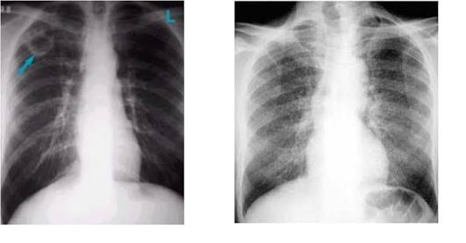

Slide 32
MANTOUX SKIN TEST
Done by intradermal injection of 0.1 ml of tuberculoprotein , purified protein derivative.
Delayed type of hypersensitivity develops in individuals who are having or have been previously infected with tuberculous infection which is identified as an indurated area of more than 15 mm in 72 hours.
Reaction larger than 15 mm is unlikely to be due to previous BCG vaccination.
Patients having disseminated tuberculosis may show negative test.
A positive test is indicative of cell mediated hypersensitivity to tuberculous antigens but dose not distinguish between infection and disease

Slide 33
DIFFERENTIAL DIAGNOSIS
Tuberculosis can be differentiated from following diseases:-
Sarcoidosis
Pneumonia
Occupational Lung disease
Asthma
Disease of Pleura
Bronchiectasis
Pulmonary Hypertension
Pulmonary Embolism
Lung Cancer

Slide 34
Sarcoidosis | Occupational Lung Disease | Pulmonary Embolism
An inflammatory disease characterize by the process of non- caseating granuloma. Its cause is unknown but it is hypothesize that it is Mycobacterium and fungal infection. Cough, dyspnea are the most common presenting symptoms. Patient presents with a 2-4 week history of symptoms. Non specific constitutional symptoms are fatigue, fever, night sweat, weight loss. Chest roentgenogram, CT- scan ( peribronchial thickening is seen). | It mainly includes pneumoconiosis and silicosis. Its characteristic pathological features are focal and interstitial fibrosis, centrilobular emphysema and progressive massive fibrosis. Its symptoms are breathlessness and cough, melanoptysis (black cough). Multiple well circumscribed 3-5 mm nodular opacities n mid and upper zones are seen in CXR. | Arise from the propagation of lower limb deep vein thrombosis due to pulmonary artery occlusion or right heart failure. Its symptoms include chest pain, low grade fever, severe dyspnea, tachycardia, cyanosis and hypertension. CXR shows pleuro-pulmonary opacities, pleural effusion, raised hemi diaphragm and enlarged heart.

Slide 35
ASTHMA | BRONCHIECTASIS | PNEUMONIA
It is chronic inflammatory disorder of airways.it is associated with airway hyper-responsiveness . It’s cause is viral infection, cold weather, exposure to airborne allergens or pollutants. Symptoms include paroxysm of dyspnea , wheezing, breathlessness, coughing, chest tightness, disturbed sleep. Sputum culture contains eosinophils, Charcot Leyden crystals. Bronchial wall shows thickened basement membrane. | It refers to abnormal dilatation of the large bronchi and is chronic suppurative airway infection with sputum production, progressive scarring and lung damage. It mainly affects bronchiectatic cavities in lower lobe. Left lung is more affected. Its symptoms are chronic cough , purulent sputum, pleuritic pain, halitosis, general debility , decreased weight and exertional breathlessness. Bronchogram reveals the dilated bronchi and blood shows leucocytosis. | Acute inflammation of lung parenchyma distal to terminal bronchiole. It’s causes are streptococcus pneumonae , staphylococcus , ß- hemolytic streptococcus inhalation of microbes, aspiration of organism. Symptoms include shaking chills, fever, malaise with pleuritic chest pain, dyspnea, cough with expectoration . It has marked neutrophilic leukocytosis and CXR shows consolidation.

Slide 36
PULMONARY HYPERTENSION | LUNG CANCER
Defined as mean pulmonary arterial pressure of at least 25 mm hg at rest . It affects women aged between 20-30 yrs. There is marked narrowing of vessel lumen. Symptoms occurs insidiously with breathlessness , chest pain, fatigue, palpitation , syncope and accentuation of right ventricular 3rd heart sound. | Lung cancer arise from bronchial epithelium or mucous gland Peripheral squamous tumor may undergo central necrosis and cavitation and may resemble a lung abscess. Lung cancer may involve pleura directly or by lymphatic spread and may extend into chest wall. Cough is early symptom , hemoptysis , bronchial obstruction , breathlessness ,mediastinal displacement , stridor, clubbing of fingers ,pain and nerve entrapment dullness on percussion with reduced breath sound. Chest x-ray ,CT-scan (mediastinal and metastatic spread revealed),CT guided biopsy , sputum cytology , biopsy and needle aspiration of affected lymph node ,skin , bone marrow.

Slide 37
DISEASE OF PLEURA
INFLAMMATORY
(Pleurisy)
-Serous , fibrinous and serofibrinous pleuritis
-Suppurative Pleuritis
-Hemorrhagic Pleuritis
Symptoms
-chest pain on breathing
A friction is audible on auscultation.
NON-INFLAMMATORY
(Pleural Effusion)
- Hydrothorax
- Hemothorax
-Chylothorax
Symptoms
Breathlessness, tachypnea, tachycardia, central cyanosis, weakness,fatigueness, fullness of chest and restricted movement of the chest.

Slide 38
HOMEOPATHIC
THERAPEUTICS

Slide 39
ARSENICUM IODATUM | BRYONIA ALBA | DULCAMARA
It acts upon mucous membrane or respiratory ,digestive tract ,on heart,glands skin. Suited to persons having tuberculous diathesis. Used in early stages of TB with an afternoon rise in temperature. indicated by rapid irritable pulse recurring fever and sweats and tendency to diarrhea with hoarse, racking cough and profuse purulent expectoration with cardiac weakness.in cases of emaciation with good appetite <by sneezing,11pm until 2am, motion, talking, warm room. | Acts on all serous membrane and viscera they contain. Suited to rheumatic and gouty diathesis. All complaints develop slowly and have an insidious beginning. Cough is dry; must sit up with vomoting,with stitches in chest and expectoration of rust colored sputum. Frequent desire to take long breath. Stitches in cardiac region. <in summer, by heat, after a meal, movement. >lying on painful side,pressure,rest,cold things. | It has specific relation to skin,glands,digestive organs, mucous membrane secrets more. Suited to scrofulous constitution. Hot days and cold nights towards the close the summers are favorable to action of medicine. Cough with free expectoration, tickling in larynx. Sputa tough green, stitches here and there in chest. Must cough in long time to expel phlegm. < in changes from warm to cold ,at night, physical exertion, rainy weather. >from moving about, external warmth.

Slide 40
GUAIACUM | KALI CARBONICUM | LYCOPODIUM CLAVATUM
Chief action on fibrous tissue and specially adapted to arthritic diathesis,rhumatism and tonsillitis . It promotes suppuration of abscesses. Used in late stage of tuberculosis with pleuritic pain referred to left apex and offensive mucopurulent sputa, pulse soft, small and frequent, night sweats smelling very offensive. <from motion,heat,cold wet wet weather, from 6pm-4am . >by external pressure. | Suited to fleshy aged people with dropsical and paretic tendencies with tubercular diathesis. Pains from within out and of stinging character. Lower portion of right lung is affected. Cough with nausea and vomiting specially 3am with constrictive and stitching pain in chest, redness of face and sweat all over, large quantity of white purulent expectoration. <lying on left and painful side, after eating, in cold weather . >in warm weather during day while moving about. | Adapted more specially to ailments gradually developing functional power weakening, with failures of digestive powers, with uric acid diathesis. Pains come and go suddenly. Phthisis from chronic bronchial catarrhal with abundant, purulent, foul smelling expectoration, lemon yellow green or white sputa. Emaciation of upper body while lower one may be enormously distended, night cough. <4-8pm,heat or warm room, right side. >by motion, after midnight, from being uncovered.

Slide 41
NATRUM CARBONICUM | NITRIC ACID | PHOSPHORUS
Suited to persons of leucophlegmatic constitution .Pale face with blue rings around the eyes . Chronic effects of sunstroke. Used in early stages , loud rales through chest ,pain about left 9th and 10th ribs ,lower lobe of left lung affected , coldness between scapula , dry cough when coming into warm room from outdoor. <from sitting ,music, summer heat ,mental exertion, thunderstorm. >by moving ,by boring in ears and nose. | Special seat of action is the outlets of body where mucous membrane and skin meet. Best suited to dark complexion and past middle aged persons. Frequent bright red hemorrhages from lungs, chest feels sore to touch, stitches from right chest to scapula, offensive bloody sputa with loose rattling cough , hectic fever from breaking down of tubercles, exhausting night sweats. < evening and night, cold climate. >while riding in carriage. | Suited to tall, slender persons , narrow chested with thin, transparent skin, weakened by loss of animal fluids with great nervous debility . Phthisis in rapidly growing persons , pains through apex of left lung . Dry, hollow spasmodic cough with tightness across chest must press it with hands. Albuminous and bloody streaked sputa difficult to expectorate. Clergymen’s sore throat. <lying on left side , when anyone enters in rom, mental exertion, wet in hot weather. >in dark, washing with cold water, sleep.

Slide 42
SANGUINARIA CANADENSIS | THERIDION | VERATRUM ALBUM
It is a right- sided remedy and mainly affects mucous membranes of respiratory tract. It has marked vaso-motor disturbances. Fibroid phthisis. Chronic dryness in throat and sensation of swelling in larynx and expectoration of thick mucous, breath and sputa smell badly; sharp stitching pains . Sudden stoppage of catarrh brings on diarrhea. < sweets, at night,2-4 p.m. motion touch . > sleep , darkness | It has affinity to tubercular diathesis, patient is hysterical and sensitive to cold . Peculiar pain around the heart region . Noise seems to strike on painful spots. Phthisis , stitch high up in the left apex. Mostly used in the beginning of the disease , icy sweat at night, pinching in left pectoral muscle, pain in left floating ribs. Cardiac pain and anxiety. < touch, pressure, riding in carriage, closing eyes. > rest, warmth | It is especially suited to the complaints of people too young and too old. Excessive dryness of all mucous membranes is seen. Much mucous in bronchial tubes that can not be coughed up. Chronic bronchitis in aged. Loud, barking, stomach cough followed by eructation of gas, cough comes on from drinking cold water, urine escapes when coughing. Coughing on entering warm ram from cold air. < at night, wet, cold weather. > walking and warmth.

Slide 43
BALSAMUM PERUVIANUM | CHININIUM ARSENICOSUM | OLEUM JECORIS ASELLI
Catarrhal phthisis. Cheesy degeneration of tubercle with copious purulent expectoration ; profuse fetid expectoration from vomicae in lungs ; hectic fever ; debility with slow, feeble circulation. | Anxiety with dyspnea and unquenchable thirst , must sit up bend forward ; blueness of lips ,hands and nails with attacks of suffocation .Limbs icy-cold ,clammy sweat; great prostration ,followed by deep sleep after dyspnea and awakens exhausted and bathed in sweat all over. < morning till noon. | Initial stages of TB , chills running down the back , sharp stitching pains here and there through chest ,evening fever with burning in palms of hands weakness in chest with hard coughing spells towards morning, loss of strength and appetite , expectoration of yellow mucous or blood-tinged sputa accompanied with palpitation. < night

