Slide 1
Dr. Neha Kayath, M.D.(Hom.) Repertory
Dr. MPKHMCH & R.C, Constituent College of Homoeopathy University Saipura,
Sanganer, Jaipur.
Mail- nehakayath1308@gmail.com. Ph.- 7737624322

Slide 2
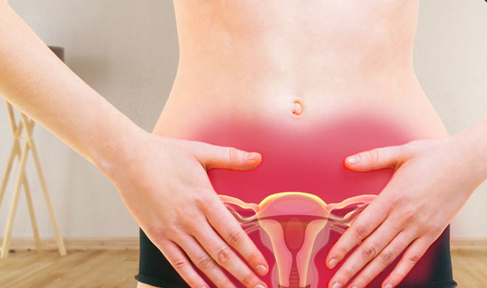
TITLE OF PRESENTATION
DYSMENORRHEA: “Leading Cause of School Abseentism.”

Slide 3
.
DEFINITION
CLINICAL FEATURES
EPIDEMIOLOGY
MEASUREMENT
PATHO PHYSIOLOGY
EXAMINATION
RISK FACTORS
INVESTIGATION
TYPES
DIFFERENTIAL DIAGNOSIS
VARIETIES
MANAGEMENT

Slide 4
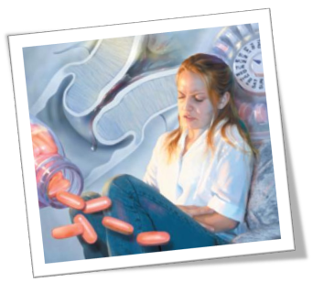
DEFINITION
Dysmenorrhea / Dysmenorrhoea :
The term “Dysmenorrhoea” is used to designate the condition in which mensturation is performed with difficulty and pain.
The pain, the essential element, is of various degrees of intensity, and, like all uterine and ovarian pain, is chiefly felt at the bottom of the back and within the lower part of the abdomen.
It is the leading cause of lost time from school and work among women in teens and 20's.

Slide 5
EPIDEMIOLOGY
Primary Dysmenorrhea is by far the most common gynecological problem in young menstruating women.
It is so common that many women fails to report it in medical interviews, even when their daily activities are restricted.
Reported prevalence rates are as high as 90 %.

Slide 6
INCIDENCE
The peak incidence of Primary Dysmenorrhoea occurs in late adolescence and the early 20s.
It is more common amongst girls from affluent society.
The incidence of Dysmenorrhoea in adolescents is reportedly as high as 92%.
The incidence falls with increasing age and with increasing parity.

Slide 7
PREVALENCE
The prevalence and severity of Dysmenorrhoea in parous women were significantly lower.
In an Epidemiologic study of an adolescent population (aged 12-17 y), Klein and Litt reported a prevalence of Dysmenorrhoea of 59.7%. of patients reporting pain, 12% described it as severe; 37%, as moderate; and 49%, as mild.
Dysmenorrhoea caused 14% of patients to miss school frequently.

Slide 8
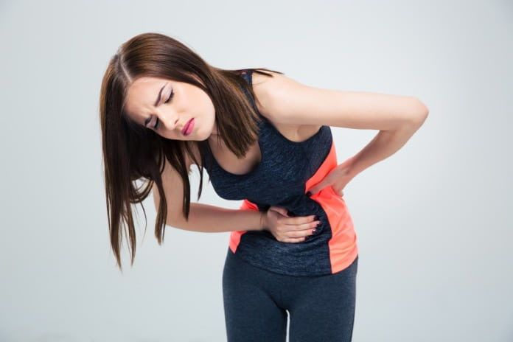
AGE
Primary dysmenorrhoea is predominantly confined to adolescent girls.
The most severe cases are seen between the age of 15 & 19.
It is rare to encounter in women over the age of 35.
RACE
No data suggest that race affects the incidence of dysmenorrhoea.

Slide 9
Depression/anxiety Disruption of social networks
Earlier age at menarche
Smoking,
Obesity
RISK
FACTORS
Long menstrual periods
Positive family history

Slide 10
Primary Dysmenorrhea
DYSMENORRHEA
Secondary Dysmenorrhea

Slide 11
PRIMARY DYSMENORRHEA
Primary Dysmenorrhoea usually begins 6 to 12 months after menarche, almost invariably coinciding with the onset of ovulatory cycles.
It is one where there is no identifiable pelvic pathology.
Incidence :
The incidence of Primary Dysmenorrhoea of sufficient magnitude with incapacitation is about 15- 20% .

Slide 12
Normal Menstruation

Slide 13
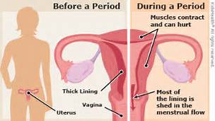
Pathophysiology

Slide 14
CAUSE OF PAIN
Mostly confined to adolescents.
Almost always confined to ovulatory cycles.
Psychosomatic factors of tension and anxiety during adolescence; lower the pain threshold.
Abnormal anatomical and functional aspect of myometrium.
Uterine myometrial hyperactivity has been observed in cases with Primary Dysmenorrhoea.
Imbalance in the autonomic nervous control of uterine muscle.

Slide 15
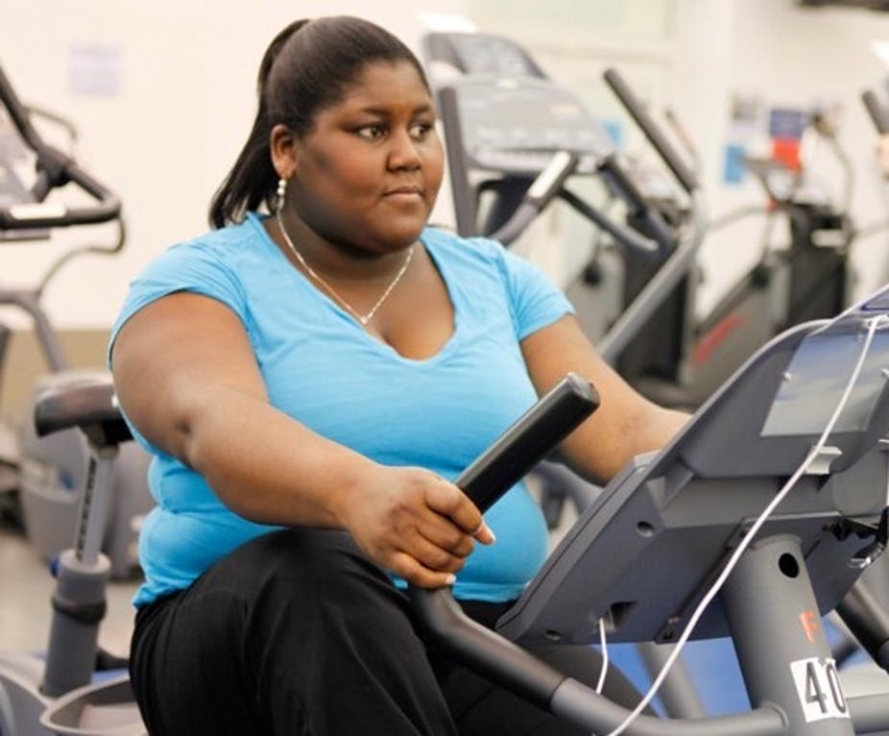
OTHER FACTORS OF PAIN
Lack of exercise.
Psychological or social stress.
Smoking.
Drinking alcohol.
Being overweight.

Slide 16
CLINICAL FEATURES
The pain is often intense, cramping, crippling and severely incapacitating so that it causes a major disruption of social activities.
The pain begins a few hours before or just with the onset of menstruation.
The severity of pain usually lasts for few hours, may extend to 24 hours but seldom persists beyond 48 hours.
The pain is spasmodic and confined to lower abdomen; may radiate to the back and medial aspect of thighs.

Slide 17
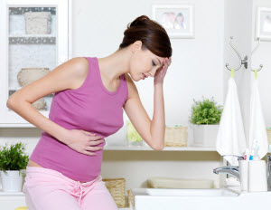
Associated Systemic discomfort
Nausea and vomiting.
Diarrhea.
Headache.
Fainting & fatigue.
Tachycardia.

Slide 18
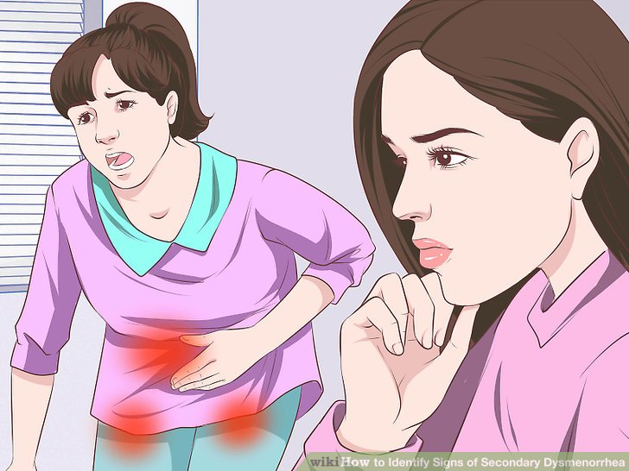
SECONDARY DYSMENORRHOEA
Secondary dysmenorrhoea is caused by organic pelvic pathology and it usually has its onset many years after the menarche.
Any woman who develops secondary dysmenorrhoea should be considered to have organic pathology in the pelvis until proved otherwise.

Slide 19
CAUSES Of PAIN
The pain may be related to increasing tension in the pelvic tissues due to pre – menstrual pelvic congestion or increased vascularity in the pelvic organs.
Pelvic examination is particularly important in this situation and, if the findings are negative, laparoscopy is indicated.
Causes of Secondary Dysmenorrhea
Fibroid
ENDOMETRIAL Polyp
Uterine Infection/ Stenosis
Adeno-myosis
Endomet-riosis
Pelvic Inflammatory Disease

Slide 20
PATHOPHYSIOLOGY OF SECONDARY DYSMENORRHOEA
The mechanism of pain in Secondary Dysmenorrhoea is due to pelvic congestion which is more marked in the premenstrual period.
Pain increases in its severity as menstruation approaches and is relieved by the onset of menstrual flow, due to the diminution of pelvic congestion.

Slide 21
CLINICAL FEATURES
The pain is dull, situated in the back and in front without any radiation.
It usually appears 3-5 days prior to the period and relieves with the start of bleeding.
The onset and duration of pain depends on the pathology producing the pain.
The patients may have got some discomfort even in between periods. There are symptoms of associated pelvic pathology.

Slide 22
Varieties of Dysmenorrhea
SPASMODIC DYSMENORRHEA | CONGESTIVE DYSMENORRHEA | MEMBRANOUS DYSMENORRHEA
It is the most prevalent and manifests as cramping pains, generally most pronounced on the first and second day of menstruation. | Manifests as increasing pelvic discomfort and pelvic pain a few days before menses begin. There after the patient rapidly experiences relief in her symptoms. This variety is commonly seen in pelvic inflammatory disease or pelvic endometriosis and fibroids. | Is a special group in which the endometrium is shed as a cast at the time of menstruation. The passage of the cast is accompanied by painful uterine cramps.

Slide 23
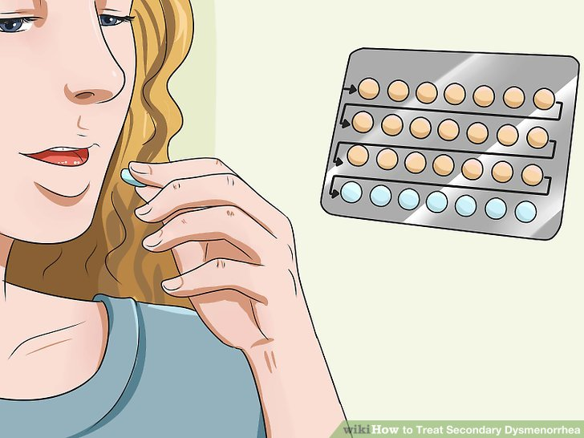
HISTORY TAKING
Pain
Time
Location
Degree
Menses
Quantity
Colour
Texture
Disruption in life-style.
Previous obs. & gynae. history.
Contraceptive methods

Slide 24
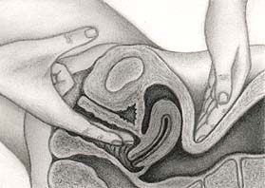
EXAMINATION
Vaginal exam not essential in young female with Primary Dysmenorrhea.
Vagina – septum
cervical - moving tenderness
Uterus- size / mobility/ position/
tenderness.
Adnexa –tenderness/enlargement

Slide 25
Dysmenorrhea: Assessment
A medical assessments should include:
Patient history.
Physical examination.
Primary Dysmenorrhea
cramping pain with menstruation and the physical examination is completely normal.
Secondary dysmenorrhea
the history discloses cramping pain starting after 25 years old with pelvic abnormality.
history of infertility.
heavy menstrual flow.
irregular cycles.
little or no response to NSAIDs
detailed sexual history to asses for inflammation or scaring.

Slide 26
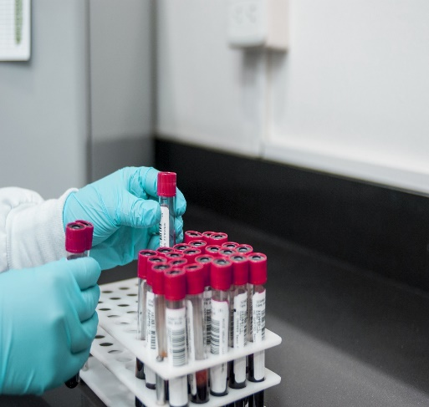
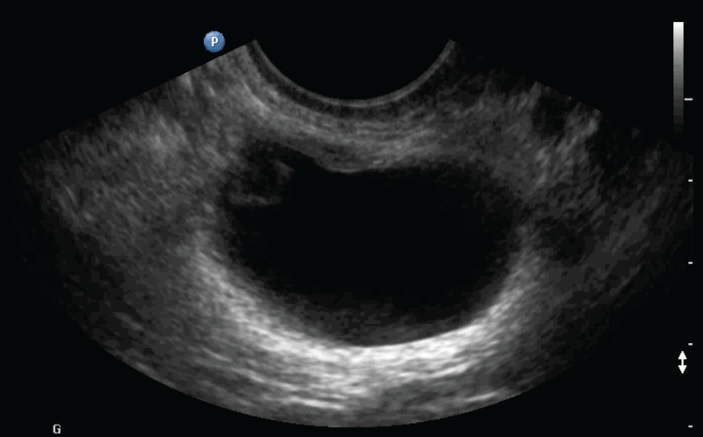
Continued:
Bimanual pelvic examination in non menstrual phase of the cycle
Laboratory tests for:
CBC to R/O anaemia
Urine analysis to R/O bladder infection
Pregnancy test
Cervical culture to exclude STI
ESR to detect an inflammatory process
Pelvic and vaginal U/S
Diagnostic laprascopy or lapratomy to
detect any pathology.

Slide 27
DIFFERNTIAL DIAGNOSIS
Torsion of Ovarian Cyst
Urinary Stones
Appendicitis
Colitis & Acute Gastroent-eritis

Slide 28
Management of Dysmenorrhea
Allopathic Management
Homoeopathic Management
Natural Therapy & Lifestyle Management

Slide 29
ALLOPATHIC MANAGEMENT
Primary dysmenorrhea is usually treated by-
Medication such as an analgesic medication.
Many women find relief with non steroidal anti-inflammatory drugs (NSAIDs) such as-
Ibuprofen.
Naproxen.
And acetylsalicylic acid (ASA).
Oral contraceptives.

Slide 30
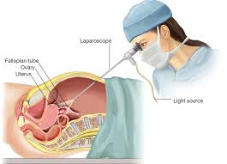
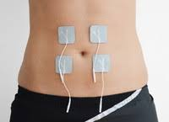
Continued:
Women who do not respond after three months of treatment with NSAIDs and hormonal contraceptives may have secondary dysmenorrhea.
Treatment for Secondary Dysmenorrhea will vary with the underlying cause.
Diagnostic laparoscopy, other hormonal treatments, or trial of transcutaneous electrical nerve stimulation (TENS) are potential next steps.
Surgery can be done to remove fibroids or to widen the cervical canal if it is too narrow.

Slide 31
MIASMATIC ANALYSIS OF SYMPTOMS OF DYSMENORRHOEA.

Slide 32
PSORA | SYPHILIS | SYCOSIS | PSEUDO PSORA
Pain usually- Sharp. Never colicky. | Profuse menstrual flow. | Flow offensive, clotted, dark even black, fish brine odour. | Headache, backache, neuralgias, epistaxis, diarrhoea, nausea, vomiting, cold extremities, febrile states.
 |  |  | Hysterical, sad, gloomy, fear, sensitive, nervous irritability & inclination to weep.

Slide 33
PSORA | SYPHILIS | SYCOSIS | PSEUDO PSORA
All functional menstrual disorders. Dysmenorrhoea shows itself- Very early. At puberty. At climacteric. | Depression and fears during menses. | Pains and diseases of uterus, spasmodic, colicky and paroxysmal. Acrid discharge, Pruritis, painful and frequent urination, mastodynia. | Painful, always exhausting, prolonged, copious. Feels badly a week before menses. Flow bright red, thin, watery.

Slide 34
REPERTORIAL ANALYSIS

Slide 35
According to the Repertory of Homoeopathic Materia Medica by J.T. KENT-
GENITALIA FEMALE, Menses: Painful, Dysmenorrhoea:
BELL, CACT, CALC-P, CHAM, & KALI-C.
Acon, Am-c, Ars-alb, Calc, Caul, Coff, Coloc, Dios, Lac-c, Lach, Lil-t, Lyco, Med, Meli, Nat-c, Nux-v, Phos, Puls, Sabin, Sep, Sulph, Sep, Sulph, Tub, Verat & Xan.
GENITALIA FEMALE, Menses: Painful, Dysmenorrhoea: Feet wet, from getting :
PULS.
Phos & Rhus-t.

Slide 36
According to the Boeninghausen’s Characteristics And Repertory by C.M.BOGER-
GENITALS, MENSTRUATION: Menses: Painful:
Calc, Cham, Cimic, Cocc, Con, Cupr, Graph, Lyc, Med, Nux-m, Plat, Puls, Sep, Sulph, Tub, Verat, Vib.
According to SYNTHESIS Repertory-
FEMALE GENITALIA/SEX - Menses - painful :
abrom-a.;1; abrot.;1; acon.;2; aesc.;1; alum.;1; alum-sil.;1; am-c.;3; am-m.;1; anac.;2; ant-t.;2; apis;1; arg-n.;1; arn.;1asar.;1; asc-c.;1; bar-c.;1; bell.;3; bell-p.;1; berb.;2; borx.;2; bov.;1; bry.;1;cact.;3; calc.;2; calc-p.;3;carb-v.;1; caul.;2; caust.;2;cham.;3; cic.;1; cimic.;3; coff.;2; coll.;1; coloc.;2; crot-h.;1;cycl.;2;dios.;2; dulc.;2.

Slide 37
CONTINUED:
ferr.;1; gels.;2; graph.;2; grat.;1; guaj.;2; haem.;1; ham.;1; hyper.;1; ign.;2; iod.;1; ip.;1; iris;1; kali-bi.;1; kali-c.;3; lil-t.;2; mag-c.;1; mag-m.;1; mag-p.;3; nat-c.;2; nat-m.;1; nat-p.;1; nit-ac.;1; plat.;2; psor.;3; puls.;2; rhus-t.;2; sabin.;2; sep.;2; sil.;1; tarent.;2; verat.;2; verat-v.;3; vib.;3; xan.;3; zinc.;2;

Slide 38
According to the Homoeopathic Medical Repertory by ROBIN MURPHY-
FEMALE : dysmenorrhoea, spasmodic, neuralgic:
Acon, Agar, BELL, Caul, Cham, Cimic, Coff, Coll, COLOC, Gels, Glon, Gnaph, Mag-m, MAG-P, Nux v, Puls, Sabin, Sant, Sec, Senec, Sep, Verat-v, Vib, Xanth

Slide 39
According to the COMPLETE Repertory-
FEMALE GENITALIA: Menses : Painful, Dysmenorrhea:
3 Marks
Am-c, Bell, Cact, Calc-p, Cham, Cimic, Cocc, Erig, Kali-c, Mag-p, Mill, Psor, Puls, Sulph, ust, Verat-v, Vib, Xan
2 marks
Acon, Anac, Ant-t, Ars, Berb, Bor, Bry, Calc, Caul, Caust, Coff, Coloc, Con, Dios, Dulc, Gels, Ham, Helon, Ign, Kali-p, Kali-s, Lac-c, Lach, Mag-c, Merc, Nat-c, Nux-v, Phos, Plat, Rhus-t, Sabin, Sep, Syph, Tanac, Tarent, Tub, Verat, Zinc.
1Mark
Abrot, Alum, Alumn, Ammc, Ant-c, Apis, Arg-n, Aur, Bar-c, Calc-s, Calc-sil, Cann-I, Cann-s, Canth, Carb-v, Cic, Crot-c, Euphr, Ferr, Ferr-ar, Ferr-p, Glon, Hep, Hyos, Hyper, Iod, Iodof , Ip, Kali-bi, Kalm, Kreos, Led, Lob, Mag-m, Mag-s

Slide 40
HOMOEOPATHIC MANAGEMENT
Constitutional Approach
Acute Remedies for Pain Management.

Slide 41
ACONITUM
In cases due to inflammation or congestion of the uterus or ovaries , especially it attended with febrile symptoms.
ARSENICUM
Neuralgic pain burning, restlessness, prostration, chronic inflammation of the uterus.

Slide 42
BELLADONNA (Deadly nightshade)
Congestive enlargement of uterus or ovaries, bearing down pain.
Dryness and heat in the vagina.
There Is severe inflammation and the parts become very sensitive.
Dragging pains in loins , severe throbbing in sacrum.

Slide 43
BORAX
Membranous Dysmenorrhoea.
Menses too early, too profuse, and attended with colic and nausea; flow preceded by stitching pains in pectoral region, lancinating pains in the groin during the flow.
Sterility.

Slide 44
CHAMOMILLA
Too early , too profuse, with dark, coagulated, sometimes offensive blood ; membranous dysmenorrhoea.
Cutting colic in abdomen and thighs ; irritable and snappish ; during : profuse discharge of large clotted blood, severe labor like pains in the uterus; tearing pains down the thighs, gripping and pinching in uterus, followed by discharge of clots.

Slide 45
CIMICIFUGA
Spasmodic dysmenorrheal , pains persists until flow ceases.
Spasmodic dysmenorrheal , pains persists until flow ceases.
Mainly young unmarried females.
Bearing down sensation with pressing pains in uterine region , pains shifting from one hip to another.
Dysmenorrhoea with rheumatic complaints.

Slide 46
CAULOPHYLLUM
Dysmenorrhoea, with pains flying to other parts of body.
Erratic pains changing place every few minutes. Pains are intermittent, paroxysmal, spasmodic. Chorea, hysteria or epilepsy at puberty, during establishment of menstrual functions.
Before menses: pain in small of back, great aching and soreness of lower limbs, bitter taste, vertigo, chilliness, flow very scanty, blood very light, with intense nausea and vomiting of yellow bitter matter, pain unremitting for several hours, habitual cold feet became warm.

Slide 47
MELILOTUS ALBA
Congestion of the uterine mucous membrane, of the ovaries, of the fallopian tubes which makes the patient restless.
Flow starts, stops and reappears after a gap of ten to fifteen days or so , striking pains in external genitalia.

Slide 48
PULSATILLA
Derangements at puberty; menses, suppressed from getting the feet wet; too late, scanty, slimy, painful, irregular, intermittent flow, with evening chilliness; with intense pain, changeable, comes suddenly and goes gradually, great restlessness and tossing about, flows more during day.
Delayed first menstruation. Mild, gentle, weeping disposition, fair complexion.
Catamenia with colic, hysterical spasms in abdomen, hepatic pains, gastralgia, pain in loins, nausea and vomiting, vertigo, tenesmus of anus and bladder, stitches in side, and many other sufferings before, during, or after period. Diarrhoea during menses.

Slide 49
SENECIO AUREUS
Dysmenorrhoea with urinary symptoms, cutting in sacral and hypogastric regions, flow scanty or profuse or irregular, pale, weak, anaemic, strumous, hacking cough at night, wandering pains in back and shoulders.

Slide 50
VIBURNUM OPULUS
Spasmodic and membranous dysmenorrhoea, when the menses are too late, scanty and lasting for few hours.
Bearing down pains in the uterine region.
Tearing and shooting pains in ovarian region
Uterine complaints associated with cramps in the thighs, extending to calf.
Colicky pains in pelvic region.

Slide 51
XANTHOXYLUM
Menses are too early and painful , usually associated with ovarian neuralgia with pain in loins and lower abdomen.
The pains are agonizing and shooting which start in left loin and travel down the thigh.
Given for neuralgic dysmenorrhoea.
Neurasthenic patients who are thin, emaciated with poor assimilation and insomnia.
With dysmenorrhoea there are gripping pains in abdomen with diarrhea.

Slide 52
MAGNESIA PHOSPHORICA. [MAG-P]
The pains calling for it are neuralgic and crampy preceding the flow, and the great indication for the use of this remedy is the relief from warmth and the aggravation from motion.
In neuralgia of the uterus Magnesia phosphorica vies with Cimicifuga.
Uterine engorgements with the characteristic crampy pains will indicate the remedy. It has also been used successfully in membraneous dysmenorrhea.

Slide 53
Hale mentions Viburnum, Guaiacum and Ustillago, besides Borax, for Membraneous Dysmenorrhea.
Colocynth, a useful remedy in dysmenorrhea, may be compared with Magnesia phosphorica.
The symptoms of Colocynth are severe left-sided ovarian pains, causing patient to double up; pains extend from umbilicus to genitals.

Slide 54
Research on Dysmenorrhea in Homoeopathy.
A prospective research-targeted study has shown strongly positive outcomes (+3/+2) in dysmenorrhea (28%).
Individualized prescription predominated (95%).
This systematic recording catalogue the frequency and success rate of treating Obs. & Gyn. conditions using Homoeopathy.

Slide 55
NATURAL THERAPY AND LIFESTYLE MANAGEMENT

Slide 56
Exercise:
Exercising most days of the week can make you feel better. Aerobic workouts such as-
Walking.
Jogging.
Biking, or swimming.
Help produce chemicals that block pain.

Slide 57
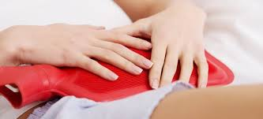
Apply heat
A warm bath or a heating pad or hot water bottle on your abdomen can be soothing.
Sleep
Make sure you get enough sleep before and during your period. This can help you cope with any discomfort.
Relax
Meditate or practice yoga. Relaxation techniques
can help you cope with pain.

Slide 58
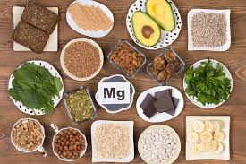
DIET CHANGES
Decrease salt.
Sugar
Caffiene.
Increase protein, ca, mg & vit. B Complex

Slide 59
Home Remedies for Dysmenorrhea

Slide 60
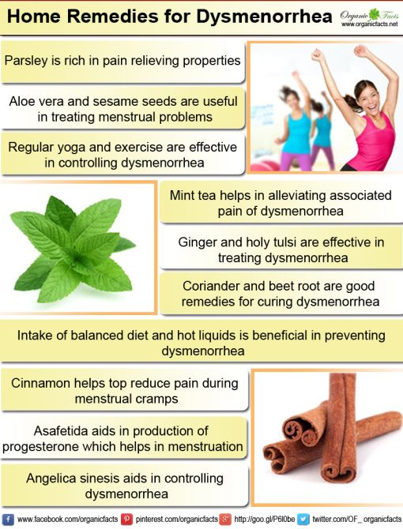

Slide 62
Yoga Poses to Relief Pain

Slide 63
BIBLIOGRAPHY
Ruddock E.H. Ruddock’s the lady's manual of homoeopathic treatment: painful mensturation. 2nd ed. B Jain Publishers Pvt. Ltd.
Jamieson DJ, Steege JF. The prevalence of dysmenorrhea, dyspareunia, pelvic pain, and irritable bowel syndrome in primary care practices. Obstet Gynecol.[Internet] 1996 [cited 2017 Feb 23];87:55–8.
Rao K. &Choudhury N.N. Clinical Gynaecology, 3rd edition, Orient Longman, Chennai.
DC Dutta’s textbook of Gynecology; dysmenorrhea and other disorders of menstrual cycle; edited by Hiralal Konar.

Slide 64
Continued:
Sulhan Sudha, disorders of mensturation; textbook of Gynecology. 2nd ed. B Jain Publishers, New Delhi.
Banerjee S.K : Miasmatic Diagnosis, reprint edition 2001, B. Jain publishers, New Delhi.
Speight P: A Comparison Of Chronic Miasms, reprint edition 1998, B. Jain publishers, New Delhi.
Kent J.T : Repertory Of Homoeopathic Materia Medica, reprint edition 1997, B. Jain publishers, New Delhi.

Slide 65
Continued:
Boger C.M : Boeninghausen’s Characteristics & Repertory, reprint edition 1996, B. Jain publishers, New Delhi.
Frederick S. Synthesis Repertory, edition 8.1, Homoeopathic book publishers, London.
Murphy R. Homoeopathic Medical Repertory, 2nd edition, B. Jain publishers, New Delhi.
Zandovert R.V. The Complete Repertory, B. Jain publishers, New Delhi.

Slide 66
Continued:
Boericke William,MD; Pocket Manual of Homoeopathic Materia Medica & Repertory.
Allen H.C : Keynotes & Characteristics Of The Leading Remedies Of Materia Medica With Bowel Nosodes, 8th edition, B. Jain publishers, New Delhi
Subhranil S. et al. obstetrics and gynecology outpatient scenario of an outpatient homoeopathic hospital: A prospective research targeted study: Journal of traditional and ComplementryMedicne;[Internet] (2016) ; 168-171.

Slide 67
Thank you

