Slide 1
DEMONSTRATE THE ABILITY TO APPLY MATERIA MEDICA IN PRACTICAL SITUATION
GUIDED BY- DR. JYOTI A. M
Department of Materia Medica
PRESENTED BY : DR. DEEPTI DEWAN
MD - 1st year
Department of Repertory

Slide 2
WHAT IS MATERIA MEDICA ?
The branch of medical science concerned with the study of drugs used in the treatment of disease: includes pharmacology, clinical pharmacology, and the history, physical and chemical properties of drugs.
Ref : Shiel W.C. ; Medical Definition of Materia medica; available at www.Medicinenet.com ; accessed on 2nd Dec 2019.

Slide 3
HOMOEOPATHIC MATERIA MEDICA
According to Samuel Hahnemann in his Organon of Medicine § 143, homeopathic materia medica is "a collection of real, pure, reliable modes of action of simple medicinal substances, a volume of book of nature.”
They thus act as a homeopathic prescribing reference guide and source for compiling Homeopathic repertory.
Ref : Organon of medicine.

Slide 4
PURPOSE TO STUDY MATERIA MEDICA
To know the pathogenetic powers of the drugs
To individualize
For comparison between drugs.
To compare the pathogenesis of a remedy with the recorded anamnesis of the patient.

Slide 5
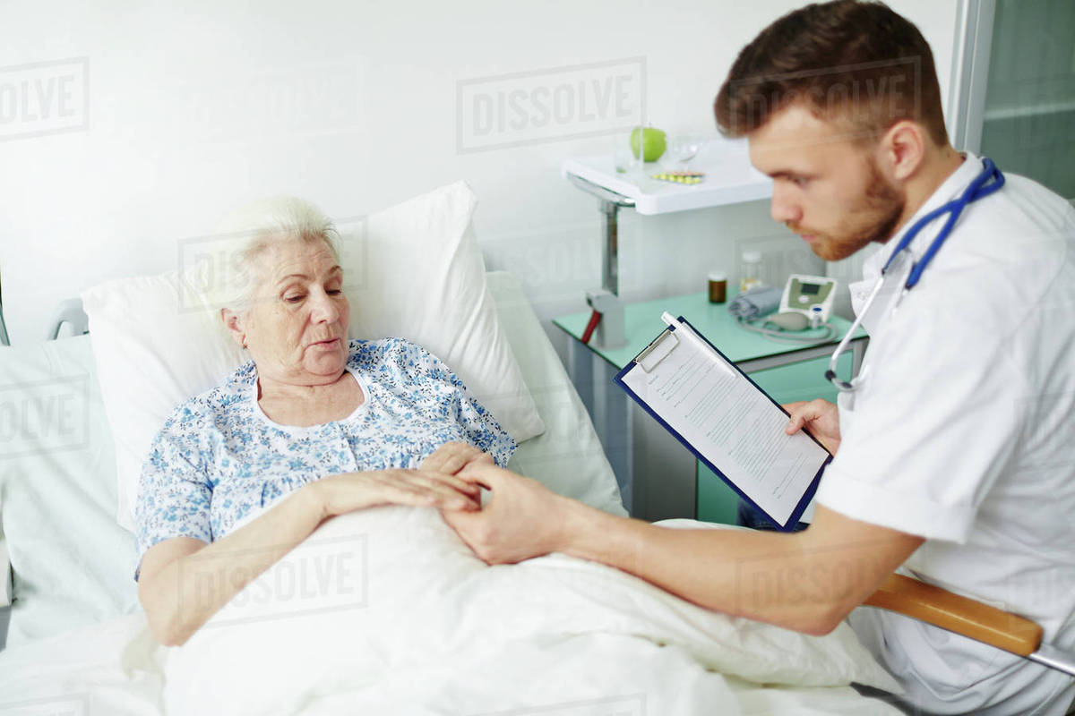
PRACTICAL SITUATIONS

Slide 6
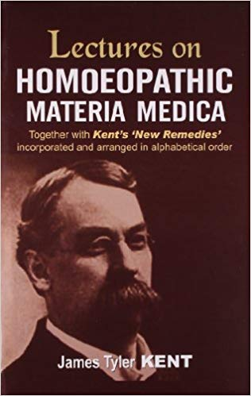
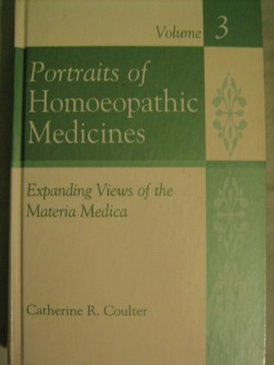
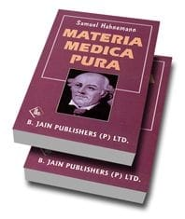
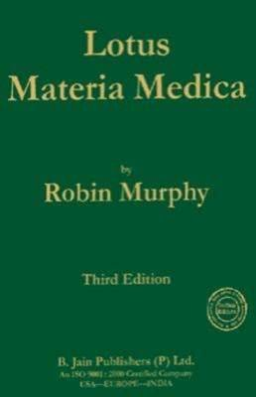
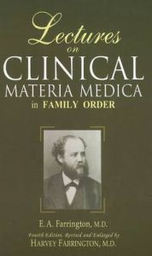

Slide 7
How the knowledge of Materia Medica can be applied Practically ?

Slide 8
WAYS OF APPLYING MM IN PRACTICAL SITUATIONS
Observing the patient
Physiognomy
Case taking and individualization
Depending on system involvement
Depending on sufferings
Miasmatic or intercurrent totality

Slide 9
What is the sole aim of Physician ?
Removal of totality of symptoms is nothing but the restoration of health.
This is the highest SOLE aim of physician
Ref :Aphorism 17; Organon of Medicine; www.organonofmedicine.com; accessed on 2nd Dec 2019.

Slide 10
Types of cases we get in our OPD
Acute Cases
Chronic cases
Patients Willing for Add- on therapy

Slide 11
Homoeopathic approach for Treatment
The core concept of homoeopathy is the principle of “Similia Similibus Curantur”.
In homoeopathy the prescriptions are made by tailoring of remedies to the patient’s personality type, causation of the illness and totality of symptoms.
So our main focus is to individualize the person from the other patients with similar diseases. Keeping in view the same homoeopath prescribes the different remedies for different patient with same illness.
So, from where we get all this differentiating features – here our tool is the knowledge of Materia medica and its proper application.
Ref :Principles of Prescribing; national health portal; available at www.nhp.gov.in accessed on 2nd Dec 2019.

Slide 13
Ref : How to approach homeopathic case; The Way of Homoeopathy; available on http://wayofhpathy.Blogspot.Com/2015/06/how-to-approach-homeopathic-case; accessed on 02nd Dec 2019
As our mentor Hahnemann stated ‘a well taken case is half cured.’ Your case taking starts as soon as the patient takes an appointment on the phone and or as soon as he enters your clinic. So, the physician must be vigilant enough in his observation of the patient. We should thoroughly observe the patient before we starts taking case.
For an example when patient enter in our OPD we should observe the way of making his entrance, i.e. he/she enter fast or slow, looks timid or bold? Does he/she look anxious? How was his/her expression on face? All these little things matter in homeopathic case taking. They fill missing gaps in case. Mostly they are helping in construct the constitution of the patient. Also if these symptoms are prominent in case it would be the basis of our prescription also.

Slide 14
Importance of Body language & Gestures
Body Language : the conscious & unconscious movements and postures by which attitudes and feelings are communicated.
Gestures : a movement of part of the body, especially a hand or the head to express an idea or meaning.
So, it important to observe how patient sits, talks, facial expression. All these are helpful in selecting the most appropriate medicine simibilimum to the case.

Slide 15
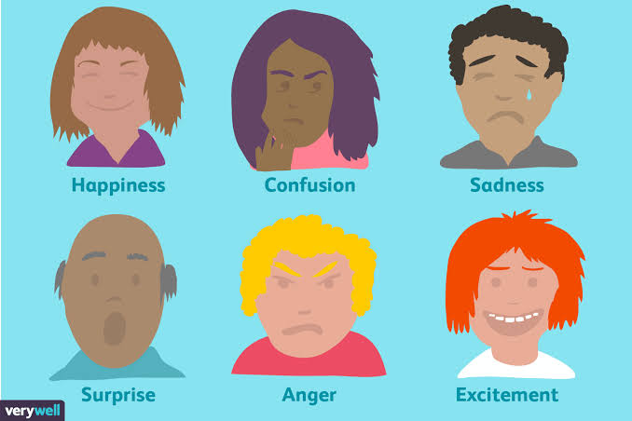

Slide 17
The personality of the patient is at least as important as the physical characteristics in individualizing the case and finding the similimum.
For example : the essence of Lycopodium is a lack of self-confidence, and this must be recognized by the homeopath through the confident exterior that many Lycopodiums adopt. An understanding of the essence of the mentals is just as important as an understanding of the specific symptoms of a remedy.
Ref : BAILEY Philip M. ; Personality Profiles of the Major Constitutional Remedies ; available at : https://epdf.pub/homeopathic-psychology-personality-profiles-of-the-major-constitutional-remedies.html

Slide 18
Observe the position that the patient adopts on sitting down. A patient who sits as far back as they can, or who chooses a chair more distant than the one meant for them is likely to be one of the cautious types listed above. Similarly, someone who leans forward in the chair, or even moves it forwards, probably belongs to one of the enthusiastic types, especially Phosphorus.
The clothes that the patient is wearing may provide much relevant information. A flamboyantly dressed patient is likely to need Argentum, Medorrhinum, Phosphorus or Sulphur. Certain types are more likely to wear black, particularly Ignatia, Natrum Muriaticum and Sepia.
The emotional types Phosphorus, Pulsatilla, and Graphites often wear pink, (at least the females!). Slovenly, dirty or untidy dress sense favours Baryta, Mercurius and Sulphur.
The woman who wears a rather manly suit is probably Ignatia, Natrum Muriaticum, or Nux. Look for the formal, bolt upright posture of Aurum, the Kalis, and some Natrums. It will probably make you feel a bit tense yourself.
Ref : BAILEY Philip M. ; Personality Profiles of the Major Constitutional Remedies ; available at : https://epdf.pub/homeopathic-psychology-personality-profiles-of-the-major-constitutional-remedies accessed on 02nd Dec 2019.

Slide 19
During the taking of physical case history observe the degree of detail with which the patient describes his or her symptoms.
The following types are likely to be objective and precise in their descriptions; Arsenicum, Aurum, Causticum, the Kalis, Lachesis, Lycopodium, Medorrhinum, Mercurius, the Natrums, Nux, Silica, Sulphur, and Tuberculinum.
Look for the clearly hypochondriacal concern with which some members of the following types describe their symptoms; Arsenicum, Calcarea, the Kalis, Phosphorus and Natrum Muriaticum. Ignatia tends to dramatise whatever she says, and hence is likely to exaggerate, as are Sulphur and Phosphorus.
Ref : BAILEY Philip M. ; Personality Profiles of the Major Constitutional Remedies ; available at : https://epdf.pub/homeopathic-psychology-personality-profiles-of-the-major-constitutional-remedies, accessed on 02nd Dec 2019

Slide 20
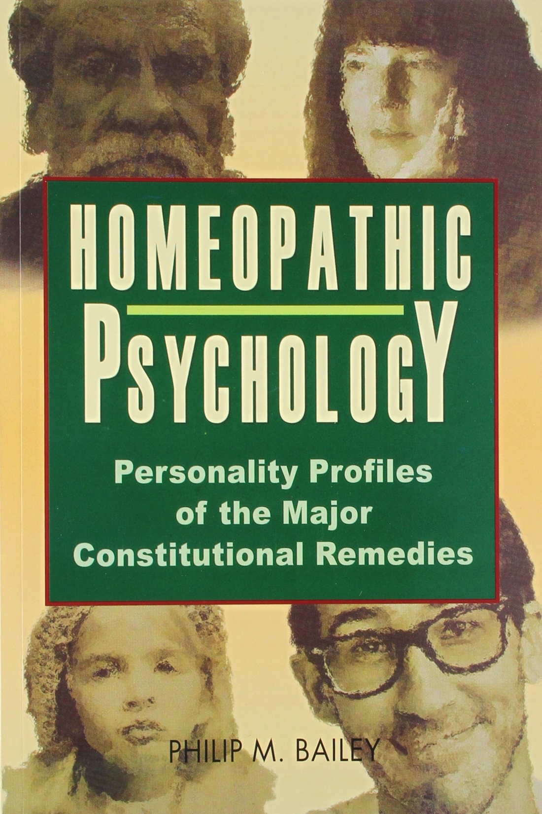

Slide 21
Approach for Acute Prescription
The acute disease in homeopathy is a clinical condition with a sudden onset, sudden progress and a sudden decline.. It is characterized by the symptoms having a rapid onset. In many cases there may not be many peculiar symptoms other than the disease symptoms to select a similimum or there may not be much time for a detailed case taking. In such cases, while taking the case, one has to give importance to the observation, objective signs or symptoms and any keynotes besides the major symptoms including the causation which would definitely help you in the prescription.
Acute homeopathic prescribing needs immediate attention and faster action.
Usually the therapeutic books/ keynotes book helps in finding remedies for acute prescriptions.

Slide 22
Keynote Prescription
There are some great stalwarts who prescribe based on one or two keynotes for the cases with great success. This become possible only when the experienced physician could identify those few key notes that represent the patient as a whole and is in a position to select the similar remedy with the same characteristics. Depending on the caliber and efficiency of the physician the prescription could be scientific, artistic, or intuitive.
The physician’s hard work backed up by the knowledge of Materia medica is essential factors for any success on key note prescription.
Materia medica such as Allen’s Key notes the striking symptoms of each remedies in bold letters. In some other Materia medicas, this may be in italic letters.

Slide 23
The keynote generally falls under the following categories
Very peculiar symptoms
Mental concomitant with bodily disease
Precise locality e.g., Capsicum – Mastoditis
Course and direction of pain sensation e.g., Chelidonium
Alternative symptoms – e.g., Alternate constipation & diarrhoea – Opium
Modalities

Slide 24
Examples :
Case no. 1 - A male aged, 25 years visited GHMC OPD, presented with sudden onset of profuse discharge from nose, watery discharge from eyes burning, itching eyes. These are only his complaints.
So, here I approached for the keynote prescription method.
In Allen’s under Euphrasia: Catarrhal affections of mucous membranes, especially of the eyes and nose. Profuse acrid lachrymation, with profuse, bland coryza (reverse of All. c.). The eyes water all the time and are agglutinated in the morning; margins of lids red, swollen, burning.
Euphrasia 200/ 3doses were given
Ref : Allen H.C.. Keynotes and Characteristics with comparisons of the leading remedies of the Materia Medica with bowel nosodes. 8th edition. New Delhi (India); B. Jain Publishers (P) Ltd; 2007

Slide 25
Case no. -2
A male, aged 32 years of age, presented with complaint of having warts in the foot since 15 days, painful on walking. Also, he had constipation, with ineffectual urge to pass stool. Stools are unsatisfactory.
Prescription done :Antimonium crudum : Constipation; with frequent unsuccessful desire, passing small quantities of faeces (in upper abdomen, Ign., Ver.); sensation as if not finished. Frequent desire for stool.
Large horny corns on soles of feet (Ran. b.); very sensitive when walking
Antimonium crudum 200/ 3doses were given.
Ref : Allen H.C.. Keynotes and Characteristics with comparisons of the leading remedies of the Materia Medica with bowel nosodes. 8th edition. New Delhi (India); B. Jain Publishers (P) Ltd; 2007

Slide 26
Examples of Materia Medica books for keynotes prescription
Keynotes on leading remedies by H.C. Allen
A synoptic key to Materia Medica by C M Boger
Leading symptoms of thousand remedies by M. Bhattacharya
Characteristic Materia Medica by W H Burt

Slide 27
Approach for prescription in Chronic Diseases
Chronic diseases are those complaints that have persisted for a long time – sometimes throughout one’s whole life. The symptoms are usually less severe than those of the acute conditions, but they can seriously affect quality of life and become progressively worse over time.
This group of diseases have a slow on set, slow progress and slow decline. Chronic diseases do not resolve themselves, but can be treated with the help of well-chosen homeopathic remedies known as constitutional remedies. To select such a constitutional remedy, knowledge about the constitution is necessary.

Slide 28
In homoeopathic point of view to deal with chronic cases we have to take case in detail including presenting complaints, history of presenting complaints, general physicals, mental generals, examination, diagnosis.
Here, we have to built the totality of the symptoms to form the drug picture of the patient.
Here the pathogenesis of drug is presented in a comprehensive manner so that an individual picture of a drug comes out.
Examples :
Homoeopathic Drug Picture by M L Tylor – 1952, 125 medicines
Lectures of Homoeopathic Materia Medica by J T Kent – 1904, 174 medicines.

Slide 29
Clinical Materia Medica
Remedies were selected on the basis of their affinity for the organ in which the disease was felt to reside, and differentiated further on the basis of the "genus" of the disease.
Therapeutic Index helps for the direct selection of medicine for particular disease.
Ref : Specificity of Seat - James Compton Burnett and the Generalization of Locality; Section 1; http://www.wholehealthnow.com/homeopathy_pro

Slide 30
Prescription using Clinical Materia Medica
Animal Kingdom : The Ophidia
The Ophidia as a group are characterized by their paralyzing action upon the nerves. They directly weaken the brain and heart action then follow decomposition of the blood changes in the muscular tissue and local death from gangrene.
Constrictions are noticed as in the throat larynx and sphincters in general. Haemorraghes which are dark, decomposed oozing from every orifice of the body.
They are most marked under Lachesis and Crotalus.
Ref : Farrington E.A. Clinical Materia Medica , 4th edition. New Delhi (India); B.Jain Publisher 1998

Slide 31
Face sickly pale, anxious, bloated , dark red or bluish. So, the this class of disease we will find these poisons curative Inflammations and fever of low destructive type such as gangrene, malignant ulcerations, diphtheria, typhoid, pyaemia etc.
So, final selection of medicine can be made through its action of sphere, which has to be confirm from Materia medica only.
Ref : Farrington E.A. Clinical Materia Medica , 4th edition. New Delhi (India); B.Jain Publisher 1998

Slide 32
Pocket manual of homoeopathic materia medica with repertory by W. Boericke 9th edition 1927 – 1414 drugs
A Clinical Materia Medica by E A Farrington 1st edition 1887, 536 drugs
Dictionary of Practical Materia Medica by John Henry Clarke

Slide 33
Psycho -analysis type of prescription
In type of approach the mental symptoms and psychological sphere are analyzed and probed so that drugs are individualized on the basis of their personality, temperament understanding etc.
Examples :
Essence of Homoeopathic Materia Medica by George Vithoulkas
Portraits of Homoeopathic Materia Medica by Catherine Coulter
Homoeopathic Psychology by Philip M Barley.

Slide 34
Case of Urolithiasis treated with Sepia
Mr X , 22 years age, suffering from renal stone since ---- , he has visited my OPD with all reports. Patient presented with mild hydronephrosis, mild hydropelvis, mild hydroureter with severe pain, cramps in abdomen, burning during micturition.
After taking the whole case, the gist of the case was patient was
very much mentally disturbed as compared to his physical problems.
He always says that his friends eat the same foods but they all are
healthy, he was not happy he feels he is lacking a healthy state as
compared to his friends. He was very much concern about human
rights and injustice.
Ref : Dewan D, Gupta J. A case of Urolithiasis treated with Sepia; ejournal – homoeopathy for everyone; vol. 16 (10), 2019 Oct available at https: // hpathy.com/journal/homeopathy-for-everyone-october-2019.

Slide 35
So after concerning the mental state have Sepia 200 was prescribed
In Sepia, this frequently lies at the root of discontent. He abstractly envies others for their good fortune and success. Here the patient thought that none of his friends have suffered from same problem he is facing. They all stay together, go out and eat same stuff but only he is the sufferer, so he was not happy with their good health. Sepia chronically worries that others have something he lacks.
Another prominent Sepia modality is the left sidedness of many complaints. In the occult sciences the left side has traditionally been regarded as pertaining to the emotions, the irrational and the unconscious, while the right side represents the intellect, rationality, and consciousness. Thus, his predominantly left sided symptoms are yet another way suggest an imbalance of the emotional, rather than the intellectual, sphere.
.
Ref : Coulter R. Catherine , Portraits of Homoeopathic Medicines; California; North Atlantic Books;1986;139-141
Allen T.F , The Encyclopedia of Pure Materia Medica;reprinted 1986;India; B.Jain Publishers(p)ltd;8;633

Slide 36
It is traditionally known that Sepia produces “Pain like knives shooting through the uterus spasmodically, lancinating pains in the uterus shooting upwards, pressure in the uterus as if everything would issue through the vulva, and the pressure downward is as if everything would fall out”. From this we understand that Sepia produces its spasmodic action on the uterus and expels the product through the vulva, so why not in the case of Urolithiasis, in would spasmodic action helped in the expulsion of this stone.
So, here the approach of our prescription is mental state of the patient.
Ref : Coulter R. Catherine , Portraits of Homoeopathic Medicines; California; North Atlantic Books;1986;139-141
Allen T.F , The Encyclopedia of Pure Materia Medica;reprinted 1986;India; B.Jain Publishers(p)ltd;8;633

Slide 37
SPHERE OF ACTION
It especially acts upon the vascular and lymphatic system, of the genito- urinary organs.
It especially affects the mucous membrane of the genito- urinary organs, and skin.
Ref : SEPIA Characteristic Materia Medica by William H Burt
by William Burt https://homeopathybooks.in/characteristic-materia-medica-by-william-h-burt/sepia-3/

Slide 38
Organopathic Prescription
Oraganopathic prescriptions are made based on the Paracelsus principle that the given drugs affect given organs (parts) by self elective preference. Many doctors like J H Clark, R T Coopers, Boger, and Burnett, have given in their experiences on the importance of selection of Organopathic remedies and their usefulness when other guiding symptoms, causations and Miasms were rare or not available.
Such references are available on Chelidonium, Cardus, Chionanthus, Leptendra, Myrica, Kalmegh, for liver disorders; Sabal Ser, Ferr Pic for Prostate affection; Adonis V, Cactus, Crategus, Strophanthus for heart disorders. From their experience, these experts have identified the special affinity of these medicines on special organs and used at random for affections. These are usually prescribed as rejuvenators of the organ.
Drugs are compared with indication for a particular organ. Eg. Therapeutics by K C Bhanja

Slide 39
Therapeutic Materia Medica
Here drugs are studied under the headings of different disease.
E.g., Pain in different joints are described under arthritis.
Whole picture of the drugs cannot be studied.
E.g., Practical homoeopathic therapeutics by W. A. Dewey
Uterine therapeutics by Minton

Slide 40
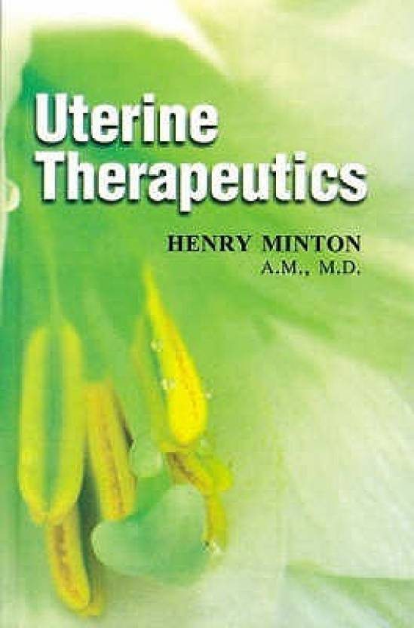

Slide 41
Few Examples of cases treated by Homoeopathic Approach

Slide 42
A Case of Adjustment Disorder with Anxiety A Homeopathic Medicine
Abstract: An acute case of adjustment disorder with anxiety is presented that responded to the homeopathic prescription of Vanadium, after the failure of Silicea. Elemental homeopathic analysis using Jan Scholten’s method of analysis provided the guidance to recognize Vanadium as the indicated medicine.
Ref: Guess G. A Case of Adjustment Disorder with Anxiety A Homeopathic Medicine Case Report; American Journal of Homoopathic Medicine Spring 2017; 10 (1); available at : https://homeopathyusa.org/AJHM/AJHM-Spring-2017; accessed on 05th Dec 2019.

Slide 43
A 25 year-old female nurse practitioner consulted with for anxiety and insomnia after completed her training, she began working as a primary care provider.
She had heretofore worked as a nurse and completed her Nurse Practitioner (NP) training without any such problems, having always felt quite confident of her abilities and having performed them admirably.
When she first began working in her new position she became overwhelmed with the new charting system and, as she began shadowing her NP superiors, she began worrying that her knowledge of medicine was inadequate to meet the demands of the position and became anxious about being on her own.
Her anxiety especially escalated when she was on call and had sole responsibility for the care of her patients.
She felt very insecure. Whenever she returned home from work she would look up information to ensure she’d been correct in her assessments. She could not turn her mind off. She worried as well that others at work would be critical of her. Her anxiety was partially relieved by walks outdoors and exercise.

Slide 44
Physical Complaints :
Hair loss
Appetite reduced from the stress, with consequent weight loss.
She was typically a warm-blooded person and often overly warm at night with some mild chest perspiration. Lately, however, she’d become more chilly and sensitive to drafts.
Night sweats, with heat.
Craving sweets earlier it was absent
Menses were irregular lately, with long cycles of about five weeks; otherwise menses were unremarkable. She noted white spots on her nails and complained of dry scalp and skin.
Medicine given : Silicea 200/one dose
Follow up : her anxiety was much worse, so much so that she was thinking of quitting her position.

Slide 45
In this case ‘Elemental homeopathy;’ ie, Jan Scholten’s schema of homeopathic analysis based primarily on the mental-emotional characteristics of patients was considered. [see Homeopathy and Minerals and Homeopathy and the Elements by Jan Scholten].

Slide 46
The Element theory is an analysis of all the elements of the periodic table. With this theory an analysis of the whole mineral kingdom became possible.
On the left side of the periodic table—the side pertaining to those who suffer varying degrees of insecurity—appeared most apt. Those two stages suggested two possible remedies— Titanium metallicum and Vanadium.
Dr Rajan Shankaran writes about the Vanadium “The structure is complete, but the foundation is not strong. Should I go ahead or not? Do I have the ability or not? Trying, unsure, postponing, preparing.” This patient had progressed beyond just beginning; she had accepted that she had to perform on her own, but this decision made her feel insecure and she questioned her ability, even considering quitting when her anxiety was most pronounced. So, Vanadium is prescribed.
Ref: Guess G. A Case of Adjustment Disorder with Anxiety A Homeopathic Medicine Case Report; American Journal of Homoopathic Medicine Spring 2017; 10 (1); available at : https://homeopathyusa.org/AJHM/AJHM-Spring-2017; accessed on 05th Dec 2019.

Slide 47
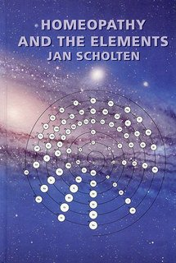

Slide 48
Homeopathic Treatment Prevents Surgery in a Case of Pronounced Acute Compartment Syndrome
Abstract Acute compartment syndrome (ACS) is a severe disease requiring immediate medical intervention consisting of decompressive surgical fasciotomy and antimicrobial treatment, occasionally leading to amputation of the affected limb. In this case, a patient with ACS is described. The patient received conventional treatment for pronounced acute compartment syndrome consisting of relevant medicines and seven surgical procedures, after which amputation of the right foot was suggested. At this stage the patient chose to consult a homeopathic physician. Through individualized homeopathic therapy, the abscess was cured within seven months and the patient was able to walk independently without pain. The patient was deprived of conventional therapy, namely amputation, homeopathic treatment enabled the patient to retain her limb and regain her mobility.
Ref: Frass M. Homeopathic Treatment Prevents Surgery in a Case ofPronounced Acute Compartment Syndrome; Arch Clin Med Case Rep 2019; 3 (6): 567-572; available at http://www.fortunejournals.com/articles/homeopathic-treatment-prevents-surgery-in-a-case-of-pronounced-acute-compartment-syndrome.pdfaccessed on 05th Dec 2019.

Slide 49
The striking symptoms were marked redness, heat and swelling around the right ankle joint for which the patient put on ice-packs. The patient also reported that even the slightest movement was extremely painful. Repertorization with the help of MacRepertory of these symptoms led to the decision to prescribe the homeopathic medicine Bryonia alba. Bryonia is particularly indicated where pain is aggravated by any movement. Boericke describes red, swollen, hot joints, with stitches and tearing; worse on least movement. The patient received a single dose of 5 globules of Bryonia alba CH200

Slide 50
Ref: Oberbaum M. Homoeopathic treatment in emergency medicine – a case series; Homeopathy; 2003; 92, 44-47; accessed on 05th Dec 2019.

Slide 51
Keynotes of remedies applied for anxiety
Sudden fear/anxiety Aconite
Fear of death Aconite
Restlessness Aconite
Worsening at night Aconite
Fear of suffocation (following burial in debris) Aconite
Weakness Arsenicum album
Thirst for small volumes Arsenicum album
Worsening at night Arsenicum album
Desire for company Arsenicum album
Sensation of a lump in the throat (globus hystericus) or elsewhere Ignatia
Silent grief and brooding Ignatia

Slide 52
Restlessness, wish to leave the bed Arsenicum album
Painlessness/pain starts late after injury Opium
Breathing stertorous Opium
Asking for nothing; Not complaining Opium
Vertigo during anxiety Opium
Dark red, swollen face Opium
Warm perspiration or scant secretion (but with increased perspiration) Opium
Sighing Ignatia

Slide 53
Ref: Chand K. S. Case reports on integrated management of tubercular disease; Homeoapthy, 2017; 106;214-222; accessed on 05th Dec 2019.

Slide 54
Homeopathic treatment was added to antibiotics according to regime.
Sulphur 30c was selected as a patient specific medicine for TB vertebrae, psoas abscess, inflammation of liver, nausea eating after, thirst for large quantities of water; once in the morning
Symphytum 30c was organ specific medicine for caries of vertebra and psoas abscess; once in the morning
Silicea 6c was a general stimulant and for psoas abscess; twice a day
Ipecacuhana 6c was used for constant nausea and hepatitis; twice a day
Tuberculinum 200c was disease specific nosode; once a week.

Slide 55
Take home Message :
Our ability to treat patient homoeopathically is not possible without the perfect of knowledge of Materia Medica, Organon & Repertory.
It depends on case to case that which approach we have to follow for our prescriptions and for that the knowledge of all types of MM books and ability to apply that should be perfect

Slide 56
Homeopathy for Acutes and Emergencies: A practical guide to homeopathic prescribing in acute illnesses and emergencies by DR. ALOK PAREEK

Slide 57
