Slide 1
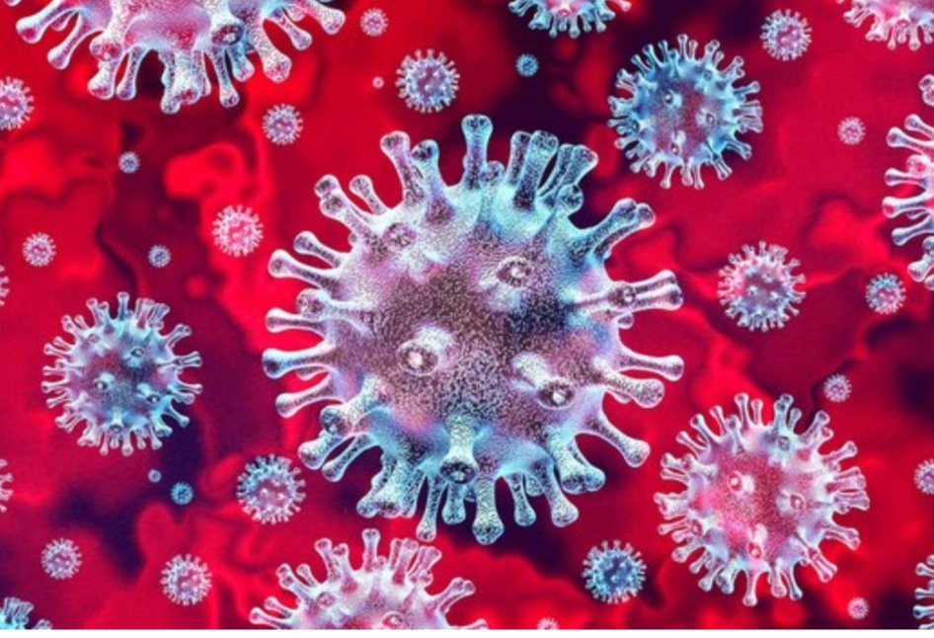
Corona virus and COVID -19

Slide 2
What is COVID-19????
Severe Accute Respiratory syndrome Corona virus 2 (SARS-COV-2) Causes COVID -19
SARS-COV-2 is a new virus
The first cases were identified in people with pneumonia In wuhan ,China in late December 2019
It probably started in animal But now it is spreading Between people

Slide 3
How is it spread ???
Most People are being infected from other people
It probably spreads the same way as colds and flu i.e through droplets which are created when we talk, cough and sneeze
People can get infected when these droplets enter the nose, eyes or mouth.

Slide 4
Touching contaminated objects puts the droplets onto your hands
If you touch your face the droplets can enter your nose / eyes / mouth
Some people have been infected following contact with an infected person with minimal or no symptoms

Slide 5
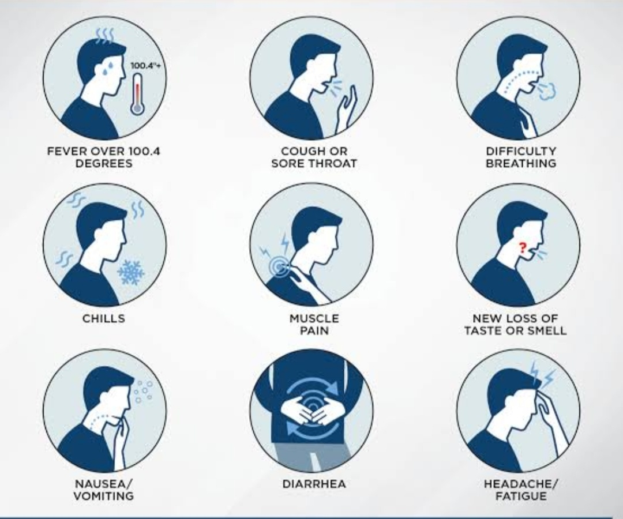
Symptoms of COVID -19

Slide 6
Symptoms start like many other illnesses
Symptoms start about One day after exposure, but can be as long as 14 days
It can be severe and sometimes fatal also

Slide 7
The main symptoms include :
Fever
Coughing
Shortness of breath
Nausea and diarrhea
Fatigue
Chills, sometimes with shaking
Bodyache
Headache
Sore throat
Loss of smell or taste

Slide 8
The virus can lead to pneumonia, respiratory failure, septic shock and death
Many covid-19 complications may be caused by a condition known as cytokine release syndrome or a cytokine srorm
This is when an infection triggers your immune system to flood your blood stream with inflammatory proteins called cytokines.
They can kill tissue and damage your organs

Slide 9
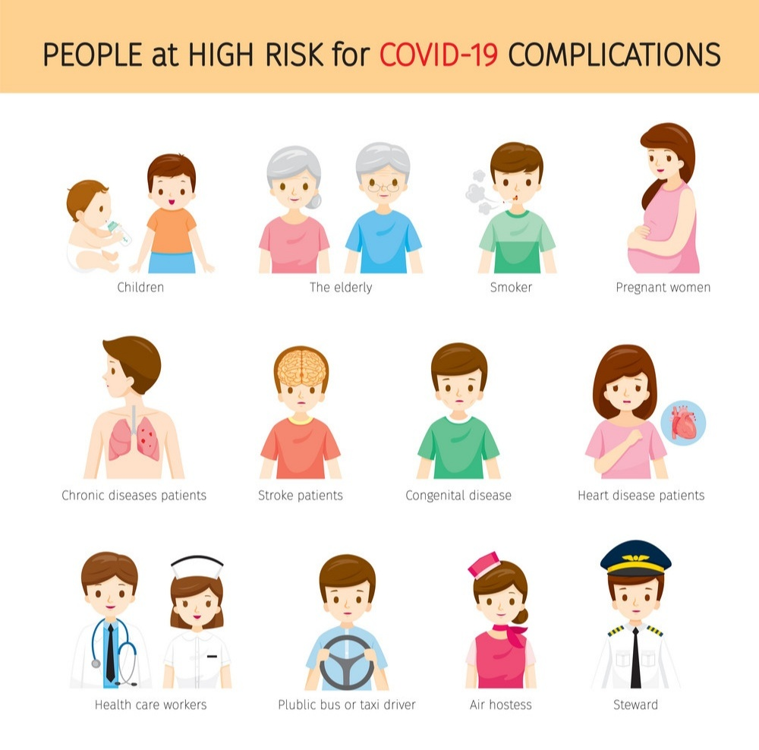
Risk factors for COVID -19

Slide 10
Chronic kidney disease
Chronic obstructive pulmonary disease (COPD)
A weakened immune system because of an organ transplant
Obesity
Serious heart conditio such as heart failure or coronary artery disease
Type-2 diabetes
Moderate to severe asthma
Cystic fibrosis
High blood pressure

Slide 11
Dementia
Liver disease
Pregnancy
Smoking
Thalassemia
Diseases that affects your blood vessels and blood flow to your brain
Damaged or scattered lung tissue (pulmonary fibrosis)

Slide 12
Diagnosis and treatment
Because symptoms are similar to many other illnesses tests are needed to make the diagnosis ( throat swab, blood tests)
There is no any specific treatment
Mild symptoms can be treated with medicine to lower the fever or relive pain
If symptoms are more severe treatment in hospital is required

Slide 13
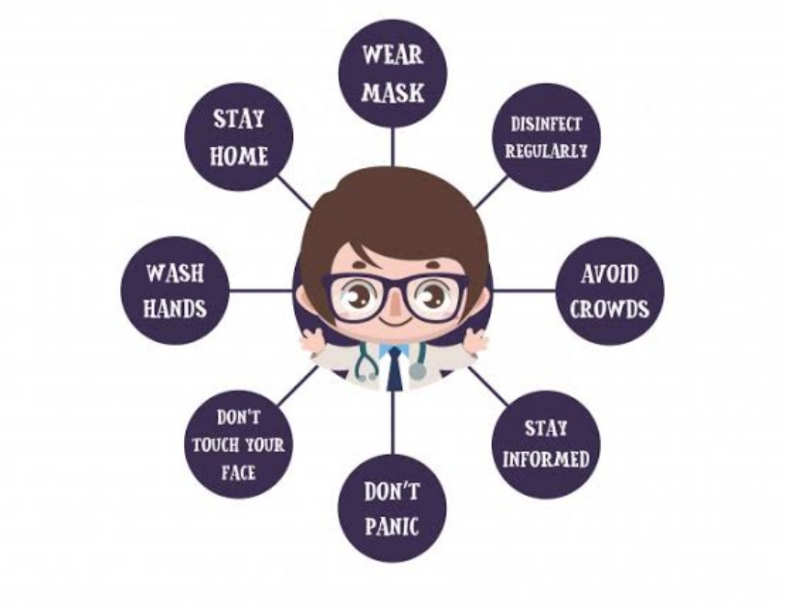
To prevent COVID-19

Slide 14
Maintain good personal hygiene
Wash your hands frequently with soap and water
Use alcohol based hand sanitiser When soap and water are not readily available
Cover your cough and sneezes.Use Tissue or your upper sleeves
Do not share , food, drinks and personal item Including mobile phones

Slide 15
Avoid exposure
Keep 1-2 meters (3 -6 feet) away from others even if they appear well and avoid direct contact with them
Avoid touching your face especially if you have touched objects handled by many people
Avoid shaking hands , hugging instead wave, bow,nod or use any other appropriate gesture
Avoid activities which expose you to large groups of people

Slide 16
Work from home, where possible
Avoid non essential teavel
Clean and disinfect frequently touched surfaces each day, use normal cleaning supplies.
Keep away from people who are sick don't let them cough or sneeze on you
Avoid visiting hospital and other medical facilities unless you need medical care

Slide 17
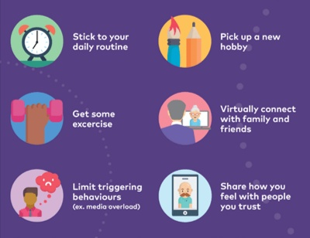
Coping with stress during COVID -19 outbreak

Slide 18
COVID-19 can be stressful, the effect can be both physical and emotional
Things you can do to reduce stress:
Take break from litsening to, watching or reading about COVID-19 frequently including social media
Seprate facts from rumors. Gather information from reliable Sources
Stick to your daily routine and develop new hobbies
Do some exercise ,yoga, meditation.

Slide 19
Talk to your friends and your family members
Share things with them
Don't panic
And if stress continue to hamper your daily activities, talk to a doctor, or someone you can trust

Slide 20
Thank you
By Minaz Shaikh
Final year BHMS
studying at ahmedabad homeopathic medical college
Under the guidance of DR.Tejal shah

