Slide 1
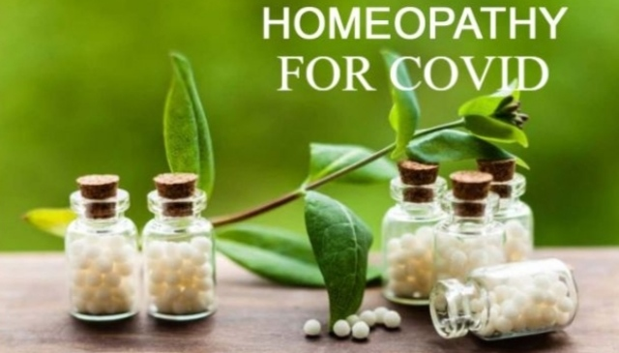
Covid 19 and Homoeopathy treatment

Slide 2
Today,humanity is living through the third serious coronavirus outbreak in less than 20 years, following SARS in 2002-2003 and MERS in 2012.While the final cost on human lives and world economy remains unpredictable,the timely identification of a suitable treatment and the development of effective vaccine remain a significant challenge and will still require time.The aim of this study is to show that the global collective effort to control the coronavirus pandamic(Covid 19 )should also consider alternative therapeutic methods,and national health systems should quickly endorse the validity of proven homoeopathic treatments in this war against coronavirus disease.

Slide 3
Homoeopathy as a healing method,is based on Hippocratic “similia similibus curenture”therapeutic law.The physician relies on the wholeleness of symptoms revealed during the entire evolution of the infection,and prescribes an ultra high diluted succussed solution product which has been proven to heal similar conditions.This is a great advantages in this timing while Covid 19 disease is in rapid development,because the diagnosis of the indicated ultra high diluted succussed solution product is based on individual symptoms or the totality of symptoms and not in the pathology.
The totality of symptoms for each patient become the guiding signs for finding the indicated remedy.

Slide 4
So here I share some information about homoeopathic medicine which can be use in the treatment of covid 19.
1)ARSENICUM ALBUM
2)BRAYONIA
3)CAMPHORA
4)SARCOLACTIC ACID
5)EUCALYPTUS GLOBULUS
6)PHOSPHORUS

Slide 5
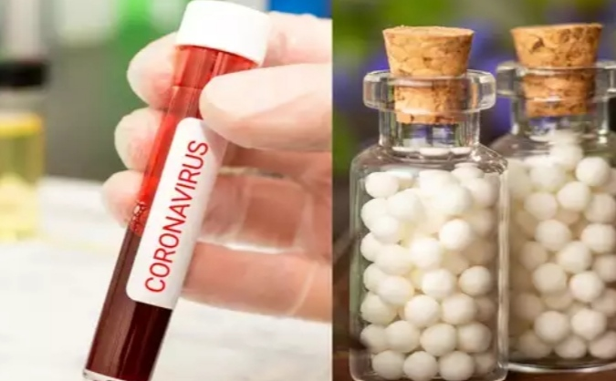

Slide 6
1)ARSENICUM ALBUM
A profoundly acting remedy on every organ and tissue. Its general symptoms often alone lead to its successful application. Among these the all-prevailing debility, exhaustion, and restlessness, with nightly aggravation, are most important .Burning pains. Unquenchable thirst. Burning relieved by heat.
Worse, wet weather, after midnight; from cold, cold drinks, or food. Seashore. Right side. Better from heat; from head elevated; warm drinks.

Slide 7
Unable to lie down; fears suffocation. Air-passages constricted.Burning in chest. Suffocative catarrh. Cough worse after midnight; worse lying on back. Expectoration scanty, frothy. Darting pain through upper third of right lung. Wheezing respiration. Hæmoptysis with pain between shoulders; burning heat all over. Cough dry, as from sulphur fumes; after drinking.
High temperature. Periodicity marked with adynamia. Septic fevers. Intermittent. Paroxysms incomplete, with marked exhaustion. Complete exhaustion. Delirium; worse after midnight. Great restlessness. Great heat about 3 am.

Slide 8
2)BRAYONIA ALBA
Acts on all serous membranes and the viscera they contain. The general character of the pain here produced is a stitching, tearing; worse by motion, better rest. These characteristic stitching pains, greatly aggravated by any motion, are found everywhere, but especially in the chest; worse pressure. Mucous membranes are all dry.
Bryonia affects especially the constitution of a robust, firm fiber and dark complexion, with tendency to leanness and irritability. It prefers the right side, the evening, and open air, warm weather after cold days, to manifest its action most markedly.

Slide 9
Soreness in larynx and trachea. Hoarseness; worse in open air. Dry, hacking cough from irritation in upper trachea. Cough, dry, at night; must sit up; worse after eating or drinking, with vomiting, with stitches in chest, and expectoration of rust-coloured sputa. Frequent desire to take a long breath; must expand lungs. Difficult, quick respiration; worse every movement; caused by stitches in chest. Cough, with feeling as if chest would fly to pieces; presses his head on sternum; must support chest. Croupous and pleuro-pneumonia. Expectoration brick shade, tough, and falls like lumps of jelly. Tough mucus in trachea, loosened only with much hawking. Coming into warm room excites cough (Nat carb). Heaviness beneath the sternum extending towards the right shoulder. Cough worse by going into warm room.

Slide 10
Pulse full, hard, tense, and quick. Chill with external coldness, dry cough, stitches. Internal heat. Sour sweat after slight exertion. Easy, profuse perspiration.
Worse, warmth, any motion, morning, eating, hot weather, exertion, touch. Cannot sit up; gets faint and sick. Better, lying on painful side, pressure, rest, cold things.

Slide 11
3)CAMPHORA
It is characteristic of Camphor that the patient will not be covered, notwithstanding the icy coldness of the body. Pain better while thinking of it. Very sensitive to cold and to touch.
Stopped; sneezing. Fluent coryza on sudden change of weather. Suffocative dyspnœa. Violent, dry, hacking cough. Palpitation. Breath cold. Suspended respiration.
Pulse small, weak, slow. Icy coldness of the whole body. Cold perspiration. Congestive chill. Tongue cold, flabby, trembling.
Worse, motion, night, contact, cold air. Better, warmth.

Slide 12
4)SARCOLACTIC ACID
Tired feeling with muscular prostration, worse any exertion. Sore feeling all over, worse in afternoon. Restless at night. Difficulty in getting to sleep. Tired feeling in morning on getting up.
Constriction in pharynx. Sore throat with tightness in naso-pharynx. Tickling in throat.
Proved by Wm. B. Griggs, M. D, who found it of great value in the most violent form of Epidemic influenza, especially with violent and retching and greatest prostration.

Slide 13
5)EUCALYPTUS GLOBULUS
Stuffed-up sensation; thin, watery coryza; nose does not stop running; tightness across bridge. Chronic catarrhal, purulent and fetid discharge.
great dyspnœa and palpitation. Expectoration white, thick mucus. Profuse expectoration of offensive muco-pus. Irritative cough. Fetid form of bronchitis, bronchial dilatation and emphysema.
Elevation of temperature. Discharges show a tendency to foulness, high temperature, accelerated but not strong pulse.

Slide 14
6)PHOSPHORUS
Phosphorus irritates, inflames and degenerates mucous membranes, irritates and inflames serous membranes.
Cough from tickling in throat; worse, cold air, reading, laughing, talking, from going from warm room into cold air. Sweetish taste while coughing. Hard, dry, tight, racking cough. Congestion of lungs. Burning pains, heat and oppression of chest. Tightness across chest; great weight on chest. Sharp stitches in chest; respiration quickened, oppressed. Much heat in chest. Pneumonia, with oppression; worse, lying on left side. Whole body trembles, with cough. Sputa rusty, blood-colored, or purulent. Tuberculosis in tall, rapidly-growing young people. Do not give it .

Slide 15
Chilly every evening. Cold knees at night. Adynamic with lack of thirst, but unnatural hunger. Hectic, with small, quick pulse; viscid night-sweats. Stupid delirium. Profuse perspiration.
Worse, touch; physical or mental exertion; twilight; warm food or drink; from getting wet in hot weather; evening; lying on left or painful side;

Slide 16
THANK YOU
PRESENTED BY:
SHAIKH ZARQA MAKSUD AHMED (FINAL YEAR STUDENT AT AHMEDABAD HOMOEOPATHY MEDICAL COLLAGE)
UNDER GUIDANCE OF :
DR.TEJAL SHAH
(HOD & PROFESSOR)
(COMMUNITY MEDICINEDEPARTMENT)

