Slide 1
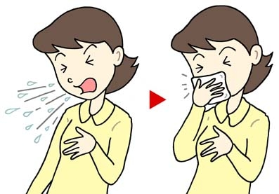
COMMON COLD AND HOMOEOPATHY
PRESENTED BY
DR. AZIZUL ISLAM KHADIM
PGT (PRACTICE OF MEDICINE)
2019 BATCH
RBTS GOVT. HOMOEOPATHIC
MEDICAL COLLEGE AND
HOSPITAL.
UNDER THE GUIDANCE OF
DR. KANAK KUMAR (H.O.D OF
PRACTICE OF MEDICINE)

Slide 2
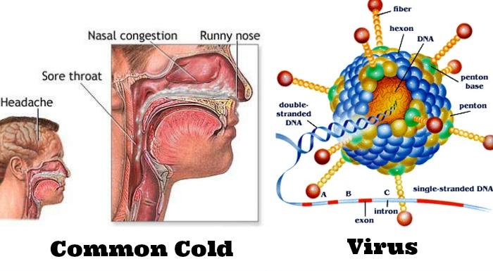
CONTENT∹
1. THE COMMON COLD.
2. EPIDEMIOLOGY.
3. CLINICAL SYMPTOMS.
4. AETIOLOGY AND TRANSMISSION.
5. PREVENTION AND PROGNOSIS.
6. COMPLICATION AND D/D.
7. HOMOEOPATHY IN COMMON COLD.
8. DIFFERENT REPERTORY OF FEVER.
9. THERAPEUTICS OF COMMON COLD.
10. CASE PRESENTATION.
11. CONCLUSION.
12. BIBLIOGRAPHY.

Slide 3
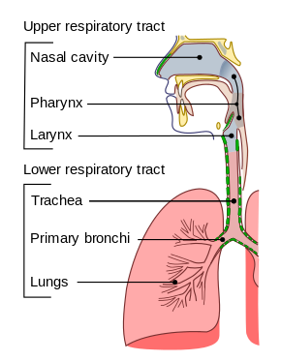
INTRODUCTION
STRUCTURE OF RESPIRATORY TRACT

Slide 4
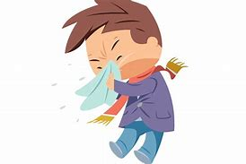
epidemiology∹
1. There are no major gender or ethinicity differences in incidence.
2. Most infections occur in the winter period.
3. A 2000 US Study found that 23.6% of adults had experienced a cold in 4 weeks.
4. Children get 6 to 8 colds per year.
5. Adults get 4 to 6 cold per year.
6. Older patients about 1 per year.
7. 12.5% in patient visit common cold per month during winter season.
8. Stress and poor sleep may increase the risk of common cold among young adults.

Slide 5
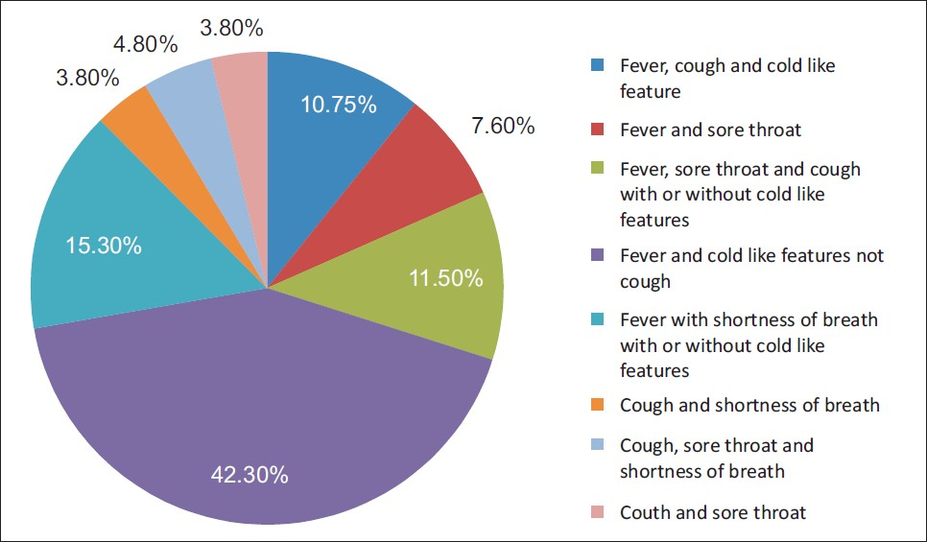
CLINICAL SYMPTOMS∹ 1. Fever with cough and cold.
2. Sneezing. 3. Sore throat. 4. Runny nose(green/yellow discharge). 5. Headache. 6. Fatigue.
7. Nasal congestion. 8. Bodyache. 9. Loss of appetite.
Progression∹ Common cold begins with fatigue, a feeling of being chilled,sneezing and headache followed by running of nose and cough with fever.
In children, the cough lasts for more than 10 days in 35-40% cases.

Slide 6
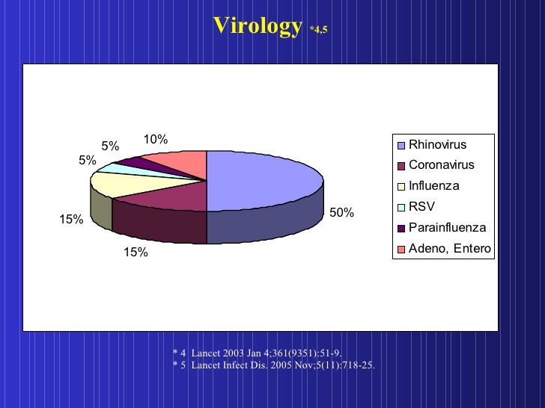
CAUSES∹ The common cold is a viral infection of the upper respiratory tract. Following virus are responsible mainly Rhino virus.
Transmission∹

Slide 7
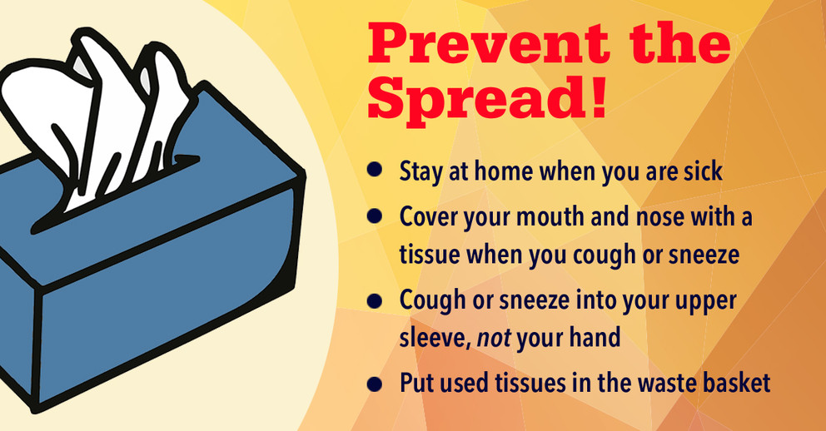
PREVENTION∹
Physical Intervention∹ 67 studies various types of Randomized control trial,cohort study,case-control studies, various technique used like-hand washing/use of alcohol based disinfectant/masks/gloves reduce the risk of common cold.
Zinc supplements Cochrane rivew of the prophylactic efficacy of orally administered(10-15mg)
PROGNOSIS∹ The common cold is generally mild with most symptoms generally improving in a week. Half of cases go away in 10 day s and 90% in 15 days.

Slide 8
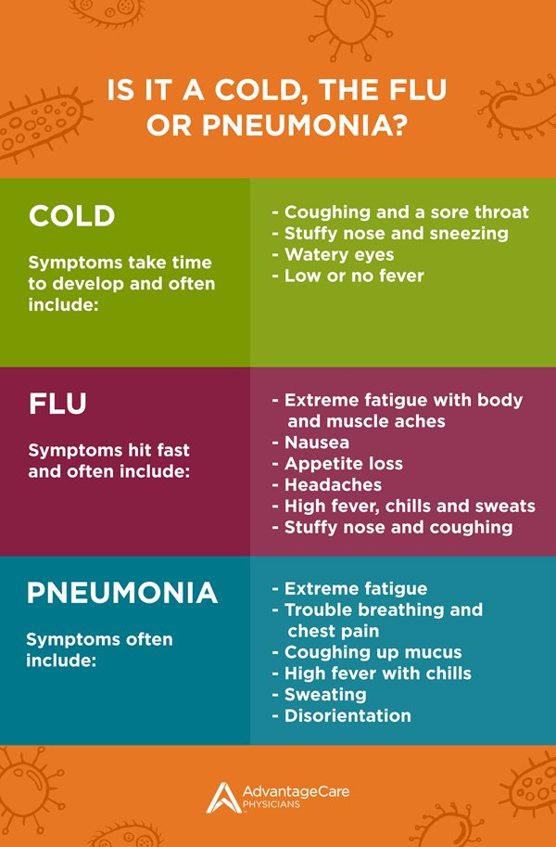
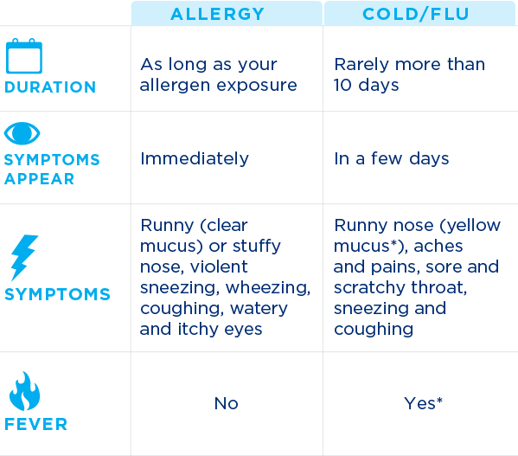
COMPLICATION∹ The complications if they occurs are usually in the very old,the very young,or those who are immunosuppressed. Complications are-
1. Sinusitis (8% cases)
2. Pharyngitis.
3. Ear infections (30% cases),etc
DIFFERENTIAL DIAGNOSIS∹
1. INFECTIONS∹ a) Sinusitis(more severe and lasts more then 4 weeks or longer,purulent nasal discharge,facial pain.)
b) Pharyngitis(Absent cough,tender anterior axillary cervical lymph node,tonsilar swelling or exudates.)
c) Pneumonia.
2. ALLERGY∹ a) Allergic Rhinitis(due to allergen,fever absent)

Slide 9
HOMOEOPATHY IN COMMON COLD∹
According to ORGANON OF MEDICINE,
Sec-73, As regards acute diseases,they are either of such a kind attack human being individually, the exciting cause being injuriuous influences to which they were particularly exposed........Chills, over heating....are exciting causes of such acute febrile affections.......
Homoeopathy treats the man in disease.So when a person with fever comes he is treated on the basis of acute totality-onset,types of fever,sucession of stages of fever,modality,thermal,thirst,general activity. Apart these-ailments,physical(chills,overheating....),mental emotions....
Sec-83, Individualizing examination of a case of disease......
Regarding Diet and Regimen,
Sec-263,The desire of the patient affected by an acute disease with regard food and drink is certainly chiefly for things that give palliative relief.........the room and the heat or coolness of the bed-covering......with the patients wish...........

Slide 10
DIFFERENT REPERTORY OF FEVER∹
1. THE THERAPEUTICS OF FEVER- Dr.H.C ALLEN (1879) Author states that, It is the patient not the fever that is chiefly and especially is considered. The remedy were selected from the totality of the objective,subjective and miasmatic symptoms.
Many repertories have given seperate chapters of fever like-Kents repertory/B.T.P.B/Complete repertory etc.....
But In B.B.C.R- Fever totality is the unique contribution of Dr. Boger. The arrangement of chapter is self-explanatory.Each stage of fever followed by TIME/AGG./AME./CONCOMITANT
JOURNAL OF COMMON COLD∹
IJRH JOURNAL(Homoeopathy in influenza like illness) Over the years the incidence of communicable diseases have reduced but viral infections especially influenza is on rise. It is caused by different strains of virus that produce symptoms with some variation and is better known as Influenza like illness (ILI). Even World Health Organization (WHO) has set up National Influenza Centres in Western Pacific and S]outh-East Asian regions for its surveillance . ] Homoeopathic practitioners successfully manage cases of ILI in their routine practice, they use centesimal as well as LM potencies with variable success.
In order to elicit the healing properties of medicine according to the principle of similitude, homoeopathy employs human experimentation known as homoeopathic pathogenetic trials (HPTs) as its model of clinical pharmacological research. HPT takes into account all kinds of primary actions or pathogenetic manifestations (mentals, generals, and local symptoms) elicited by drugs on the state of health of human beings. ^{[3]} In this issue, we present HPT on Gymnema sylvestre, ^{[4]} a herb commonly found in central India and is widely used for diabetes mellitus. However, from the symptoms produced during the HPT, this drug seems to be useful in clinical conditions such as headache, vertigo, common cold, cough, diarrhea, etc. Further, clinical verification is desirable to explore its therapeutic potential.

Slide 11
THERAPEUTICS OF COMMON COLD∹
There are large number of medicine for common cold these are- Aco,Ars.alb,allium cepa,Bell,Bry,cact,Chamomilla,cina,dul,ferr-p,gels,hep,merc.sol,phos,puls,rhus.tox.....etc..
I discuss few medicine with there characteristic of symptoms, these are-
1. Aconite- Great fear and anxiety of mind/ skin dry and hot with burning thirst for large quatites of cold water/complaints from dry cold air,dry north and west wind/cough on expiration.
2. Allium Cepa- Catarrhal dull headache with coryza˂in the evening˃in open air/coryza profuse watery and acrid nasal discharge.
3. Ars.Alb-Mentally restless but physically too weak to move,cant rest in one place/great thirst for cold water:drinks often,but little at a time:eats seldom,but much/˂midday,midnight˃ heat in general.
4. Bryonia-ailments from when warm weather sets in,after cold days,after taking cold or getting hot in summer,from chilling,overheated/dryness of mucous membrane /grat thirst for large quantites at long intervals/˂motion˃absolute rest.
5. Belladonna-violent delirium,hallucination/great liability to take cold/congestive headache with red face,eyes,throbbing of carotid/dryness of mucous membrane.
6. Puls-weeps easily,˃consolation/grat dryness of mouth with thirstlessness/nasal discharge thick,bland,yellowish-green.
7. Rhus.Tox-bad effects of getting wet after being over heated/restlessness,cant stay long in one position/great thirst with dry tongue(triangular red tip,imprint of teeth)/˂cold,during rest˃warm,motion.

Slide 12
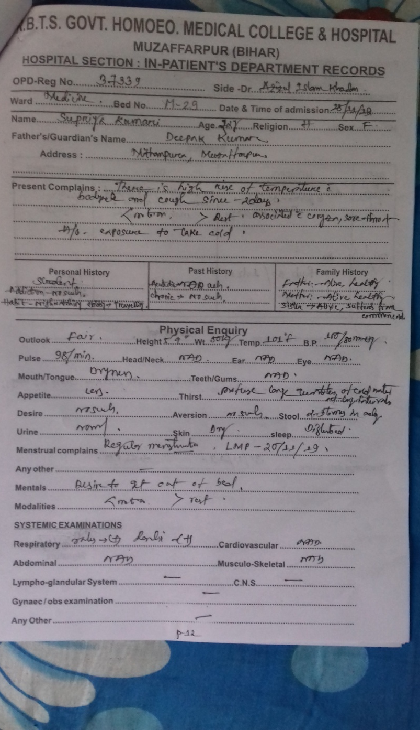
CASE PRESENTATION∹
PATIENT HISTORY WITH COMPLAINTS
PRESCRIPTION

Slide 13
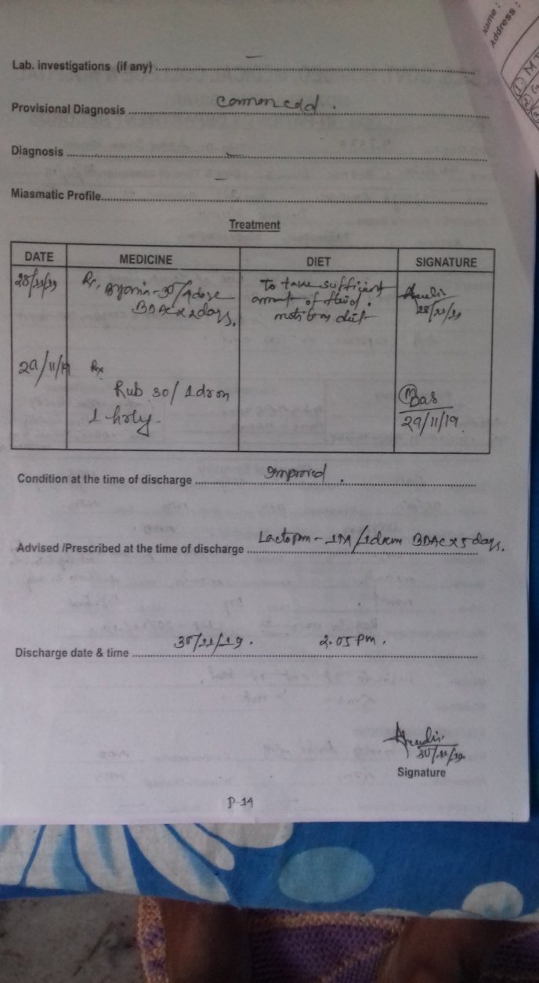
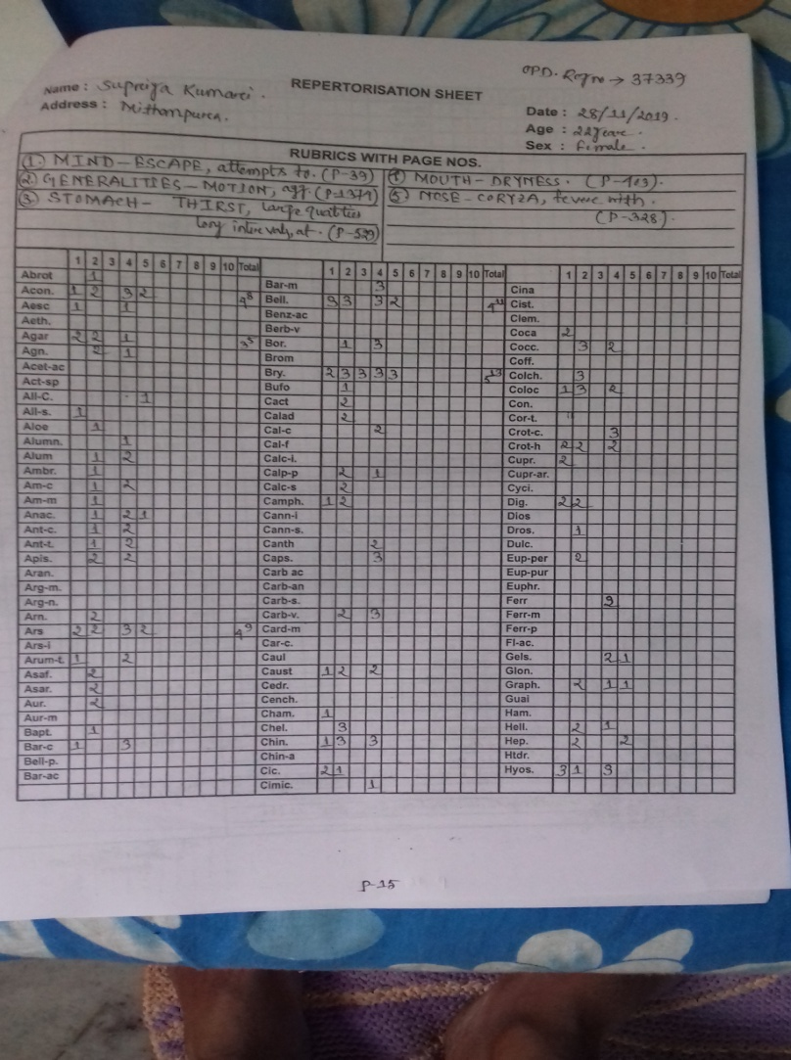
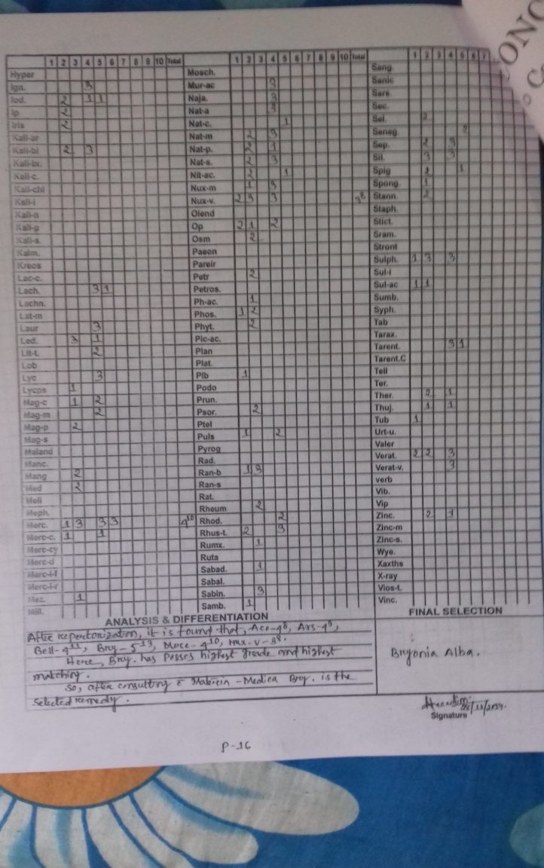
REPERTORIAL RESULT WITH REPERTORIZATION BY REPERTORIAL SHEET
THE FINAL SELECTION OF REMEDY IS BRYONIA ALBA

Slide 14
CONCLUSION∹
Common cold is nothing but the immuno mediated viral infection.Higher rates occurs in humid,crowded conditions,change of weather,rainy season.
Homoeopathic treatment provides safe and quick relief in common cold.
But along with medicine the patients needs adequete rest,take sufficient amount of water, nutritious diet, avoid cold exposure.

Slide 15
BIBLIOGRAPHY∹
1.Davidson-Principles and practice of medicine(19th edition),p-525.
2. Das PC,Textbook of medicine(6th edition),p-104.
3. Smillie G.wilson The New England Journal of Medicine,vol-23,number-17,Smillie G.wilson(oct.24,1940)
4.Worrall Graham,common cold(www.ncbi.nlm.nih.gov)
5.Common cold ,wikipedia(www.google.com)
6. cold,flu,pnemonia(www.acpny.com)
7.Hahnemann samuel,organon of medicine(5th and 6th edition)p-67,73,132
8.Allen HC,Allens keynotes(10th edition)
9. Boericke willium,pocket manual of Homoeopathic Materia medica and Reperetory,Low price edition.
10,Kent JT,Repertory of the Homoeopathic Materia medica,enriched Indian edition.
11. Tiwari shashi kant,Essentials of Repertorization(5th edition)
12. Manchanda RK,Homoeopathy in Influenza like illness2013,volume-7,issue-1 page-1-2(www.ijrh.com)
13. Allan Micheal.G and Arroll Bruce,Prevention and treatment of the common cold:making sense of the evidence(www.ncbi.nlm.nih.gov), 18 Feb.2014

Slide 16
THANK YOU

