Slide 1
Hemorrhoids
surgery
Efficacy of homoeopathy in surgical cases
Definition - Hemorrhoids are downward sliding of anal cushions due to straining or other causes.

Slide 2
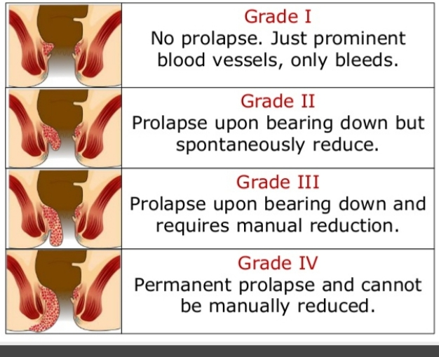
Grade and position of hemorrhoids
External
Internal
Interoexternal
external

Slide 3
Homoeopathic management
1.Aloe Socotrina
Miasm-Psora
Sore pain in anal region and pain in pelvic can be controlled with this remedy.
Burning sensation in the rectum while passing stools can be controlled effectively.
2.Muriatic acid
Miasm-Psora
Treatment in extreme cases of piles where the person cannot Bear touch.
It is used in case of large, swollen purple and blue
Hemorrhoids.

Slide 4
3.Hamamelis this one of the important remedies used to control bleeding caused due to piles. Pain in lower back and pulsation in the rectum can also be controlled with this remedy.
4.Arsenic album
Miasm- psoric,syphylitic,sycotic combination
For patient who experience burning sensation while
walking or standing.
bluish and swollen with lots of bleeding piles are
treated by this remedy.

Slide 5
5.Sulphur Miasm –anti-psoric It is one of the useful remedies for controlling major symptoms of internal and external piles. Itching, burning, pain in the anal area can be controlled with it. Some benefits of homoeopathic treatment.
Homoeopathic treatment can curses the piles completely.
No need to go for surgery
No chance of reappearance in future.
Relieves the pain and bleeding just after a few days of treatment.
It not only curse your piles permanently but also improve your bowel movement clear and relieves constipation.
It is most safe ,no drug side effect.

