Slide 2
Autism spectrum disorder, previously known as the pervasive developmental disorders, are a group of neurodevelopmental syndromes with heritability.

Slide 3
DSM-5

Slide 5
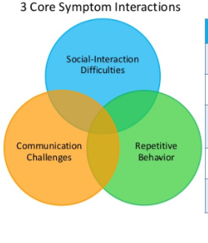
Autistic disorder was characterized by impairments in three domains:
social communication,
restricted and repetitive behaviors, and
aberrant language development and usage.

Slide 6
Children often exhibit idiosyncratic intense interest in a narrow range of activities, resist change, and do not respond to their social environment in accordance with their peers.
Approximately one third of children meeting the current DSM-5 diagnosis of autism spectrum disorder, exhibit intellectual disability (ID).

Slide 8
Kanner described children who exhibited extreme "autistic aloneness";
failure to assume an anticipatory posture;
delayed or deviant language development with echolalia and often with pronominal reversal (using you for I);
monotonous repetitions of noises or verbal utterances;
excellent rote memory;
limited range of spontaneous activities, stereotypies, and mannerisms; and
anxiously obsessive desire for the maintenance of sameness and dread of change.

Slide 9
Socially, Kanner's sample was described as having
poor eye contact;
awkward relationships; and
a preference for pictures and inanimate objects.
Kanner suggested that some children with infantile autism may have been misclassified as "mentally retarded" or schizophrenic, over time, it became evident that these were two distinct psychiatric entities.

Slide 11
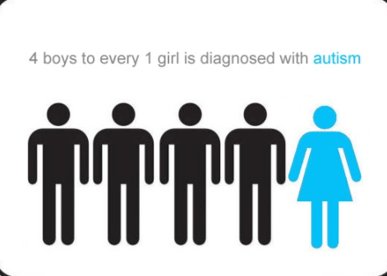
EPIDEMIOLOGY
The current estimated prevalence is at approximately 1 percent in the United States ¹ 0.4-0.5 per 1000 population. ³
It is diagnosed four times more often in boys than in girls.
In clinical samples, girls with autism spectrum disorder more often exhibit intellectual disability than boys.

Slide 12
ETIOLOGY AND PATHOGENESIS

Slide 13
Genetic Factors
Siblings of a child with autism spectrum disorder are also at increased risk for a variety of developmental impairments in communication and social skills, even when they do not meet criteria for autism spectrum disorder.

Slide 14
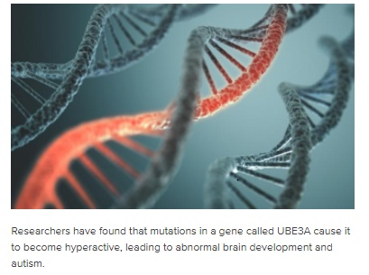
GENETIC FACTORS: Up to 15 percent of cases of autism spectrum disorder appear to be associated with a known genetic mutation, in most cases; its expression is dependent on multiple genes. SLC29A4 gene UBE3A GENE

Slide 15
Immunological Factors –
Several reports have suggested that immunological incompatibility (i.e., maternal antibodies directed at the foetus) may contribute to autistic disorder. The lymphocytes of some autistic children react with maternal antibodies, which raises the possibility that embryonic neural tissues may be damaged during gestation.

Slide 16
Prenatal Factors - advanced maternal and paternal age at birth, maternal gestational bleeding, gestational diabetes, and firstborn baby.
Perinatal Factors - umbilical cord complications, birth trauma, fetal distress, small for gestational age, low birth weight, low 5-minute Apgar score, congenital malformation, ABO blood group system or Rh factor incompatibility and hyperbilirubinemia.

Slide 17
Comorbid Neurological Disorders - 4 to 32 percent of individuals with ASD have grand mal seizures at some time, and about 20 to 25 percent show ventricular enlargement on computed tomography (CT) scans.
Various EEG abnormalities^{1,3} are found in 10 to 83 percent of children with the previously defined autistic disorder, and although no EEG finding is specific to autistic disorder, there is some indication of failed cerebral lateralization.

Slide 18
Risk factors ⁵
Gender—boys are more likely to be diagnosed with ASD than girls
Having a sibling with ASD
Having older parents (a mother who was 35 or older, and/or a father who was 40 or older when the baby was born)
Genetics—about 20% of children with ASD also have certain genetic conditions. Those conditions include Down syndrome, fragile X syndrome, and tuberous sclerosis among others.

Slide 20
CORE SYMPTOMS

Slide 23
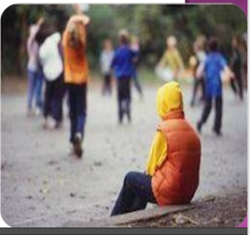
Persistent Deficits In Social Communication and Interaction

Slide 24
Children characteristically do not conform to the expected level of reciprocal social skills and spontaneous nonverbal social interactions. Less frequent and poor eye contact is common during childhood and adolescence compared to other children.
Infants may not develop a social smile, and older babies may lack the anticipatory posture for being picked up by a caretaker.

Slide 25
The social development of children is characterized by atypical, but not absent, attachment behavior¹; Absence of fear in presence of danger .
Children may not explicitly acknowledge or differentiate the most important persons in their lives-parents, siblings and teachers-and on the other hand, may not react as strongly to being left with a stranger compared to others their age, treats people as furniture

Slide 26
They often feel and display extreme anxiety when their usual routine is disrupted. By the time they reach school age, their social skills may have increased, and social withdrawal may be less obvious, particularly in higher-functioning children.

Slide 27
An observable deficit often remains in spontaneous play with peers and in subtle social abilities that promote developing friendships, prefers solitary games.
In older school-aged children, social impairments may be manifested in a lack of conventional back and forth conversation, fewer shared interests, and fewer body and facial gestures during conversations.
Cognitively, children are frequently more skilled in visualspatial tasks than in tasks requiring skill in verbal reasoning.

Slide 28
Individuals have difficulty with making attributions about the motivation or intentions of others (also termed "theory of mind") and thus have difficulty developing empathy. The lack of a "theory of mind" produces difficulties interpreting the social behavior of others and leads to a lack of social reciprocation.
Individuals generally desire friendships, and higher functioning children may be aware that their lack of spontaneity and poor skills in responding to the emotions and feelings of their peers are major obstacles in developing friendships.

Slide 29
So, children with this disorder are often avoided or shunned by peers who expect them to conform to their mainstream activities, and experience their behavior as awkward and alienating.
Adolescents and adults often desire romantic relationships, and for some, their increase in social competence and skills over time enables them to develop long-term relationships.

Slide 30
Restricted, Repetitive Patterns of Behavior, Interests and Activities

Slide 31
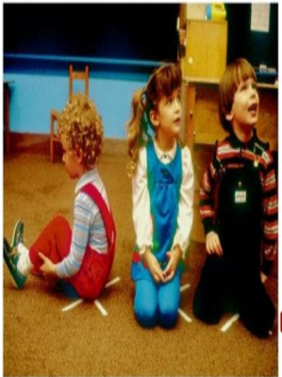
From the first years of life, developmentally expected exploratory play is restricted and muted.
Children do not show the level of imitative play or abstract pantomime that other children of their age exhibit spontaneously. The activities and play of children may appear more rigid, repetitive, and monotonous than their peers.
Ritualistic and compulsive behaviors are common in early and middle childhood.

Slide 32
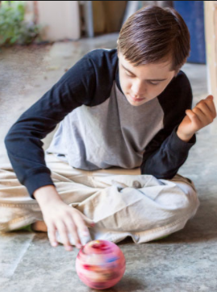
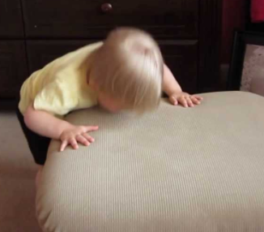
They often seem to enjoy spinning, banging, and watching water flowing.
Having overly focused interests, such as with moving objects or parts of objects. Having a lasting, intense interest in certain topics, such as numbers, details, or facts.

Slide 33
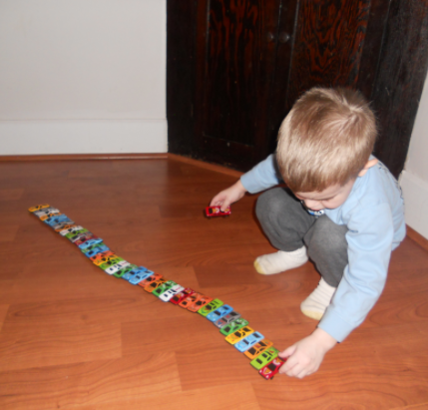
Frank compulsive behaviors such as lining up objects are common and not infrequently a child with may exhibit a strong attachment to a particular inanimate object.

Slide 34
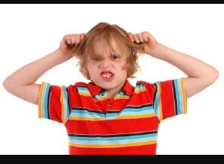
Children who are severely intellectually disabled have increased rates of self-stimulatory and self-injurious behaviors. Stereotypies such as head-banging, body-spinning, hand-flicking, lining-up objects, rocking, clapping, twirling, etc. mannerisms, and grimacing emerge most frequently when a child is in a less-structured situation.

Slide 35
Children often find transitions and changes intimidating. Moving to a new house, rearranging furniture in a room, or even a change such as eating a meal before a bath when the reverse was the routine, may evoke panic, fear, or temper tantrums in a child with autism spectrum disorder.

Slide 36
Associated Physical Characteristics.
At first glance, children do not show any physical signs indicating the disorder.
Children overall, do exhibit higher rates of minor physical anomalies, such as ear malformations, and others that may reflect abnormalities in foetal development of those organs along with parts of the brain.
Children have been observed to have a higher incidence of abnormal dermatoglyphics (e.g., fingerprints) than those in the general population. This finding may suggest a disturbance in neuroectodermal development.

Slide 37
Disturbances In Language Development and Usage
Deficits in language development and difficulty using language to communicate ideas are not among the core criteria for diagnosing autism spectrum disorder, however, they occur in a subset of those individuals with autism spectrum disorder.
Language deviance, as much as language delay, is characteristic of more severe subtypes of autism spectrum disorder. Children with severe ASD have significant difficulty putting meaningful sentences together, even when they have large vocabularies.

Slide 38
In the first year of life, a typical pattern of babbling may be minimal or absent^{1,3}. Some children with vocalize noises---clicks, screeches, or nonsense syllablesin a stereotyped fashion, without a seeming intent of communication.
Unlike most young children who generally have better receptive language skills than expressive ones, children with ASD may express more than they understand.
Lack of verbal or facial response to sounds or voices; might be thought as deaf initially.

Slide 39
Having trouble understanding another person’s point of view or being unable to predict or understand other people’s actions.
Often talking at length about a favorite subject without noticing that others are not interested or without giving others a chance to respond.

Slide 40
It is not atypical for a child with to use a word once and then not use it again for a week, a month, or years. Speech may contain echolalia, both immediate and delayed, or stereotyped phrases that seem out of context. These language patterns are frequently associated with pronoun reversals.

Slide 41
A child with autistic disorder might say, "You want the toy" when she means that she wants it. Difficulties in articulation are also common. Many children with autistic disorder use peculiar voice quality and rhythm. About 50 percent never develop useful speech.
Some of the brightest children show a particular fascination with letters and numbers.

Slide 42
Children with autism spectrum disorder sometimes excel in certain tasks or have special abilities; for example, a child may learn to read fluently at preschool age (hyperlexia ), often astonishingly well. Very young children with autism spectrum disorder who can read many words, however, have little comprehension of the words read.
Rote memory is usually good. Abstract thinking is impaired.

Slide 43
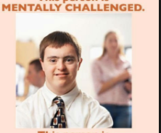
Intellectual Disability.
About 30 percent of children with ASD function in the intellectually disabled range of intellectual function. Of those, about 30 percent of children function in the mild to moderate range, and about 45 to 50 percent are severely to profoundly intellectually disabled.¹Only about 25% of all children with autism have an IQ of more than 70.
There appears to be a correlation
between severity of mental
retardation, absence of speech
and epilepsy in autism.
Epilepsy is common in children with an IQ of less than 50.

Slide 44
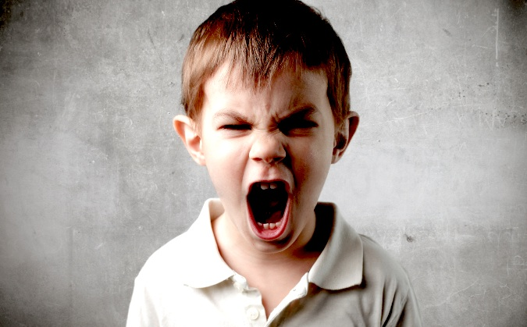
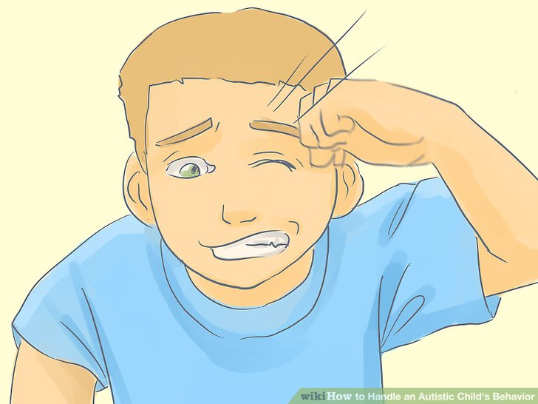
Irritability.
Irritability includes aggression, self-injurious behaviors, and severe temper tantrums.
Severe temper tantrums may be difficult to subdue, and self-injurious behaviors are often problematic to control. These symptoms are often produced by everyday situations in which these youth are expected to transition from one activity to another, sit in a classroom setting, or remain still when they desire to run around.

Slide 45
Instability of Mood and Affect.¹
Some children exhibit sudden mood changes, with bursts of laughing or crying without an obvious reason. It is difficult to learn more about these episodes if the child cannot express the thoughts related to the affect.

Slide 46
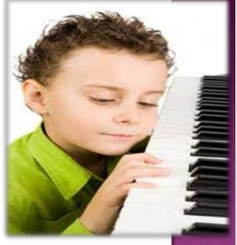
Response to Sensory Stimuli.
Children have been observed to overrespond to some stimuli and underrespond to other sensory stimuli (e.g., to sound and pain).
Many children with autism particularly enjoy music.

Slide 47
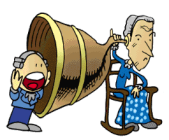
It is not uncommon for a child with autism spectrum disorder to appear deaf, at times showing little response to a normal speaking voice; on the other hand, the same child may show intent interest in the sound of a wristwatch. Some children have a heightened pain threshold or an altered response to pain.

Slide 48
Indeed, some children do not respond to an injury by crying or seeking comfort.
Some youth perseverate on a sensory experience; for example, they frequently hum a tune or sing a song or commercial jingle before saying words or using speech. Some particularly enjoy vestibular stimulation-spinning, swinging, and up-and-down movements.

Slide 49
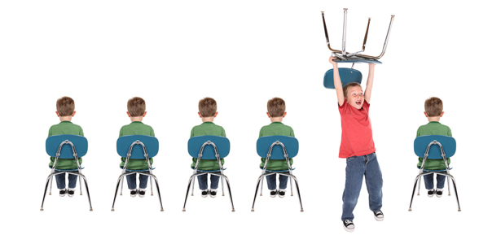
Hyperactivity and Inattention.
Hyperactivity and inattention are both common behaviors in young children. Lower than average activity level is less frequent; when present, it often alternates with hyperactivity. Short attention span, poor ability to focus on a task, may also interfere with daily functioning.

Slide 50
Precocious Skills.
Some have precocious or splinter skills of great proficiency, such as prodigious rote memories or calculating abilities, usually beyond the capabilities of their normal peers.
Other potential precocious abilities in some children with autism spectrum disorder include hyperlexia, an early ability to read well (even though they cannot understand what they read), memorizing and reciting, and musical abilities (singing or playing tunes or recognizing musical pieces).^{1,3}

Slide 51
Strengths and abilities may include: ⁵
Having above-average intelligence – the CDC reports 46% of ASD children have above average intelligence
Being able to learn things in detail and remember information for long periods of time
Being strong visual and auditory learners
Excelling in math, science, music, or art.

Slide 52
Insomnia.
Insomnia is a frequent sleep problem among children and adolescents, estimated to occur in 44 to 83 percent of school-aged children. Both behavioral and pharmacologic interventions have been applied as interventions.
Behavioral interventions include modification of parental behavior before and at bedtime, and providing routines that remove reinforcers for remaining awake.

Slide 53
Minor Infections and Gastrointestinal Symptoms.
Young children have been reported to have a higher-than-expected incidence of upper respiratory infections and other minor infections.
Gastrointestinal symptoms commonly found among children include excessive burping, constipation, and loose bowel movements.
Also seen is an increased incidence of febrile seizures in children with autism spectrum disorder.

Slide 54
DIFFERENTIAL DIAGNOSIS
Social (Pragmatic) communication disorder
Childhood Onset Schizophrenia
Intellectual Disability with Behavioural Symptoms
Language Disorder
Congenital Deafness or Hearing Impairment
Psychosocial Deprivation

Slide 55
COURSE AND PROGNOSIS
Autism spectrum disorder is typically a lifelong, albeit heterogeneous, disorder with a highly variable severity and prognosis.
Children with autism spectrum disorder and IQs above 70 with average adaptive skills, who develop communicative language by ages 5 to 7 years, have the best prognoses.

Slide 56
Early intensive behavioral interventions have been found to provide a profound positive impact and in some cases lead to recovery and function in the average range.
The autism spectrum disorder symptom areas that do not seem to improve substantively over time with early behavioral interventions are related to ritualistic and repetitive behaviors.

Slide 57
TREATMENT
The goals are to target core behaviors to improve social interactions, communication, broaden strategies to integrate into schools, develop meaningful peer relationships, and increase long-term skills in independent living.

Slide 58
Psychosocial treatment interventions aim to develop skills in social conventions, increase socially acceptable and prosocial behavior with peers, reduction of irritable and disruptive behaviors that may emerge in school and at home and may exacerbate during transitions and to decrease odd behavioral symptoms.

Slide 59
Parents of children with autism spectrum disorder often benefit from psychoeducation, support, and counselling in order to optimize their relationships and effectiveness with their children.
Comprehensive treatment for autism spectrum disorder including intensive behavioral programs, parent training and participation, and academic/educational interventions have provided the most promising results.

Slide 60
1. Social Skills Training.
Children are given guided practice in initiating social conversation, greetings, initiating games, and joint attention.
Emotion identification and regulation are often included in practice with recognizing and learning how to label emotions in given social situations, learning to attribute appropriate emotional reactions in others, and social problem-solving techniques.

Slide 61
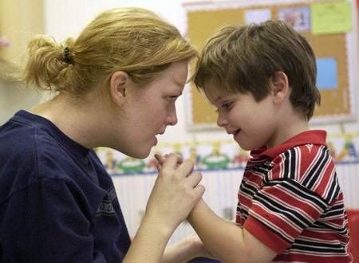
The goals are that with practice in the group setting, the child will be able to use the techniques in less structured settings and internalize strategies to interact positively with peers.
Behavioral Interventions (Bis) -Early intervention is recommended for repetitive behaviors that are self-injurious; behavioral interventions may need to be combined with pharmacologic treatments to adequately manage the symptoms.

Slide 62
1. Treatment and Education of Autistic and Communication related Handicapped children (TEACCH). Originally developed at the University of North Carolina at Chapel Hill in the 1970s, TEACCH involves structured teaching based on the notion that children with autism spectrum disorder have difficulty with perception, and so this teaching method incorporates many visual supports and a picture schedule to aid in teaching academic subjects as well as socially appropriate responses. The physical environment is arranged to support visual learning, and the day is structured to promote autonomy and social relatedness.

Slide 63
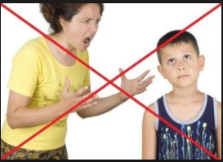
2. Broad-based approaches. These educational plans include a blend of teaching strategies that use behavioral analysis and also focus on language remediation. Behavioral reinforcement is provided for socially acceptable behaviors while academic subjects are being taught. TEACCH may also be incorporated into a broader special educational program for autism spectrum disorder.

Slide 64
3. Computer-based approaches and virtual reality. Computerbased approaches and virtual reality teaching are centered on using computer-based programs, games, and interactive programs to teach language acquisition and reading skills. This provides the child with a sense of mastery and delivers a behaviorally based instruction in a modality that is appealing for the child. The Let's Face It! program is a computerized game that helps to teach children with autism spectrum disorder to recognize faces.

Slide 65
REFERENCES:
1.SYNOPSIS OF PSYCHIATRY by Kaplan &Sadock's, eleventh edition, Wolter and Kluwer publishers.
2.THE ICD-10 CLASSIFICATION OF MENTAL AND BEHAVIOURALDISORDERS ,Reprinted edition 2004, World Health Organization 1992.
3. A SHORT TEXTBOOK OF PSYCHIATRY by Niraj Ahuja, 7th edition, Jaypee publishers.
4.https://www.researchgate.net/profile/Andrew_Pickles/publication/226341116
5. https://www.nimh.nih.gov/health/topics/autism-spectrum-disorders-asd/index
6. ESSENTIALS OF PSYCHIATRY by Jerald Kay and Allan Tasman, 2006 John Wiley &Sons .

