Slide 1
CASE PRESENTATION

Slide 2
Personal Data:
Name of patient: XYZ
Age/Sex: 32/Female
Religion/Nationality: Hindu/Indian
Name of Husband: ABC
Occupation: Businesswoman
Family Size: 3
Diet: Mixed
Address:
Chief Complaint:
Patient presents with pain in the knee, only rt. sided, < in morning
Pain is stitching type, < walking, standing+++
‘whenever I walk, I feel like something is present over my knees’, Heaviness while walking.

Slide 3
History of present illness:
Pain in rt knee since last 7-8 months. She took medicines from many doctors like calcium tablet, D3 sachet, painkillers, etc. It got better for some days, then pain started again after the effect of medicines was over.
Whole day pain persists but she ignores it then pain becomes worse at night.
Pain < at night and when alone, when giving it attention, > by ignoring the pain
Past History:
Typhoid at 9yrs of age
GI complaints like gastralgia or diarrhoea
Family History:
Father: died from accident when patient was 14yrs old
Mother: died due to unknown cause, when pt. was 6yrs old
Sister: Alive, has allergic rhinitis

Slide 4
Associated Complaints:
Constipation, since 3-4yrs of age
Location: Rectum
Sensation: I feel my rectum is loaded but there is no urge for evacuation. Stony hard feeling. After 2-3 days, I had to take isaphgul or cold water in morning.
Modality: > by cold water, < before menses
Personal History:
Accommodation/Economic Status: Good
Hobbies: reading books, spending time at home with my pets
Milestones: Normal
Occupational History: Running her father’s business
Marital History: Married at 30yrs of age
Gynaecological History: Cycle regular, menses profuse, bright red, fluid, constipation before menses.

Slide 5
No abnormal discharge/leucorrhoea per vagina
No h/o any gynaecological surgery.
Physical Generals:
Appearance: well-built, fair and beautiful
Appetite: 5-6 meals/day
Thirst: 18-20 glasses/day, depends on season, drinks large quantities at large intervals
Desire: for spicy food, smoked meat and chicken, south Indian food like idli, dosa, etc
Aversion: Nothing specific
Stool: Constipation
Urine: 8-9/1(D/N)
Sweat: not specific
Sleep: 6-7 hrs of sleep, sound, patient puts both her hands in upward direction as if covering her ears.
Thermal State: Hot

Slide 6
(Summer/Winter: no covering, fanning in both seasons, likes to bath with cold water in summer and lukewarm water in late winter, no specific relation with weather)
Patient says that she doesn’t like to wear woollen clothes in winter, as she starts to perspire and feel internal heat.

Slide 7
Life space:
Childhood history: Her mother died when she was 4yrs of age.
When asked about herself, she said that she takes care of her father’s business in a successful manner.
When asked about her relations, she says that I have a very good and friend-like relationship with her husband and her mother-in-law and I love spending time with them.
My mother-in-law is very caring, understanding and always stands with me.
I love when my mother-in-law caresses me. Even when she scolds me, I still know that she will never do anything bad to me.
What do you mean by bad/wrong?:
Her father had second marriage when she was around 10yrs of age. Initially everything was good. She has one stepbrother. The problem started after her father’s death. She was sexually abused by her stepbrother(she was 15yrs old).
She could not believe what actually happened with her – crying, doesn’t want to talk, she complained to her mother but she didn’t support her. Her mother’s behaviour totally changed after her father’s death. She behaved as if both sisters are servants of the house. She didn’t trust her even though she knew the truth.
Even being a woman, she didn’t support me because I was her stepdaughter – totally broken, cried, such thing would not happen if her father was there.

Slide 8
Whole family was against me and I was helpless at that time as I couldn’t tell my problem to my younger sister due to my stepmother’s warning – if I expose my situation, then she will throw both of us out of the house and we will have no shelter to live.
When her dad was at hospital, he told me to always stay and care of your little sister. At my father’s funeral, I was totally blank – kuch samajh nahi aaya ki kya ho gaya? Main rona chahti thi par nahi ro paayi.
When asked about the abuse, she said, Mera man kiya ki main use maar doon.
She also tried to kill him with knife, but failed. She was locked in the room and beaten a lot for 3 days.
I wanted to leave the house, take revenge but I couldn’t because of my sister. I was 15 yr old and had no money so how would I take care of her, so I stayed in that house but at that time I realised that there is nothing without power.
I started focussing on my studies, but I was repeatedly abused.
I did PhD and till then the abuse reduced because I became physically strong and aggressive.
I never let anyone come close to me. I don’t trust anyone.
I always get a feeling whenever something bad is going to happen to me.
About her work – I like to do everything perfectly, don’t like anyone interfering with me. I have a very bad anger.
Jab zyada gussa aata hai, us waqt kisine kuch kaha, toh phir vo gaya.

Slide 9
Us waqt sirf mere husband mujhe kaabu kar sakte hai, aur koi nahi.
Before marriage, I told everything to my husband and MIL. They accepted me and liked my loyalty.
After marriage, I did a court case and got my father’s properties back.
Jo un logo ne mere saath kiya, main uss jagah reh sakti thi, na seh sakti thi, main bhi unhe aisa hi jakdungi, na vo kisiko bata payenge, na seh payenge.
When I saw my stepmother in court, I felt relaxed and peaceful.
I did what I wanted.
Dreams of animals, loves crocodiles+++, loves their green eyes, their structure, behaviour, etc.
She likes to wear fashionable and colourful clothes.
She has no physical relation with husband, doesn’t talk anymore about it.

Slide 10
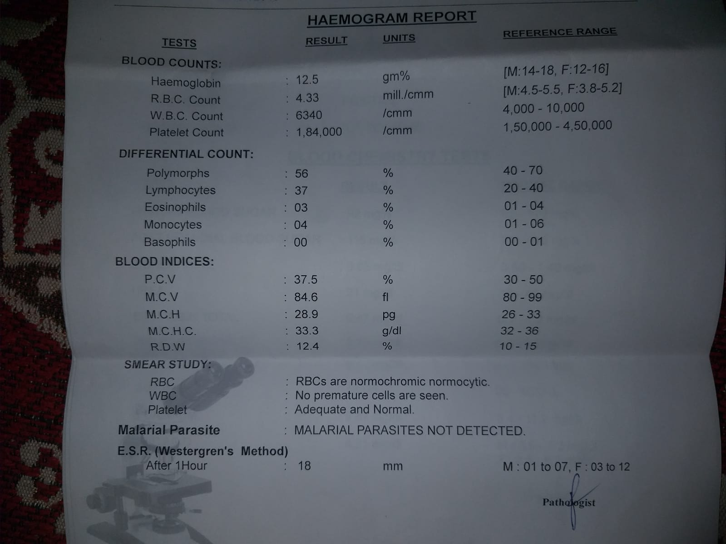
Lab Investigations:

Slide 11
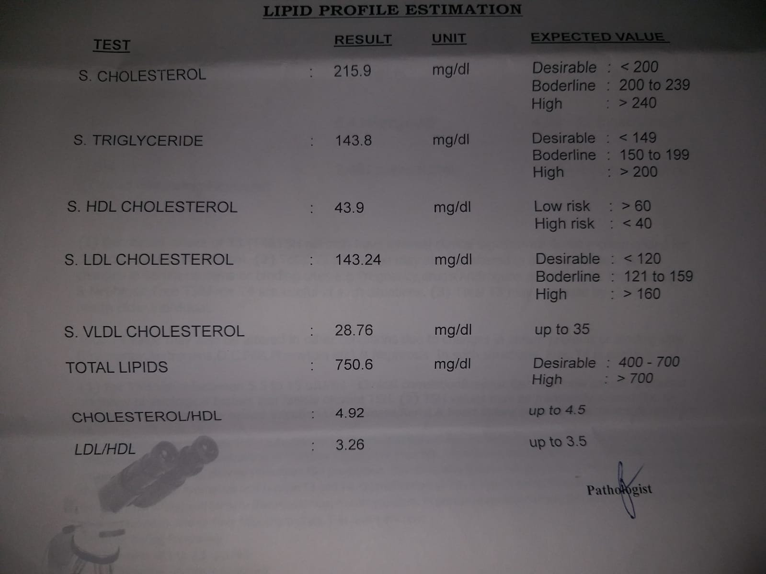

Slide 12
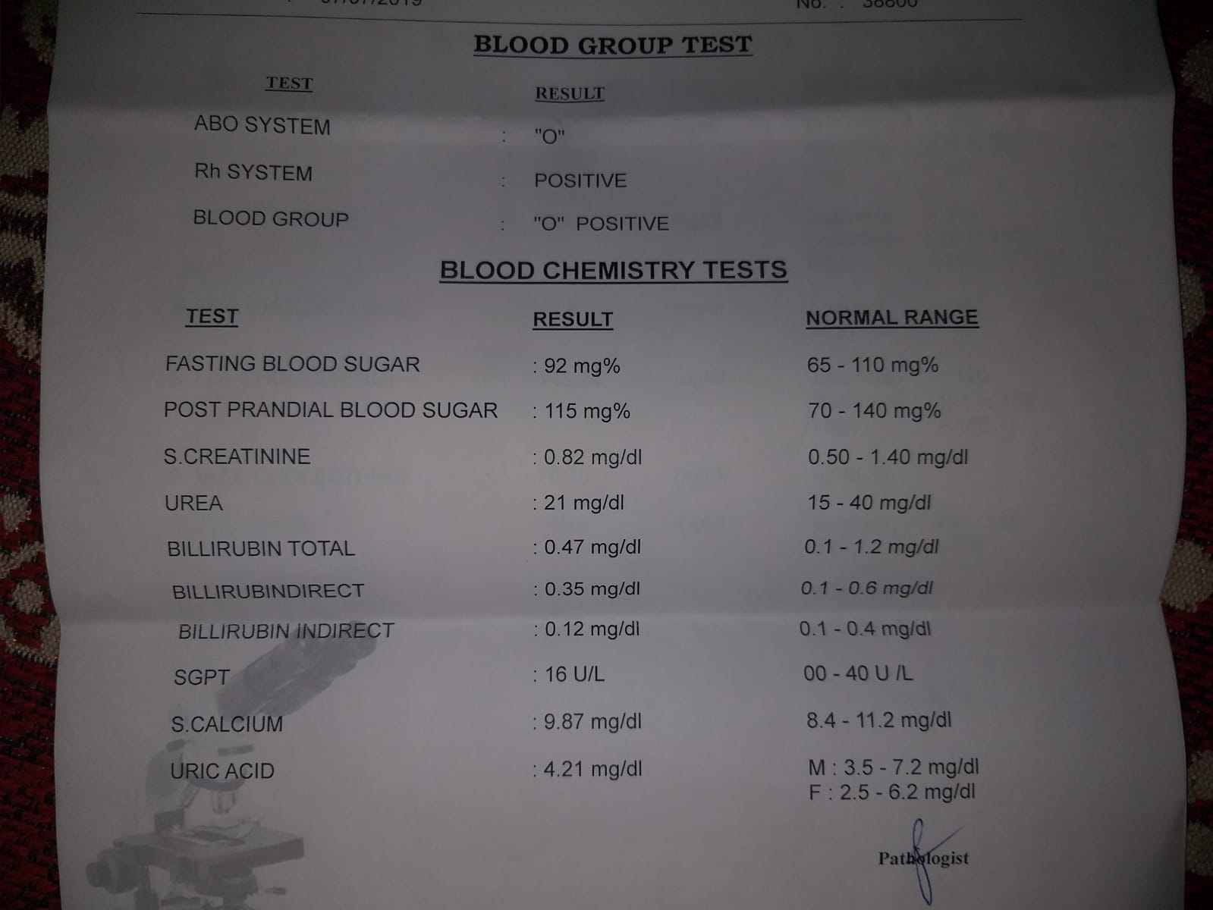

Slide 13
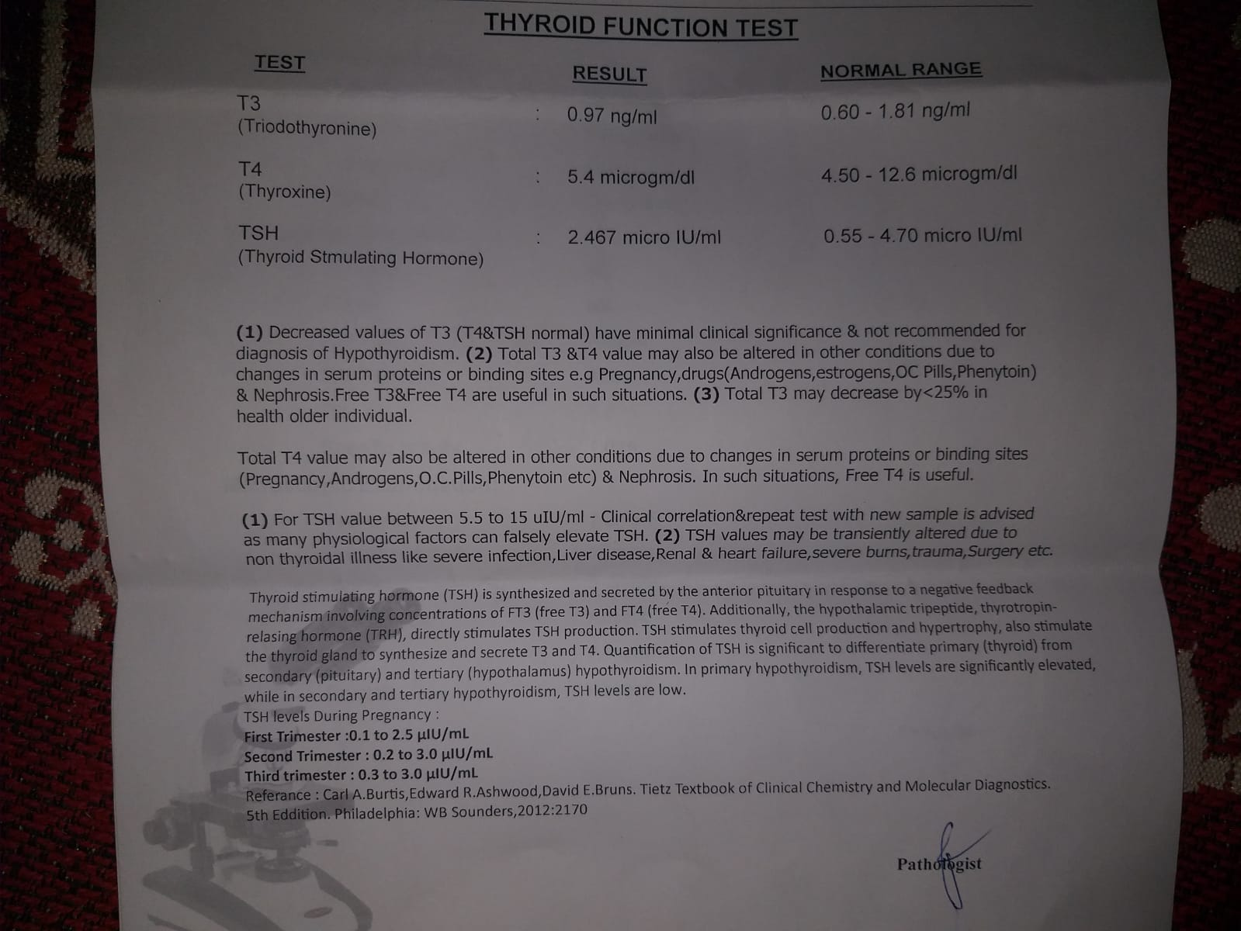

Slide 14
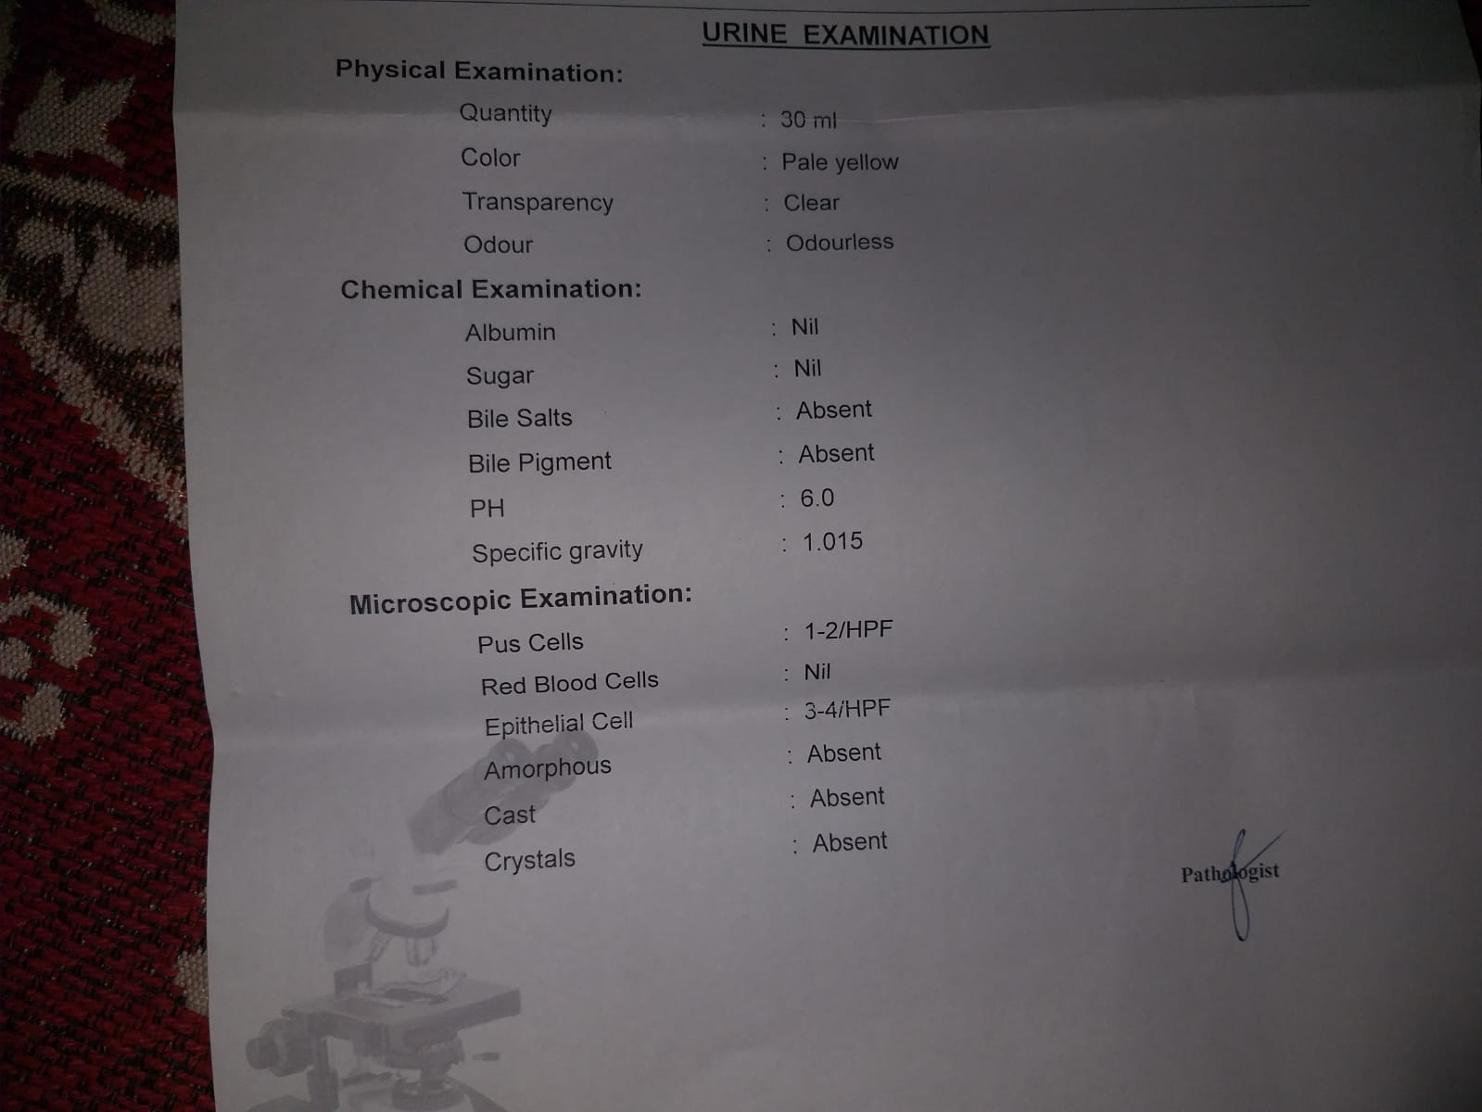

Slide 15
Analysis of symptoms:
Pain in knee joint, rt. sided (PPCS)
Stitching type of pain (PPUS)
< morning, walking, standing+++ (CM)
Sensation of heaviness, < at night, giving attention to complaint (PPUS)
Constipation, has to remove hard stool mechanically (PGUS)
< before menses, > by drinking cold water (CM)
Desire for spicy food+++, smoked meat, chicken, south indian food (PGUS)
Thirst for large quantities of water at large intervals++ (PGUS)
Thermally hot patient (PGUS)
Mental generals:
Strong will power
Ailments from sexual abuse
Revengeful
Fear of coition

Slide 16
Love for animals
Anger violent, can’t tolerate interruption
Obstinate
Clairvoyance
Courageous and ambitious personality
Perfectionist
Evaluation of symptoms:
Strong will power
Ailments from sexual abuse
Revengeful
Fear of coition
Love for animals
Anger violent, can’t tolerate interruption

Slide 17
Obstinate
Clairvoyance
Courageous and ambitious personality
Perfectionist
Desire for spicy food+++, smoked meat, chicken, south indian food
Thirst for large quantities of water at large intervals++
Thermally hot patient
Constipation, has to remove hard stool mechanically
< before menses, > by drinking cold water
Sensation of heaviness, < at night, giving attention to complaint
Stitching type of pain
< morning, walking, standing+++
Pain in knee joint, rt. sided

Slide 18
Totality of symptoms:
Strong will power
Ailments from sexual abuse
Revengeful
Fear of coition
Love for animals
Anger violent, can’t tolerate interruption
Obstinate
Clairvoyance
Courageous and ambitious personality
Perfectionist

Slide 19
Rubrics for repertorisation: (Synthesis Repertory)
Mind, ailments from, abused sexually
Mind, anger, contradiction from
Mind, anger, interruption from
Mind, anger, violent
Mind, animals, love for animals
Mind, clairvoyance
Mind, courageous
Mind, fear coition, rape
Mind, hatred
Mind, ailments from, abused, after being
Mind, obstinate
Mind, perfectionist

Slide 20
Mind, will, strong will power
rectum., constipation, mechanically must remove stool
Rectum, constipation, menses agg.
Susceptibility: HIGH

Slide 21
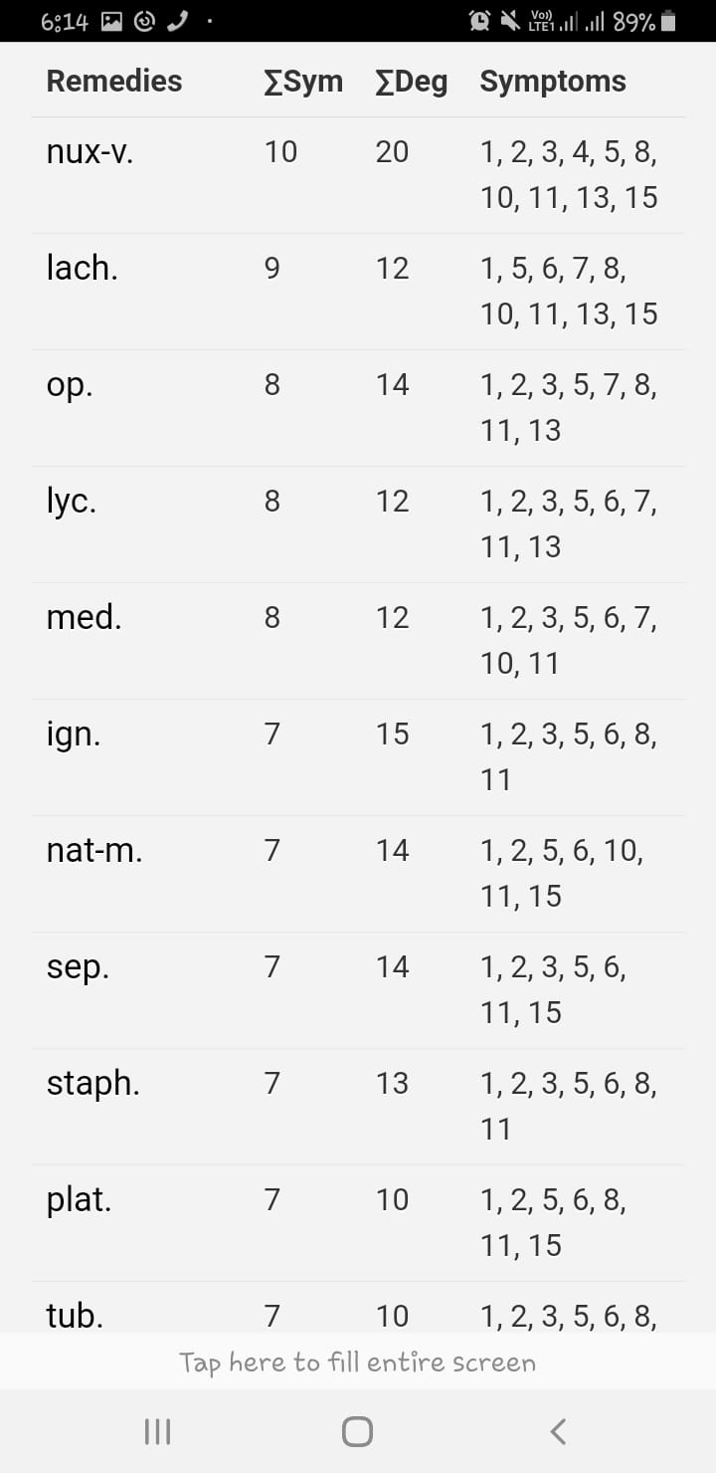
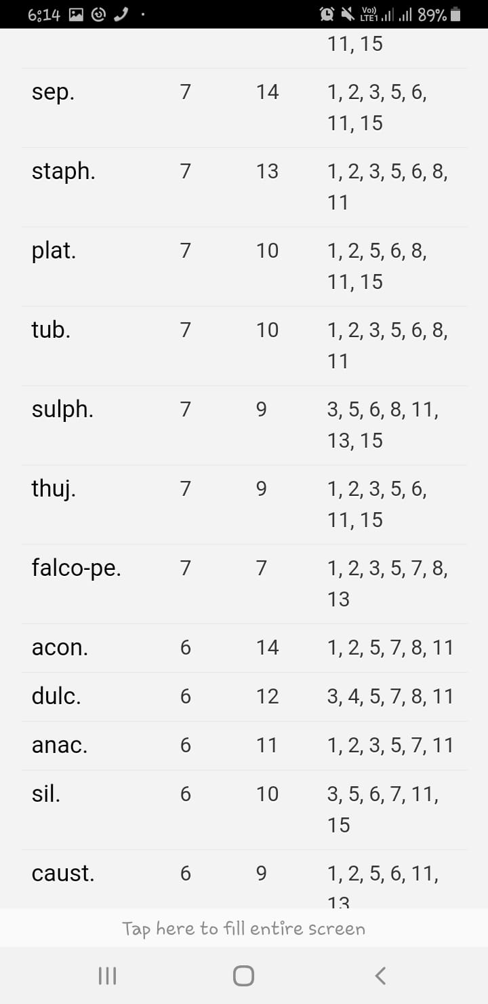

Slide 22
Prescription:
Lachesis 200C

