Slide 1
ACUTE APPENDICITIS
RAJKOT HOMOEOPATHIC MEDICAL COLLEGE; PARUL UNIVERSITY.
DR. FORAM RATANPARA ( 3rd year ).

Slide 2
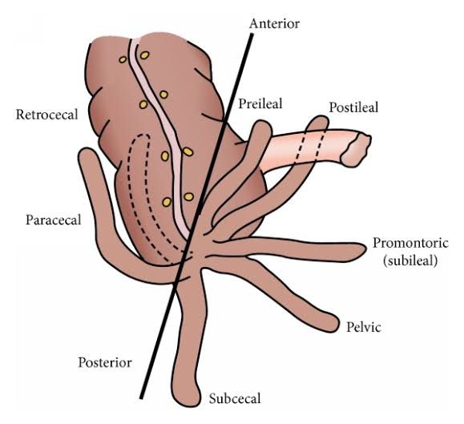
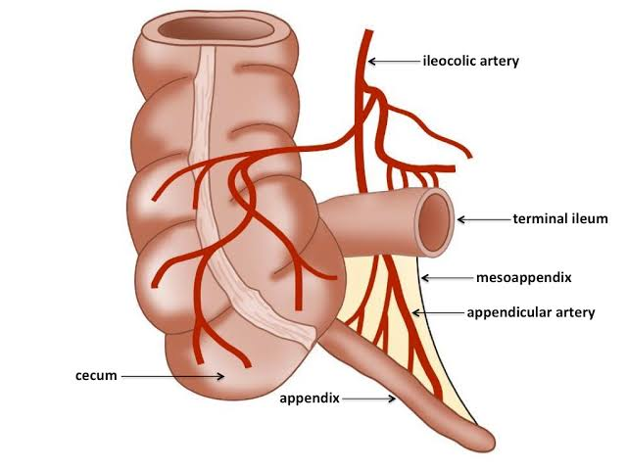
Acute Appendicitis
Anatomy and blood supply of appendix

Slide 3
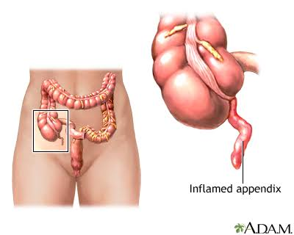
DEFINITION:-
A condition in which the appendix becomes inflamed and filled with pus, causing pain.

Slide 4
AETIOLOGY
It is common in young males.
It is common in white races.
Fibre rich diet prevents appendicitis. Less fibre diet increases chance of appendicitis.
It is common in May and August – seasonal variation often called as epidemic appendicitis.
Viral infection may cause mucosal oedema and
inflammation which later gets infected by bacteria causing appendicitis.
Family history may be relevant in 30% of appendicitis in children with appendicitis occurring in first degree relatives.

Slide 5
Cont....
8.Obstruction of the lumen of appendix causing obstructive appendicitis.
– Blockage occurs due to -Faecoliths, stricture,foreign body, round worm or threadworm.
– Adhesions and kinking—Carcinoma caecum near the base, ileocaecal Crohn’s disease.
9.Distal colonic obstruction.
10.Abuse of purgatives.
11.Faecolith is the commonest cause.

Slide 6
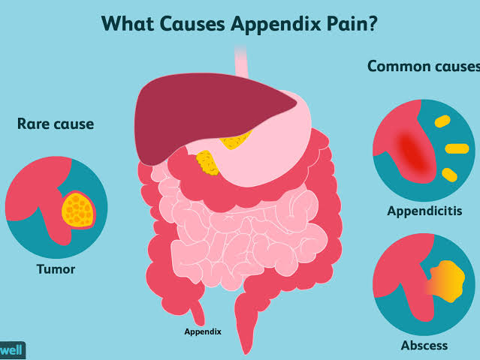
Organisms:
E. coli (85%), enterococci, (30%), streptococci, Anaerobic streptococci, Cl. welchii, bacteroides.
Pseudoappendicitis is appendicitis due to acute ileitis following Yersinia infection. It is often due to Crohn’s disease.

Slide 7
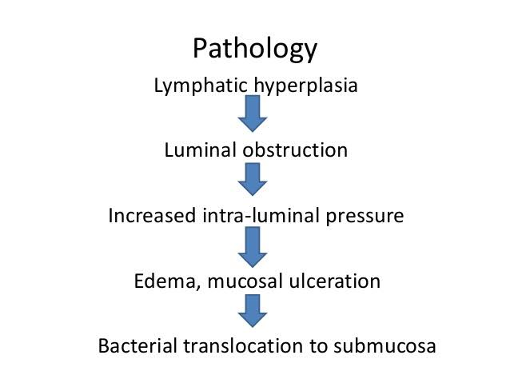
PATHOGENESIS
Acute inflammation of the mucus membrane withsecondary infection without obstruction causes acute non obstructive appendicitis. It may lead into resolution, fibrosis, recurrent appendicitis or eventual obstructive appendicitis.

Slide 8
Luminal obstruction by faecolith, lymphoidhyperplasia, pinworm (oxyuris vermicularis), otherworms, foreign body, carcinoma/Crohn‘s disease →mucus and inflammatory fluid collects inside the lumen → increases intraluminal pressure → leads to blockage of lymphatic and venous drainage →resulting in increased oedema of mucosa and wall → causes mucosal ulceration and ischaemia → bacterial translocation → bacterial spread through submucosa and muscularis propria → acute obstructive appendicitis→ thrombosis of appendicular artery → ischaemic necrosis of full thickness of the wall of the appendix → gangrene of the appendix → perforation at the tip or at the base → peritonitis.

Slide 9
• After perforation → localisation by greater omentum and dilated ileum occurs → with suppuration and pus inside forming appendicular abscess.
• In severe acute appendicitis → localisation can occur by omentum and dilated ileum without pus inside → forming appendicular mass.
• Acute appendicitis with blockage at the opening of the lumen → inflammation rarely subsides → mucus collects inside the lumen of the appendix resulting in its enlargement → Mucocele of the appendix.

Slide 12
Types
1. Acute non obstructive appendicitis (catarrhal):
Inflammation of mucous membrane occurs with redness, oedema and haemorrhages which may go for following courses:
• Resolution.
• Ulceration.
• Fibrosis.
• Suppuration.
• Recurrent appendicitis.
• Gangrene—Rare initially in non obstructive type
but later can occur.
• Peritonitis.

Slide 13
2. Acute obstructive appendicitis:
Here pus collects in the blocked lumen of appendix which is blackish, gangrenous, oedematous and rapidly progresses leading to perforation either at the tip or at the base of appendix.
This leads to peritonitis, formation of appendicular abscess or pelvic abscess.
Most often, there will be thrombosis of the appendicular artery.

Slide 14
3. Recurrent appendicitis:
Repeated attacks of non-obstructive appendicitis leads to fibrosis, adhesions causing recurrent appendicitis.
4. Subacute appendicitis is milder form of acute appendicitis.

Slide 15
Clinical features
• It is rare before the age of two, common in children and other age groups.
• Pain: It is the earliest symptom. Visceral pain starts around the umbilicus due to distension of appendix, later after few hours, somatic pain occurs in right iliac fossa due to irritation of parietal peritoneum due to inflamed appendix. Pain eventually becomes severe and diffuse which signifies spread of infection into the general peritoneal cavity.
• Vomiting:due to reflex pylorospasm

Slide 16
• Constipation is the usual feature but diarrhoea can occur if appendix is in postileal or pelvic positions.
• Fever, tachycardia, foetor oris are other features.
• Urinary frequency: Inflamed appendix may come in contact with bladder and can cause bladder irritation.
• Tenderness and rebound tenderness at McBurney’s point in right iliac fossa (release sign—Blumberg’s sign) are typical.
• Rovsing’s sign: On pressing left iliac fossa, pain occurs in right iliac fossa which is due to shift of bowel loops which irritates the parietal peritoneum.
• Hyperextension (in case of retrocaecal appendix —Cope’s psoas test) or internal rotation (in case of pelvic appendix—obturator test) of right hip causes pain in right iliac fossa due to irritation of psoas muscle and obturator internus muscle respectively.

Slide 17
• Baldwing’s test is positive in retrocaecal appendix—when legs are lifted off the bed with knee extended, the patient complains of pain while pressing over the flanks.
• P/R examination shows tenderness in right side of the rectum.
• Hyperaesthesia in ‘Sherren’s triangle’. This triangle is formed by anterior superior iliac spine, umbilicus, pubic symphysis.
Often infection gets localised by omentum, dilated ileum and parietal peritoneum leading to appendicular mass. Often suppuration occurs in the localised area resulting in appendicular abscess.

Slide 19
Acute appendicitis in infancy: Eventhough it is rare, when it occurs, it has got 80% chances of perforation with high mortality (50%).
Acute appendicitis in children: Here localisation is not present, and so peritonitis occurs early. It requires early surgery. Dehydration, septicaemia are common.
In elderly: Gangrene and perforation are common.
Because of lax abdominal wall, localisation is poor and
so peritonitis sets in early.

Slide 20
In pregnancy: Appendix shifts to upper abdomen. So pain is higher and more lateral. After 6 months, maternal mortality increases by 10 times than usual and also leads to premature labour. Appendicitis is the most common non-gynaecologic surgical emergency during pregnancy. Incidence of perforation is highest in 3rd trimester. Surgery is the treatment. Foetal death rate is 5%

Slide 21
Differential diagnosis
• Perforated peptic ulcer
• Ruptured or twisted ovarian cyst
• Acute cholecystitis
• Right ureteric colic
• Enterocolitis
• Right acute pyelonephritis
• Mesenteric lymphadenitis
• Lobar pneumonia
• Crohn’s disease
• Acute pancreatitis
• Meckel’s diverticulitis
• Acute crisis of porphyria
• Salpingitis
• Diabetic abdomen
• Ectopic gestation-ruptured
• Typhlitis

Slide 22
Differential diagnosis in females
• Ruptured ectopic gestation
• Mittelschmerz rupture of ovarian follicle during mid menstrual period
• Ovarian cyst torsion
• Salpingo-oophoritis
Differential diagnosis in elderly
• Acute diverticulitis
• Carcinoma caecum – acute features
• Mesenteric ischaemia
• Intestinal obstruction
• Aortic aneurysm leak
• Crohn‘s disease
Differential diagnosis in children
• Meckel’s diverticulitis
• Acute colitis
• Acute iliac lymphadenitis
• Intussusception
• Roundworm colic
• Lobar pneumonia

Slide 23
Sequelae of acute appendicitis
• Resorption
• Relapse and recurrent appendicitis
• Appendicular mass
• Appendicular abscess
• Perforation - has got 20% mortality
• Peritonitis
• Portal pyaemia

Slide 25
Investigation
• Total leucocyte count is increased.
• U/S is done to rule out other conditions like ureteric
stone, pancreatitis, ovarian cyst, ectopic pregnancy
and also to confirm appendicular mass or abscess.
• Laparoscopy is the most useful method.
Sonographic Criterias for Appendicitis
(85% specificity)
• Noncompressible appendix of size > 6 mm AP
diameter.
• Appendicolith.
• Interruption of submucosal continuity.
• Periappendicular fluid.

Slide 26
• Contrast CT scan is very much useful when diagnosis is difficult especially in old people. Dilated appendix; dilated lumen; thickened wall; non filling of the lumen by contrast or air; periappendicular fluid collection; presence of mass/abscess/associated pathology like carcinoma can be identified. It has 95% sensitivity and specificity with 95% accuracy.

Slide 27
Treatment
Surgery-Appendicectomy:
Approaches:
1. Gridiron’s incision (McBurney’s incision)
2. Rutherford Morison’s muscle cutting incision (Muscles are cut upwards and laterally).
3. Lanz crease incision centering at McBurney’s point— cosmetically better.
4. Right lower paramedian incision/lower midline incision—when in doubt or when there is diffuse peritonitis.
5. Laparoscopic approach: Becoming popular and better.
6. Fowler-Weir approach by cutting muscle medially over the rectus.

Slide 28
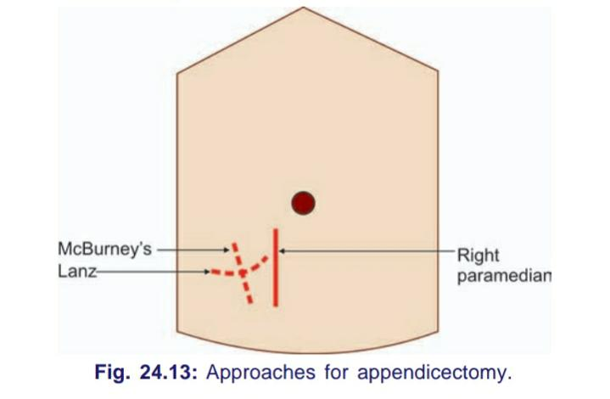
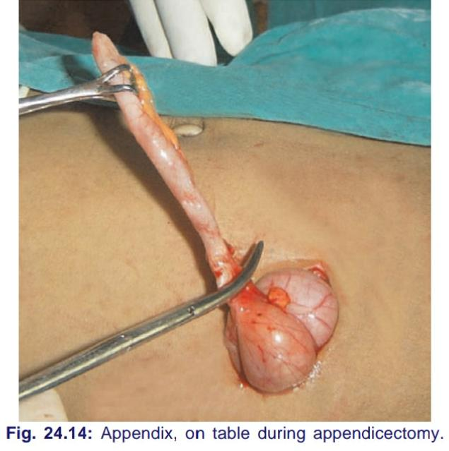

Slide 30
Complications after appendicectomy
• Paralytic ileus
• Reactionary haemorrhage due to slipping of ligature of the appendicular artery
• Residual abscess (pelvic, paracolic, local, subdiaphragmatic)
• Pylephlebitis (Portal pyaemia)
• Adhesions, kinking and intestinal obstruction
• Right inguinal hernia (direct)—due to injury to ilioinguinal nerve
• Wound sepsis 10%
• Faecal fistula
• Respiratory problems and DVT

Slide 32
REFERENCES
SRB’ MANUAL OF SURGERY ; BY SRIRAM BHATT M. 3RD EDITION.
A CONCISE TEXTBOOK OF SURGERY BY SOMEN DAS ; 10TH EDITION.
BAILEY AND LOVE’S SHORT PRACTICE OF SURGERY EDITED BY R.C.G. RUSSELL , NORMAN S. WILLIAMS AND CHRISTOPHER J.K. BULSTRODE , 23RD EDITION.

