Slide 1
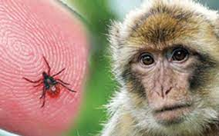
KFD
KYASANUR FOREST DISEASE .

Slide 2
INTRODUCTION :
KYASANUR FOREST DISEASE(KFD) is a febrile disease associated with haemorrhages caused by an arbovirus flavivirus and transmitted to man by bite of infective TICKS.

Slide 3
HISTORY :
KFD was first recognized in 1957 in Shimoga district of Karnataka state in South India.
Local inhabitants called the disease “MONKEY DISEASE” because of its association with dead monkeys.
The disease was later named after the locality –KYASANUR FOREST-from where the virus was first isolated.

Slide 4
PROBLEM STATEMENT :
Earlier the disease was found to be limited mainly to an area around the original focus(Shimoga district) covering about 800 sq.km.
Newer foci have since been recognized.
The disease is now restricted to four districts (Shimoga,North Kannada,South Kannada and Chikamagloor) in Karnataka State in India covering over 6000 sq.km.

Slide 5
According to the reports,about 400-500 cases occur every year.
The Karnataka Government has established a surveillance system which monitors the occurrence of KFD in humans and mortality in monkeys in known EPIDEMIC areas,as well as neighbouring areas.
Death of monkeys are considered as heralders of this disease in endemic areas.

Slide 6
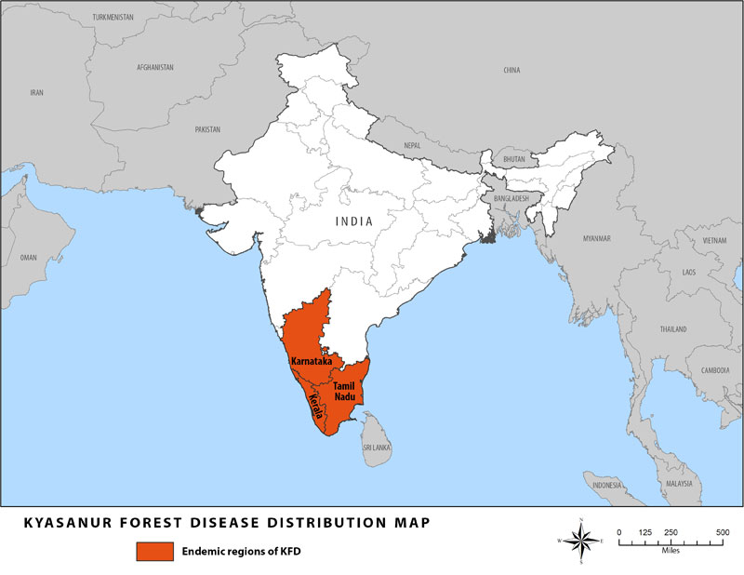

Slide 7
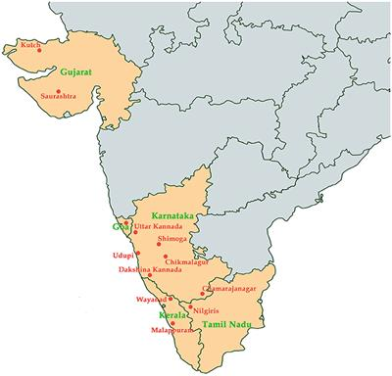

Slide 8
EPIDEMIOLOGICAL DETERMINANTS :
(a) AGENT: The agent KFD virus is a member of group B togaviruses (flaviviruses). It is antigenically related to other tick-borne flaviviruses, particularly the Far Eastern tick-borne encephalitis and Omsk haemorrhagic fever. Unlike in many other arbovirus infections , KFD has a prolonged viraemia in man for about 10 days or more .

Slide 9
(b) NATURAL HOSTS AND RESERVOIRS:
Small mammals particularly rats and squirrels are the main reservoirs of the virus.
Birds and bats are less important hosts.
The monkeys are recognized as amplifying hosts for the virus.
However, they are not effective maintenance hosts because most of them die from KFD infection.
Cattle provide HAEMAPHYSALIS ticks with a plentiful source of blood meals,which in turn leads to a population explosion among the ticks.

Slide 10
Thus, cattle are very important in maintaining tick populations but no part in virus maintenance.
Man is the incidental or dead – end host, plays no part in virus transmission

Slide 11
(c) VECTOR : The virus has a complex life cycle involving a wide variety of tick species.
At least 15 species of hard ticks of the genus HAEMAPHYSALIS,particularly H.spinigera and H.turtura are known to transmit the disease.
KFD has also been isolated from soft ticks.
The highest number of human and monkey infections occur during drier months, particularly from january to june.
This period coincides with the peak nymphal activities of ticks.

Slide 12
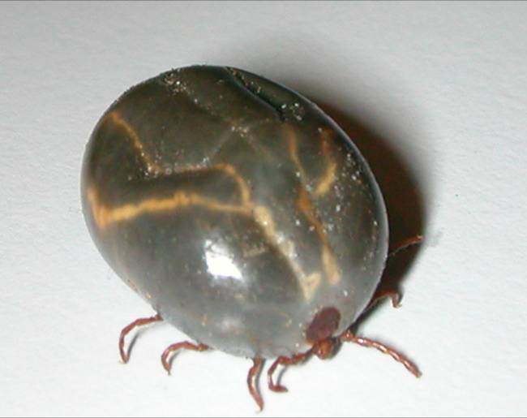
VECTOR HAEMAPHYSALIS

Slide 13
(d) HOST VECTORS : (1) AGE: Majority of cases affected were between 20 and 40 years.
(2) SEX: Attack rate was greater in males than in females.
(3) OCCUPATION : The attacked people were mostly cultivators who visited forests accompanying their cattle or cutting woods.
(4) HUMAN ACTIVITY: The epidemic period correlates well with the period of greatest human activity in the forest; from January until the onset of rains in June .

Slide 14
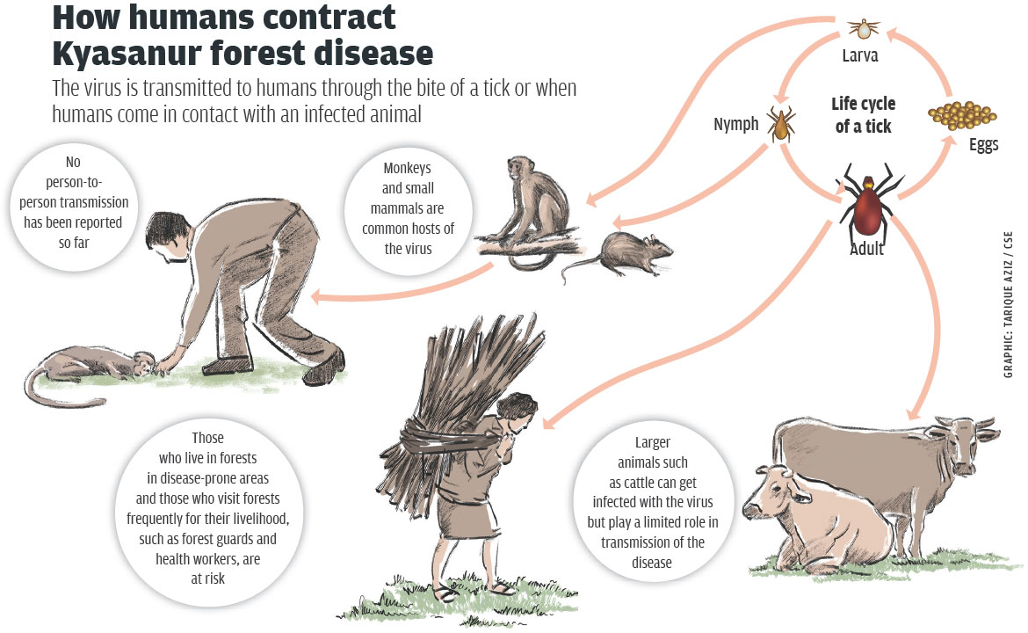
LIFE CYCLE :

Slide 15
MODE OF TRANSMISSION :
The transmission cycle involves mainly monkeys and ticks .
The disease is transmitted by the bite of infective ticks , especially nymphal stages.
There is no evidence of man to man transmission .

Slide 16
INCUBATION PERIOD :
Estimated to be between 3 – 8 days .

Slide 17
CLINICAL FEATURES :
The disease appears with a sudden onset of fever,
headache
severe myalgia, with prostration in some patients.
The acute phase lasts for about 2 weeks .
Gastro intestinal disturbances
haemorrhages from nose ,gums ,stomach and intestine may occur in severe cases.

Slide 18
In a number of cases,there is a second phase characterized by mild meningoencephalitis after an afebrile period of 7 to 21 days.
It is manifested by a return of fever,
severe headache followed by neck stiffness
coarse tremors,
abnormal reflexes and mental disturbances.
The case fatality rate has been estimated to be 5 to 10 %.

Slide 19
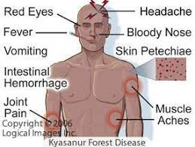

Slide 20
DIAGNOSIS :
It is established only after detecting the presence of virus in blood or serological evidence .
ELISA
PCR .

Slide 21
TREATMENT :
There is no specific treatment for KFD , but early hospitalization and support therapy is important .
Support therapy includes the maintenance of hydration and usual precaution for patient with bleeding disorder .

Slide 22
VACCINATION :
Vaccine is also available .
The population at risk should be immunised with KILLED KFD VACCINE .

Slide 23
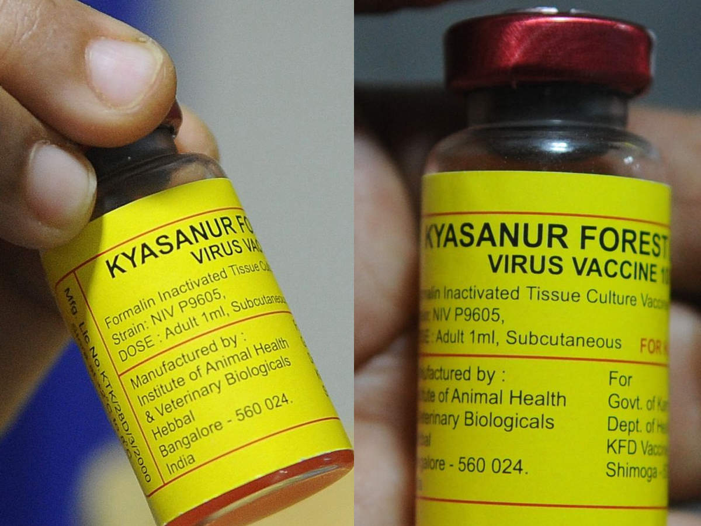

Slide 24
CONTROL :
CONTROL OF TICKS : Since KFD is a tick-borne disease, control of tick should be undertaken.
For control of ticks in forest , application can be made by power equipment or by air craft –mounted equipment to dispense carbaryl , fenthion , naled or propoxur at 2.24 kg of active ingredient per hectar .
The spraying must be carried out in “HOTSPOTS” i.e in areas where monkey deaths have been reported, within 50 meters around the spot of the monkey deaths , besides the endemic focii .

Slide 25
PROTECTION:
Protection of individuals exposed to the risk of infection by adequate clothing and insect repellants such as,
DIMETHYLPHTHALATE(DMP,DEET)
They should examine their bodies at the end of each day for ticks and remove them promptly.
The habit of sitting or lying on down on the ground should be discouraged through health education.

Slide 26
HOMOEOPATHIC THERAPEUTICS :
(1) IPECACUANHA (IPECAC) : Haemorrhages bright-red from natural orifices like nostrils, mouth and especially from uterus, bowels,kidney,stomach, lungs .
HEAD- Bones of skull feel crushed and bruised. Pain extends to teeth and root of tongue .
STOMACH- Constant nausea and vomiting, with pale, twitching of face .
FEVER- Intermittent fever,slightest chill with much heat, nausea, vomiting and dyspnoea

Slide 27
(2) PHOSPHORUS : It is a great anti-haemorrhagic drug. Haemorrhage is caused by degeneration of tissue and occurs from small injuries or cut .
Profuse, watery, bright-red blood which is non-coagulable. Bleeding from various organs and parts of the body.
FEVER-Chilly every evening. Cold knees at night. Adynamic with lack of thirst, but unnatural hunger. Hectic, with small, quick pulse; viscid night-sweats. Stupid delirium.
GIT- Empty all gone sensation in stomach. Great burning in stomach which is better by cold food and drinks but as soon as water becomes warm in stomach,it is thrown up in the form of vomiting .

Slide 28
(3) LACHESIS : Haemorrhagic diathesis .
Blood is dark watery, offensive and non-coagulable . Small wounds bleed easily and profusely.
HEAD- Congestive Headache as if would burst , very sensitive to touch. There is pressing and bursting pain in temples .
FEVER-Chilly in back, feet icy cold; hot flushes and hot perspiration . Paroxysm returns after acids . Intermittent fever every spring .
GIT- Pit of stomach painful to touch . Abdomen tympanic, sensitive , painful.

Slide 29
(4) APIS MELLIFICA : HEAD- Whole brain feels very tired. Heat, throbbing, distensive pains, better on pressure, and worse on motion. Sudden stabbing pain. Dull, heavy sensation in occiput.
GIT- Abdomen sore, bruised on pressure, when sneezing. Extremely tender . Dropsy of abdomen. Peritonitis.
FEVER- Intermittent fever, chill begins at 3 pm with thirst, worse on motion and heat . Perspiration breaks out and rise up frequently . Sleeps after the fever paroxysm. Fever is continous and low type .After perspiration nettle rash also with shuddering .

Slide 30
(5) GELSEMIUM : DULLNESS, DIZZINESS, DROWSINESS and TREMBLING or TREMORS are the keynote symptoms of gelsemium.
Tremors all over the body such as trembling of tongue, hands , legs and of entire body .
HEAD- Vertigo spreading from occiput heaviness of head, band-feeling around and occipital headache. Dull, heavy ache, with heaviness of eyelids, bruised sensation. Headache with muscular soreness of neck and shoulders.

Slide 31
FEVER- Wants to be held because he shakes too much. Pulse slow, full, soft, compressible . Dumb-ague with much muscular soreness, great prostration, and violet headache. Bilious remittent fever with stupor, dizziness, faintness, thirstless, prostrated.
PARALYSIS: Loss of power of muscular control. LACK OF MUSCULAR CO-ORDINATION IS WELL MARKED, CONFUSED, MUSCLES REFUSE TO OBRY THE WILL .Excessive trembling and weakness of all limbs .

Slide 32
THANK YOU
NAME: MEHRIN . A . SHAIKH
ROLL NUM: 59
4 thYEAR BHMS .
GUIDED BY : DR. TEJAL SHAH MAM (HEAD OF COMMUNITY MEDICINE DEPARTMENT ).

