Slide 1
BOGER BOENNINGHAUSEN’S CHARACTERISTICS AND REPERTORY

Slide 2
BY : DR. RAM PRASAD YADAV M.D SCHOLAR DEPT OF REPERTORY State National Homoeopathic Medical College, LUCKNOW

Slide 3
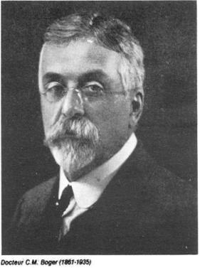
ABOUT AUTHOR …..
DR. H.A. Roberts says “Probably there has never been a more thorough student of Boenninghausen than the late Dr. Cyrus Maxwell Boger”

Slide 4
Dr .C.M. Boger was the leading and prominent homoeopathic physician of U.S.A.
He was born on 13 May 1861 in Annville, Pennsylvania U.S.A. He was the son of professor Cyrus and Isabelle Maxwell Boger.
GRADUATION- In pharmacy -: Philadelphia college of pharmacy
in medicine-: Philadelphia college of medicine

Slide 5
Dr. Boger studied at HAHNEMANN HOMOEOPATHIC MEDICAL COLLEGE, PHILADELPHIA and qualified himself as a homoeopath .

Slide 6
MEDICAL PRACTICE -: Dr. C.M. Boger began his homoeopathic practice towards the end of nineteenth century ,being a very systematic and classical prescriber.
During his long practice and carrier in medical practice and research, Dr. Boger contributed a lot by his writing and successful treatment of incurable Cases.
It is said that patients used to report to him from various parts of U.S.A. because of his ability to prescribe right medicine even in incurable cases marked with common symptoms.

Slide 7
CONTRIBUTIONS
1) A SYSTEMATIC ALPHABETIC REPERTORY OF HOMOEOPATHIC REMEDIES -1900

Slide 8
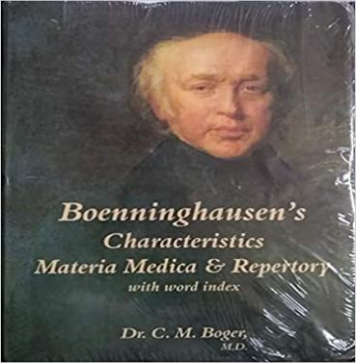
CONTRIBUTIONS
2) BOGER BOENNINGHAUSEN’S CHARACTERISTICS AND REPERTORY -1905

Slide 9
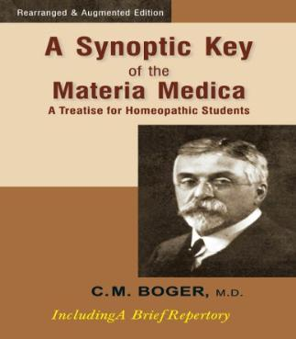
3) BOGER SYNOPTIC KEY-: 1915

Slide 10
4) BOGER CARD INDEX AND GENERAL ANALYSIS
1924

Slide 11
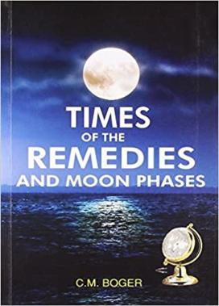
5) THE TIMES OF REMEDIES AND MOON PHASE 1931

Slide 12
6) STUDIES IN PHILOSOPHY OF HEALING AND SEVERAL OTHER ARTICLES -
1931 onwards

Slide 13
BOGER CONCEPT OF TOTALITY
He specified 7 points to understand the full picture of disease :-
Change of personality and temperament (Quis)
Peculiarities of disease (Quid)
The seat of disease (Ubi)
Concomitants (Quibus auxillis)
The cause (Cur)
Modalities (Quomodo)
Time (Quando)

Slide 14
NEED TO STUDY BBCR……
In the second half of the 19th century the Boenninghausen’s work was of great importance but later when Kent's repertory came ,it receded to the back stage ,and all his work was overlooked
Finally Boger brought it back to life by reining and enriching the fundamental and recasting the structure and methodology.
This he did by adding aggravations, ameliorations and concomitants in a detailed manner at the end of every chapter.
The outcome was a more useful work enriched with many new chapters ,new rubrics and medicines.

Slide 15
Book has 2 parts –
1st part- characteristics of medicine
2nd part –Repertory proper
Total number of medicine- 464
Total No. of Chapters – 53
Editions :
1st edition published in 1905 by Boericke and Tafel
2nd edition published in 1937 by Roy and company
(Indian edition )

Slide 16
SOURCES
Therapeutic pocket book
The repertory of Antipsoric
Repertory of remedies which are not antipsoric
Repertory part of intermittent fever
Repertory of whooping cough
A large number of paragraph from the aphorism of Hippocrates
The domestic physician

Slide 17
Philosophical background of BBCR
Doctrine of complete symptom and concomitant –
A complete symptom is that which consists of location, sensation, and modalities .
During the case taking unreasonable attendant of main symptoms are also noticed in relation to the time
(before, after or during) which are called concomitant.
In BBCR complete symptoms are well arranged and concomitant are given greater importance by Boger in relation to the parts.

Slide 18
Example-
LOCATION- Joints, small and big, since 20 year slow onset
.
SENSATION- Pain as of a scorpion bite, burning, impossible to put feet down to rest.
MODALITIES-
- < SOUR THINGS, COLD THING, POTOTOES, MILK.
-> HOT WATER BAG, GENTLE MASSAGE
CONCOMITANT- Lump like swelling here and there which disappeared on massaging.

Slide 19
Philosophical background of BBCR
2) Doctrine of pathological generals -:
General changes in the tissues and part of the body .
It tells us the state of the whole body and its changes in relation to the constitution.
They help us to concentrate on more concrete changes to select the similimum.
In BBCR the chapter sensation and complaints in general is full of examples of pathological generals such as apoplexy , asphyxia ,atrophy etc .

Slide 20
Philosophical background of BBCR
3) Doctrine of causation and time-
From the point of view of Boger, Causation and time factors are more definite and reliable in cases as well as in medicine.
Each chapter he has included time aggravation.
Gives more importance to causation and general modalities followed by general sensation which hold the key in the remedy as well as in the person.

Slide 21
Philosophical background of BBCR
4) Clinical Rubrics-
Boger was the first person,who appreciated and mentioned several clinical condition which he came across in day to day practice.
They help the physician in cases of advanced pathology, gross tissue changes where he is left without a clear picture because of poor susceptibility .

Slide 22
Philosophical background of BBCR
5) Evaluation of Remedies:
Boger followed the Boenninghausen method of grading of medicines.
He introduced the grading of symptom into five ranks by the use of different typography.
CAPITAL - 5
Bold- 4
Italics - 3
Roman - 2
(Roman) in parenthesis –(1)
The gradation is based on the frequency of the appearance of symptom in the provers.

Slide 23
Philosophical background of BBCR
6) Fever Totality:
This is the unique contribution of Boger .
The arrangement of the chapter on fever is self – explanatory .
Each stage of fever is followed by time, aggravation, amelioration and concomitant .
They help to Repertorize any simple as well as complicated case of fever.

Slide 24
Philosophical background of BBCR
7) CONCORDANCES:
By including a chapter on concordance ,Boger has made the philosophy clearer and practical though it deals with relationship of medicine of only 125 medicines.

Slide 25
PLAN AND CONSTRUCTION OF BBCR
BOGER found so many difficulties in day to day use of therapeutic pocket book, and so he tried to modify the structure and content of the book by adding many medicines and rubrics drawn from his own experiences and other sources.

Slide 26
CHAPTERS
MIND
SENSORIUM
VERTIGO
HEAD
EYES
EARS
NOSE
FACE
TEETH
MOUTH
APPETITE
THIRST
TASTE
ERUCTATION
WATERBRASH AND HEARTBURN
HICCOUGH
NAUSEA AND VOMITING
STOMACH
EPIGASTRIUM
HYPOCHONDRIA
ABDOMEN
EXTERNAL ABDOMEN
INGUINAL AND PUBIC REGION
FLATULENCE
STOOL
ANUS AND RECTUM

Slide 27
CHAPTERS
PERINEUM
PROSTATE GLAND
URINE
URINARY ORGAN
GENITALIA
SEXUAL IMPULSE
MENSTRUATION
RESPIRATION
COUGH
LARYNX AND TRACHEA
VOICE AND SPEECH
NECK AND EXTERNAL
CHEST
BACK
UPPER EXTREMITIES
LOWER EXTREMITIES
SENSATION & COMPLAINT
GLANDS
BONES
SKIN & EXTERIOR BODY
SLEEP
DREAMS
FEVER
COMPOUND FEVER
CONDITIONS IN GENERAL
CONDITION OF AGG & AMEL
CONCORDANCE

Slide 28
SOME IMPORTANT MIND RUBRICS OF BBCR
Communicative –willing and able to talk and share ideas .
(These people are too eager to give information whatever they are being asked for, if they are asked something they answer much more than that is expected.
KENT | BBCR
LOQUACITY | COMMUNICATIVE
HYOS , LACHESIS , STRAMONIUM | LACHESIS

Slide 29
CONCENTRATION DIFFICULT- a decreased ability to focus your thought on something.
KENT | BBCR
CONCENTRATION DIFFICULT | CONCENTRATION DIFFICULT
Anacardium, Baryta-carb, Carbo-veg , Causticum , Glonine , Graphitis , Nux-vomica , Nux-moschta , Phos-acid , Phos | Terebinthiniae
Calculating while- nux vomica.
Talking while- merc -cor, nat- mur
Writing while- aconite, mag carb.

Slide 30
BELLOWING - to shout in a loud deep voice, because you are angry
( to make the loud deep hollow sound characteristic of bull)
PYROMANIA- An uncontrollable desire to set fire to things .
KENT | BBCR
BELLOWING | BELLOWING
BELL , CANTH , CUPRUM-MET | CANTHARIS
KENT | BBCR
FIRE , want to set things | PYROMANIA
HEPAR SULPH | HEPAR SULPH

Slide 31
GRUNTING – making low rough sound like that of a Pig involuntarily
KENT | BBCR
GRUNTING | GRUNTING
BELL, HELLEBORUS, IGNATIA, PULS * Sleep during - Ignatia | CINA

Slide 32
MISCHIEVIOUSNESS- these people have a tendency to play tricks on other people making them annoyed or embarrassed but those are aimed at doing fun ,not to harm others.
KENT | BBCR | BTPB
MISCHIEVOUSNESS | MISCHIEVOUSNESS | MISCHIEVOUSNESS
Anacardium, Cannabis indica, Nux vomica | Arsenic album | Anacardium, Nux vomica, Lachesis, Lyco, Hyos

Slide 33
EXTRAVAGANCE- (these people spend more than is necessary in an uncontrolled way( but not wasteful way) ,but not due to foolishness.
KENT | BBCR
EXTRAVAGANCE | EXTRAVAGANCE
Belladona , Causticum , Platina ,Stramonium , Veratrum album | BELLADONNA

Slide 34
DISGUST – these people develop a strong dislike for someone or something because they feel them unpleasant
KENT | BBCR
DISGUST | DISGUST
PULSATILLA, SULPHUR,MERC, MEZERIUM | ALOE SOCOTRINA .

Slide 35
SOLEMN- these people are very quite ,they are very sensible about every thing, they laugh with measurement making lest joke and fun.
KENT | BBCR
SERIOUS | SOLEMN
ALUMINA , CINA , COCCULUS , LEDUM ,MERC ,SULPHURIC ACID *Evening- SENEGA | HYOSCYAMUS

Slide 36
INDISCREET –( making injudicious action without thinking carefully about risky consequences, these people usually show an unwise or foolish boldness.
KENT | BBCR
INDISCREET | INDISCREET
NUX- VOM., BRYONIA, CAMPHOR, HYOS, IGNATIA, NATUM -MUR | NATRUM-MUR

Slide 37
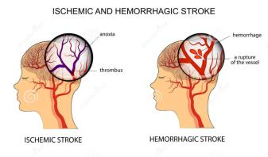
SOME IMPORTANT PATHOLOGICAL GENERALS IN THE BBCR
APOPLEXY/ STROKE -
Stroke is an acute neurological injury occurring as a result of vascular pathologic processes which manifest either as brain infarction or haemorrhage .
General | Aconite , Arnica , Lachesis , Opium, Rhus tox , Silicea
Haemorrhagic | Aconite , Aurum-met , Lyco , Lachesis
Nervous | China , Coffea , Nux-vomica , Silicea ,Stramonium

Slide 38
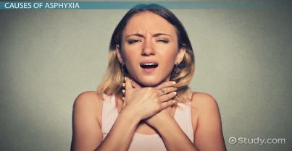
ASPHYXIA
Asphyxia or asphyxiation is a condition of deficient supply of oxygen to the body that arises from abnormal breathing.
Carbo-veg, Opium, China, Antium tart.

Slide 39
ATROPHY
Circulatory and cardiac | Calc-ac. Lachesis, Nat. mur, Opium.
Coldness | Cina, Silicea
Confustion ,with | Lachesis
Formication | Bell,cal-carb ,nitric acid,nux vom,
Gastric and epigastric | Bell, Cal-ars, Nux vom.
Pupillary | Argentum nitricum
Spinal | Indigo
Tongue | Plumbum met

Slide 40
Callus forming - Cal –phos, Symphytum.
CARPHOLOGY – Movements that delirious patient sometimes make as if searching for or grasping at imaginary objects or picking the bed clothes. -HYOS ,OPIUM ,ZINCUM MET ,RHUS TOX.
Haemophilia- Lachesis , Phosphorus, Crot-h, natum sulph.
Opisthotonos - Bell. Cham. Ignatia. Nux -vom,, Opium Stramonium

Slide 41
INFLUENZA-
Eupatorium-perf,
Merc sol
Nux vom,
Rhus tox.
Aconite
Causticum

Slide 42
MUCUS MEMBRANE
Affected | Kali Bi
Bleeding | Merc –sol, Nitric acid, phos, sulphuric -acid
Bright red | Bell ,Cantharis, Argentum nit
Catarrhal, chronic | Dulcamara,kali-iod,Plumbum, Sul-acid.
Dark-red- varicose | Argentum-nit., carvo-veg, lachesis,
Dry | Bell,bryonia, kali-carb. nux –mosch
Glistening | Bell, Phos, Stramonium .
Numb | Nux –mosh
Odematous | Kali-bi, kali-iod
Pale | Arsenic ,china, phosphorus , pulsatilla
Plagues | kali-iod, merc –sol , nitric acid, phyto.
Raw as if | Nux-vom., Arum-triphyllum

Slide 43
Bibliography
Boger Boenninghausen’s Characteristic and Repertory By D.R. C.M. BOGER
Essentials of Repertorization by Dr. S.K. Tiwari – Fourth edition
Boenninghausen therapeutic pocket book(BTPB)

Slide 44
THANKS!

