Slide 1
CHILDHOOD ASTHMA
Dr. Sarita D. Bodkhe
M.D.(Pead)HOM. PGDEMS.

Slide 2
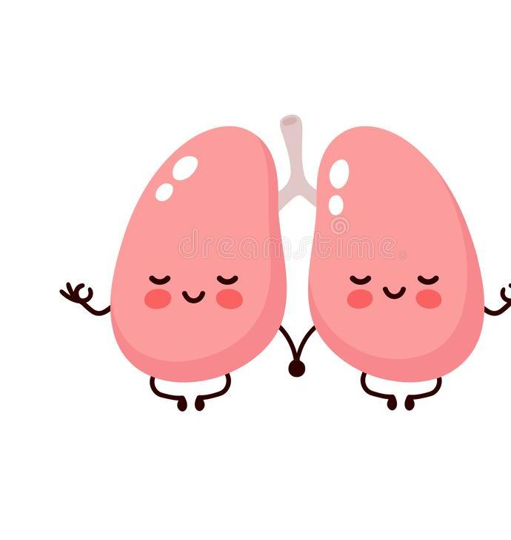
BRONCHIAL ASTHMA
Asthma is a disease of airways that is characterized by increased responsiveness of the tracheobronchial tree to a variety of stimuli resulting in widespread spasmodic narrowing of the air passages which may be relieved spontaneously or by therapy

Slide 3
Asthma is an episodic disease manifested clinically by paroxysms of dyspnoea, cough and wheezing severe and unremitting form of the disease termed status asthmaticus may prove fatal.
paroxysms of dyspnea
Cough
wheezing severe

Slide 4
AGE & GENDER
In children
2:1 - male :female ratio.
Develop it before the age of 10 years

Slide 5
ETIOPATHOGENESIS TYPES
Extrinsic (allergic, atopic)
Intrinsic(idiosyncratic, non-atopic) asthma.
Mixed

Slide 6
Extrinsic (atopic, allergic) asthma
Most common type
Childhood
Early adult life

Slide 7
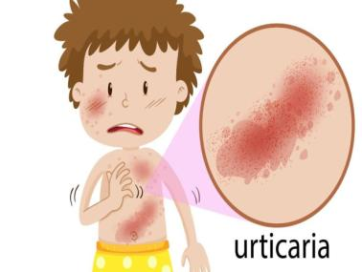
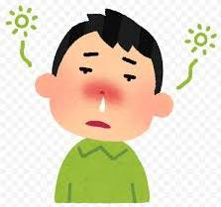
Personal and/or family history of preceding allergic diseases such as rhinitis, urticaria or infantile eczema

Slide 8
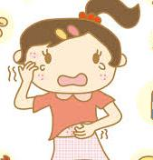
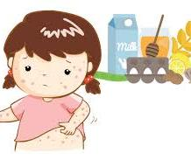
Hypersensitivity to various extrinsic antigenic substances or allergens cause ill-effects by inhalation e.g. house dust, animal danders, moulds

Slide 9
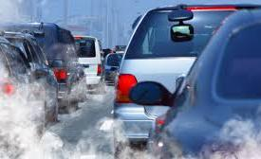
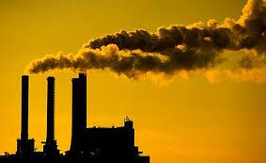
Occupational asthma stimulated by fumes, gases and organic and chemical dusts is a variant of extrinsic asthma.

Slide 10
extresic asthma & IgE

Slide 11
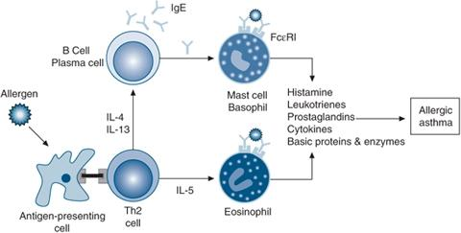
Pathophysiology of extresic asthma

Slide 12
Intrinsic asthma
This type of asthma develops later in adult life with negative personal or family history of allergy, normal serum levels of IgE. Most of these patients develop typical symptom-complex after an upper respiratory tract infection by viruses
Associated nasal polyps and chronic bronchitis are commonly present
There are no recognizable allergens but about 10% of patients become hypersensitive to drugs, most notably to small doses of aspirin (aspirin-sensitive asthma)

Slide 13
Mixed type
Many patients do not clearly fit into either of the above two categories and have mixed features of both
Those patients who develop asthma in early life have strong allergic component, while those who develop the disease late tend to be non-allergic
Asthma can be precipitated by cold, exercise and emotional stress

Slide 14
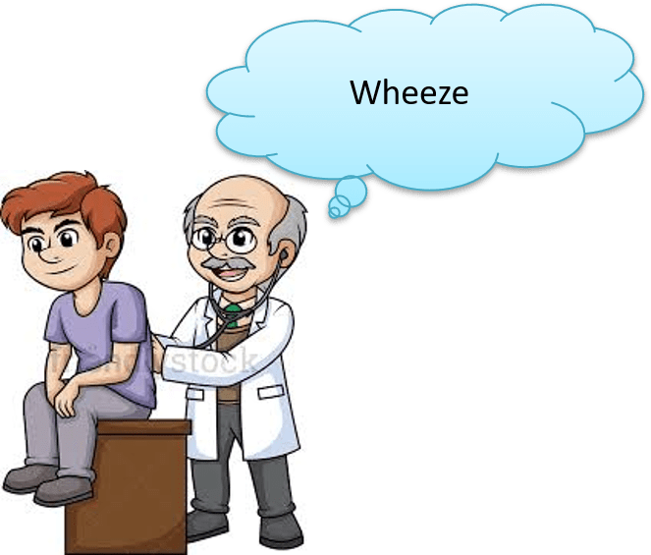
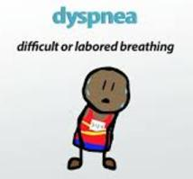
Clinical features - episodes of acute exacerbations

Slide 15
Case presentation
I got a case of 9 year boy in Dec 2011 who was lean, thin, stoop shoulders suffering from asthma since childhood. Complaint had started at age of 3 years of his age. Additionally after change in town last year, he had developed allergies and repetitive attacks of asthma.
He’d developed dryness of skin, eruptions on body agg. in evening, itching and burning and suffering from headache associated with coughing, holding his head while coughing.

Slide 16
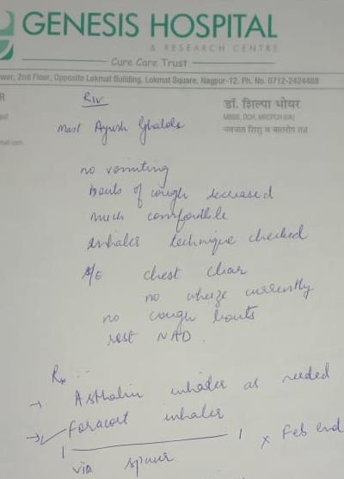
Old Perception by pediatrician
Prior to me, he was consulted with MBBS MD PEDIATRICS and diagnosed with BRONCHIAL ASTHMA.
He got a severe attack after interval of a month at full moon (pornima) for which he had hospitalized 2 times and following that he had been taking asthalin and foracort inhaler.
As symptoms were aggravated on full moon so parent visited babaji and tabiz.

Slide 17
He is extremely curious , since he inters in cabin asking me this for what , what u here does in your computer . To pointing towards my books he says wow! U read all these books, I like to read books

Slide 18
Conversation with patient and his parents
What do you like more – he quickly answer I like playing with my friends ,I like pets.
Do you have any – no but I want but mom not permitting me , …I love to rocky he his dog of my friend but he is not here . He is Talegaon.my dad transfer here (stop for sec.) but here I have Seeta ….i love her .
I asked him –wow! But who is Seeta ?
She is cat ,everyday I give her milk from my milk.
His mother interrupt us she said –he didn’t like milk.
He : yes it’s true ,I did’t like milk and fenugreek .
Me: do you miss your friends ?
He: yes too much. I miss piyush , ruturaj,akash no one is here to play with me only me and my brother play together .

Slide 19
Conversation with patient and his parents
Me: What do you like more ?
He: I like playing with my friends ,I like pets.
Me: Do you have any pet ?
He: No but I want to have, but mom is not permitting. I love rocky, he is a dog of my friend but he is not here, He stays in Talegaon. My dad transferred here (pause for sec.) but here I have Seeta ☺ and I love her .
Me: Nice! Can you tell me who is Seeta ?
He: Yes, She is a cat and everyday I give her milk from my cup.
Mother: he don’t like milk.
He : I don’t like milk, fenugreek and spinach, but mom give it med everyday ☹.
Me: Okay, do you miss your old friends?
He: Yes too much. I miss (Counting on Hand) Piyush , Ruturaj, Akash, Pankaj, Ishita but no one is with me to play now. Nowadays only me and my brother play together.

Slide 20
Conversation with patient
Me: Ohh, tell me what you u like ?(Repeating question)
He: I like kite flying, cycling ,cricket, chess (after thinking for second) and study too . I like to read books and write marathi ,english but I don’t like mathematics these calculations, too boaring .i like stories of spiderman ,batman,ben 10.
Me :Do you like Mr.bin
He :yes .
Me: who is he?
He: he is flying and catching the thief, robbers and punish them .do you know I want too be teacher .
And teach to children in school .

Slide 21
Conversation with patient
Me: Ohh, tell me what you u like ?(Repeating question)
He: I like kite flying, cycling ,cricket, chess (after thinking for second) and study too . I like to read Marathi and English books but I don’t like mathematics these calculations are boring . I like stories of Spiderman, Batman, Ben 10.
Me :Do you like Mr. Bin
He: Yesss.
Me: Who is he?
He: He fly and catch thieves, robbers and punish them. Do you know I want to be a teacher and teach children. [Mom and Dad were smiling]

Slide 22
Me:Tell me something about your dreams and sleep
He: sometime I wake up in morning but not feeling fresh .and most of the time I had happy dreams but in last week I had dream ,Me dad ,mom & my brother were going to wardha to my granny's home . Truck come from back side and all are death except me ,when I wake up . happy to see them . that was dream.
Me: what did you feel that time ?
He: I scared .
Me : why ?
HE : Without them I was alone .
Me :what do you mean alone ?
He: without them how I go to home, school .who gives me cloths ,books and who will play with me.

Slide 23
Me: Tell me something about your dreams and sleep
He: Sometime I wake up in morning and does not feel fresh. Most of the time I have happywala dreams but in last week I had dream that me, dad ,mom & my brother were going to Wardha to my granny's home in my dream truck came from back side and all were death except me and suddenly when I woke up, I rushed towards hall and happy to see them alive.
Me: What did you feel that time ?
He: I was scared .
Me : Why ?
HE : Without them I am alone .
Me :What do you mean alone ?
He: Without them how can I go to home, school, who will give me cloths ,books and who will play with me.

Slide 24
Coversation with his parents
Me: anything tell about him ?
F: He is very nice guy ,obident ,active ,good in study . he and his little brother are fight for the things .he never share his pencil, pen ,toy, chocolates with his brother.
Me: with friends?
M: No .he takes from them but not gives his things to others .

Slide 25
Coversation with his parents
Me: Tell me something about him ?
Father: He is very nice guy, obedient, active, good in study. He and his little brother fights for the things. He never share his pencil, pen, toys, chocolates with his brother.
Me: Does he share with friends?
Mother: No, he takes from his friends but not gives his things to others .

Slide 26
Me : tell me about his habits?
M: drinks lots of water .during lunch /dinner drink water more , eat less and eat nonsense things slate pencil and soil.
(When I saw towards him, he biting his teeth )
Me: tell me about his sleep pattern ?
M: he is lazy, never wake up in morning .when he had cough sweat at night over occiput wetting pillow , didn’t want covering ,if I gave he through it .

Slide 27
Me: How’s he take lunch/dinner ?
Mother: Hungry, He drinks lots of water during lunch /dinner, eat less and eat nonsense things like slate pencil and soil.
(In the meantime, he was biting his teeth )
Me: Tell me about his sleep pattern ?
Mother: He is lazy, never wake up in morning. When he had cough sweat at night, he over occiput, wetting pillow, don’t want covering, if I give him he throws it away.

Slide 28
HISTORY OF PREVIOUS ILLNESS
Past h/o – at 1st month of life he had rashes over skin. Sensitive to soap .
At the age of 3 years- 1st time asthmatic attack comes.
Sep 2011- admitted in hospital at Nagpur for asthmatic attack ,again in Nov 2011 admitted for same.

Slide 29
Milestone history
Birth weight- 3.2kg. Birth date Nov 2003
Delivery- C-section
Teething delayed.

Slide 30
FAMILY HISTORY
PATERNAL GRAND FATHER –Bronchial Asthma
PATERNAL AUNT – Allergic to artificial metal ornaments .
Father – Allergic Rhinitis .
Sibling –Otitis media 3 times since childhood .
Mother - not any specific .
Maternal grand mother –Acute peptic ulcer .

Slide 31
O/E
Throat -Uvula red .
RS – Air entry reduced on both side
mild wheeze left lower lung .

Slide 32
Analysis
In this case, we a have a child with an allergic tendency that manifests on skin and in chest in the form of Asthma.
His complaint gets worse at full moon.
Besides, he also has headache .

Slide 33
Mind
inquisitive
loves to animals
egostic
Talkative
selfish
dreams of death
loss of friend
to dwell on past

Slide 34
Physical generals
Appetite- while eating drink water more . Eat less .
Thirst – thirsty +
Desire – slate ,earth .
Aversion- milk+
Sweat- occiput+ ..when he had cough sweat profusly at night .
Thermals- towards hot .through the covering during sleep.
sleep – sometime after wake up in morning ,not feeling fresh.

Slide 35
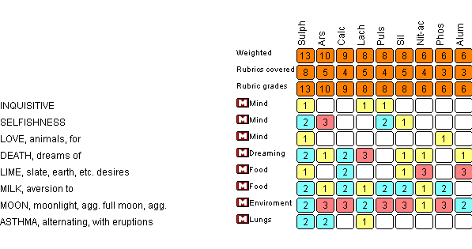
TIME TO REPOERTERASATION

Slide 36
Selection of remedy
Sluphur 200 single dose.

Slide 37
J.T. KENT -Sulphur cures bronchitis. It cures asthmatic bronchitis when the symptoms agree.

Slide 38
THANK YOU
Dr.Sarita D.Bodkhe
M.D. PAED

